Slide 1
Understanding the Key Concepts, Characteristics and Functions of Pasture and Rangeland Ecosystems
By
Dr. Muhammad Khurshid

Slide 2
What are pastures?
Pasture is a land use type having vegetation cover comprised primarily of introduced or enhanced native forage species that is used for livestock grazing.
Pastures or pasturelands are managed terrestrial ecosystems characterized by the cultivation and maintenance of herbaceous plants, primarily grasses, legumes, and forbs or other mixture of vegetation, which are grown and maintained to support grazing by the livestock.
Pasture differs from range in that it primarily produces vegetation that has initially been planted to provide preferred forage for grazing livestock. The majority of these forages are introduced, having originally come from areas in other continents.
Management usually consists of cultural treatments: fertilization, weed control, reseeding or renovation, and control of grazing. It includes land that has a vegetative cover of grasses, legumes, and/or forbs, regardless of whether or not it is being grazed by livestock.
Main difference between pastures and rangelands is the type of vegetation and level of management.

Slide 3
Types of pastures
Two major types of pastures;
Natural pasture
Natural pastures are areas of land where vegetation grows naturally without direct human intervention.
These pastures consist of indigenous or native grasses, herbs, legumes, and other plants that have adapted to the local climate, soil conditions, and grazing pressure.
Natural pastures may occur in a variety of ecosystems, including grasslands, savannas, meadows, and rangelands.
Management of natural pastures typically involves rotational grazing, controlled burning, and other practices to promote plant diversity, soil health, and sustainable forage production.
Artificial pastures
Artificial pastures are created and managed by humans through deliberate seeding, planting, or cultivation of forage crops.
These pastures consist of introduced or cultivated grasses, legumes, and other forage species selected for their nutritional value, yield potential, and suitability for grazing livestock.
Artificial pastures may be established in areas where natural vegetation is sparse or degraded, or they may complement existing natural pastures to increase forage availability and improve livestock productivity.
Management of artificial pastures involves practices such as fertilization, irrigation, weed control, and rotational grazing to optimize forage production and quality.

Slide 4
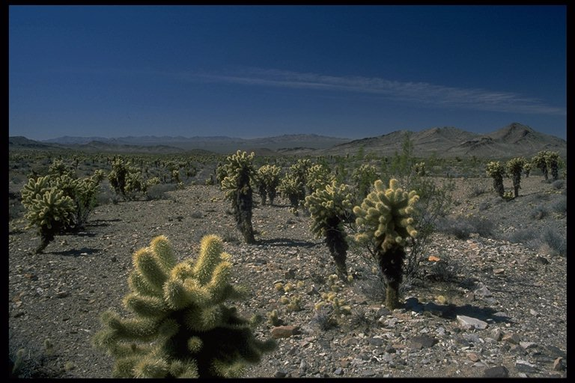
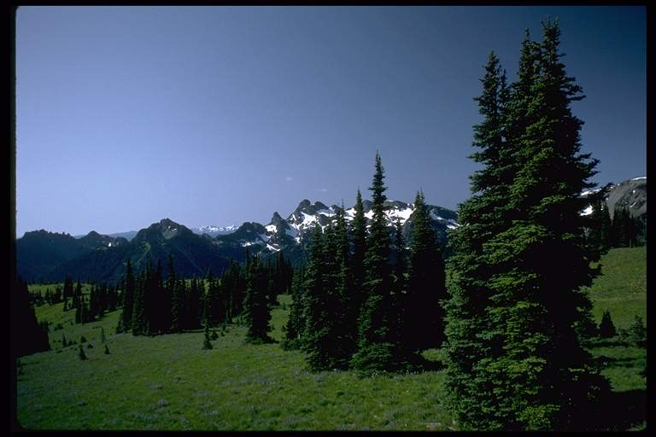
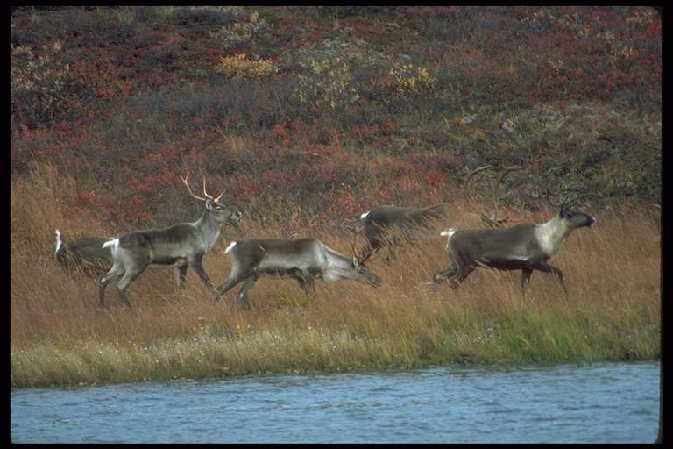
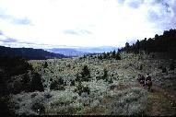
Which of these are rangeland?
Deserts
Tundra
Wetlands
Savannas
Shrublands
Forests
Grasslands
Rangeland ecosystems
Definitions
Rangelands are those areas of the world, which by reason of physical limitations—low and erratic precipitation, rough topography, poor drainage, or cold temperatures—are unsuited to cultivation and which are a source of forage for free-ranging native and domestic animals, as well as a source of wood products, water, and wild.
Rangeland is a type of land that supports different vegetation types including shrublands such as deserts and chaparral, grasslands, steppes, woodlands, temporarily treeless areas in forests, and wherever dry, sandy, rocky, saline, or wet soils; and steep topography precludes the growing of commercial farm and timber crops.

Slide 5
Key characteristics of rangelands
Rangeland is uncultivated land dominated by native plants: grasses, herbaceous broad-leaved plants (forbs) and shrubs.
Rangeland is all land that is not farmland, dense forest, barren desert or land covered by solid rock, concrete, or glaciers.
Rangeland includes: grasslands, shrublands, savannas, and open woodlands .
Are all rangelands grazed?
  Grazing as an important ecological process in all rangeland, but not all rangelands are grazed by livestock.

Slide 6
Geographical Extent
The two major global terrestrial land types are rangeland and forestland. About 35 percent of the land area in the world is grasslands and woodlands, 21 percent sparse and barren lands, 28 percent forest and woodlands, and 12 percent farmland.
Grazing land ecosystems including pastures and rangelands occupy approximately one third of the earth’s land area and support millions of households, particularly pastoralists. Although the majority of rangelands exist within the dryland category, a portion also occur in wetter regions, and high-latitude and high-elevation grasslands and tundra. Drylands are estimated to occupy 41 percent of the Earth’s land area (6 billion hectares), 69 percent of which are rangelands, and support 2 billion humans and 50 percent of global livestock.

Slide 7
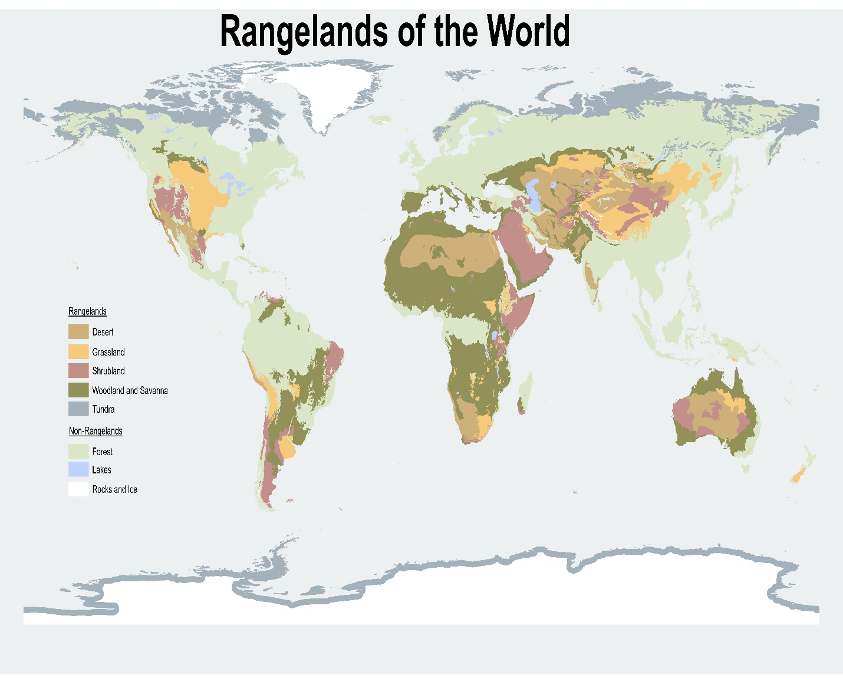

Slide 8
Socio-economic and ecological functions of rangelands
Pastoralism is a production system and livelihood strategy that is based on extensive livestock grazing on rangelands/grasslands, which has been practiced in many regions of the world for centuries. Currently, extensive pastoralism occurs on about 25 percent of Earth’s rangeland area, mostly in the developing world, from the drylands of Africa and the Arabian Peninsula to the highlands of Asia and Latin America where intensive crop cultivation is physically not possible because of a harsh environment and poor access.
Worldwide, pastoralism supports about 200 million households and herds of nearly a billion animals including camels, cattle, and smaller livestock that account for about 10 percent of the world’s meat production.
Given their expansiveness and heterogeneity, rangelands provide numerous ecosystem services including biodiversity, carbon sequestration, and cultural values, in addition to the provisioning services of food, fiber, and fuel production.

Slide 9
What is rangeland good for?
List 5 uses or services rangeland provides?
Livestock production
Wildlife habitat
Water
Minerals (oil, coal, sulfur)
Native plant products
Recreation
Open space
Western heritage

Slide 10
Key ecosystem services provided by rangelands
S.N | Categories | Key ecosystem services
1 | Supporting ecosystem services | Soil formation Biodiversity Primary production Habitat
2 | Provisioning ecosystem services | Food and fiber Wood Clean Water Medicinals
3 | Regulating ecosystem services | Climate Regulation Pollination of crops Store carbon Control flooding
4 | Cultural ecosystem Services | Inspiration Recreation Education Aesthetic

Slide 11
Thank you very much for your attention!

