Slide 1
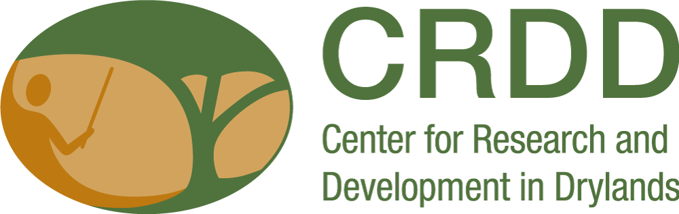
Linking time and space in research on pastoral mobility
Hussein T. Wario
27.11.2024

Slide 2

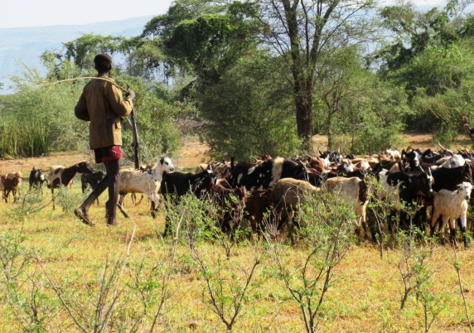
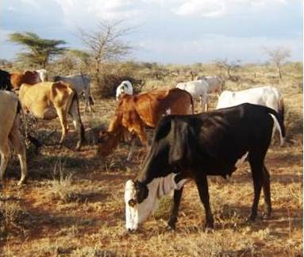
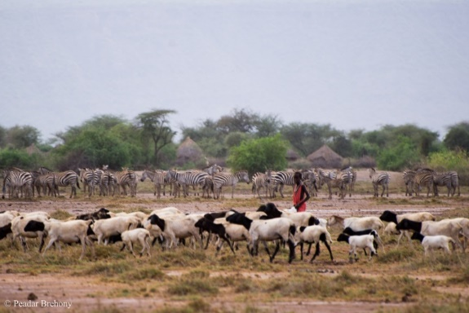
  Pastoralism – a production system in tandem with nature
Introduction
Pastoralism is a way of life with distinct economic and cultural values.
It involves production from naturally occurring forage
  Converts plant material that cannot be eaten by humans into high-quality food and other products – meat, milk, hides, fur, i.e. uses low levels of external inputs to produce high-value products
It functions in an environment that is highly variable and uncertain, i.e. experiences frequent change, and cannot support crop farming unless with high levels of external inputs.
Livestock closely linked with cultural practices that define the identity of pastoralist communities.
It is the most sustainable livelihood in the drylands and co-exists with other land uses such as conservation.

Slide 3
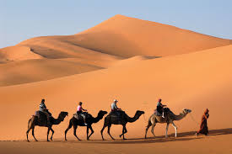
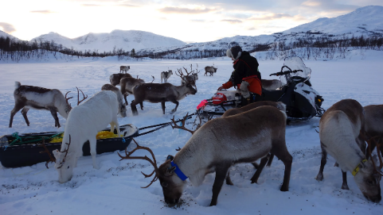
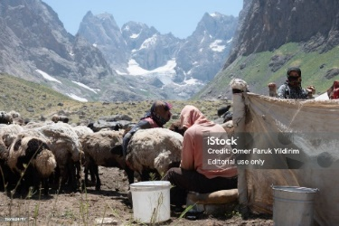
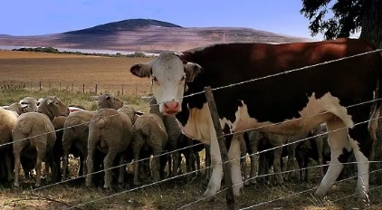
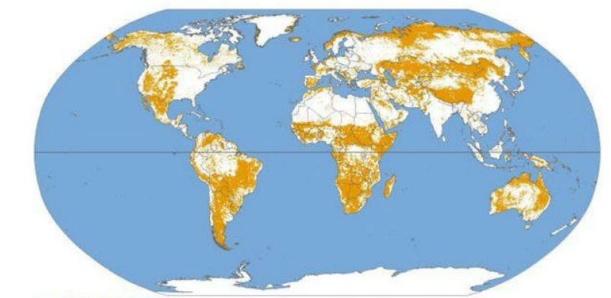
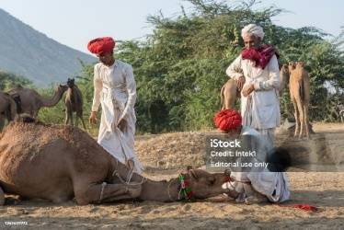
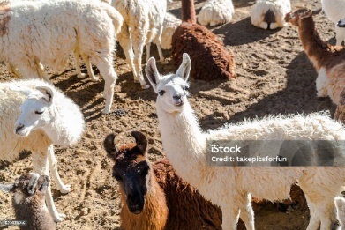
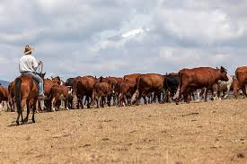
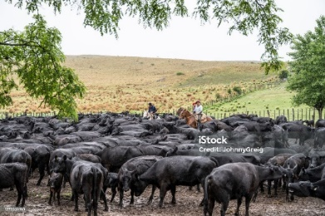
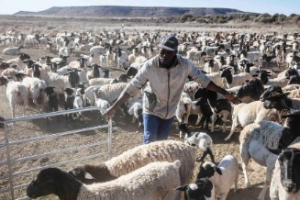
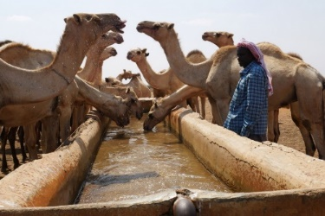
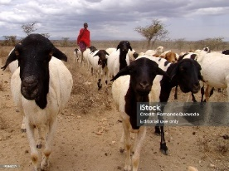
Who are the pastoralists? – a global outlook

Slide 4
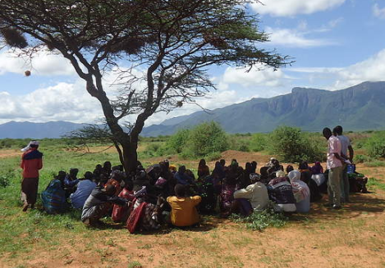
Introduction to livestock mobility
Livestock mobility as a production strategy
Mobility is complex - guided by extensive knowledge
However spatial-temporal understanding of mobility has been limited by methods
Often livestock mobility is represented using arrows – seasonal patterns

Slide 5
Introduction to livestock mobility
Such depictions oversimplifies the realities
Limits understanding of linkage between herders and their knowledge of places that guides mobility
Thus methods needed to contribute to understanding of mobility in details and at multiple scales over time

Slide 6
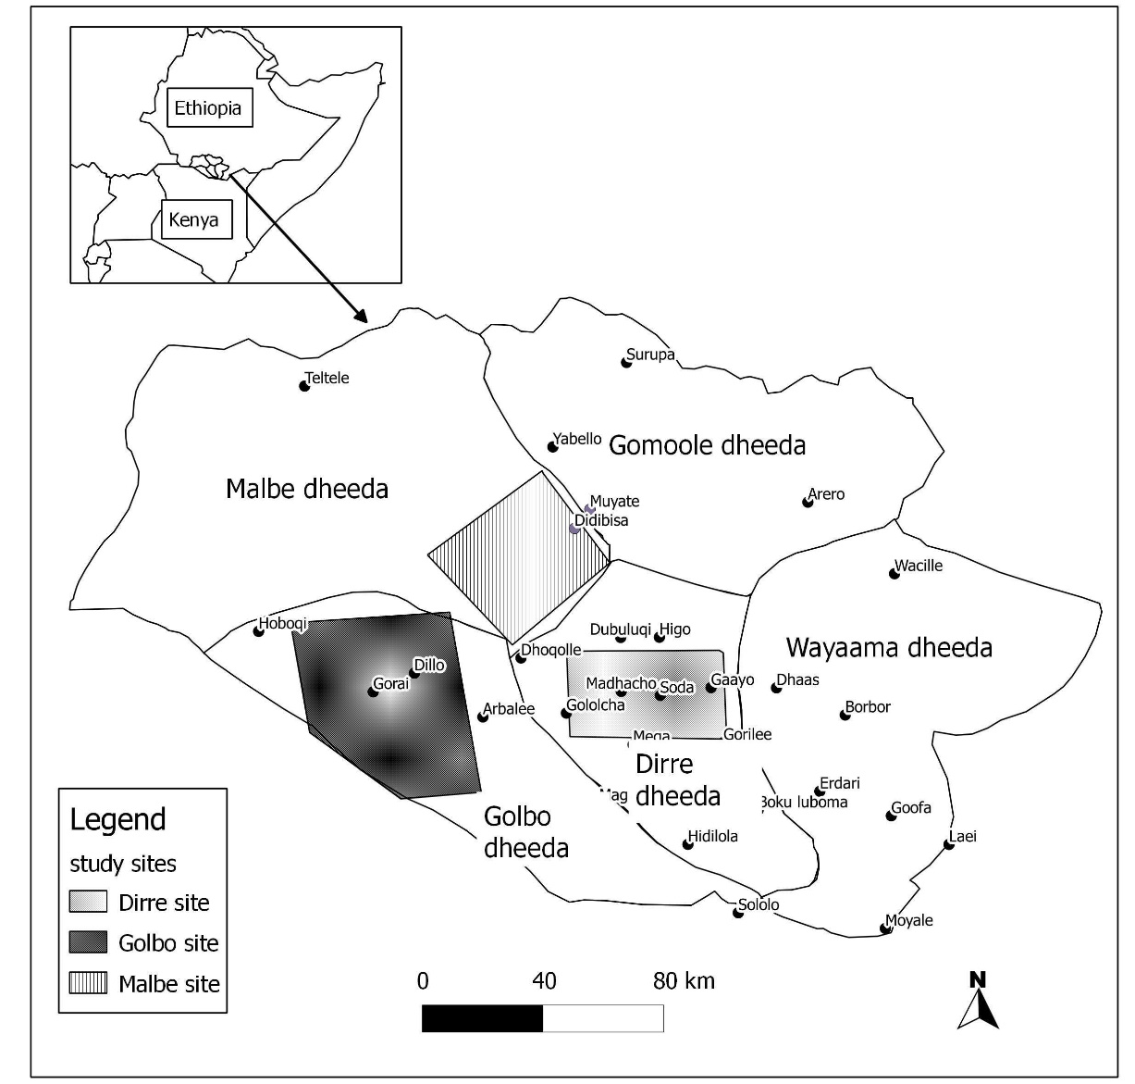
A case study from Southern Ethiopia
Study area
Study undertaken among the Borana pastoralists of southern Ethiopia
Objective: to contribute to the understanding of pastoral livestock mobility using methodologies that allow focus at different scales - from communal to individual herd level

Slide 7
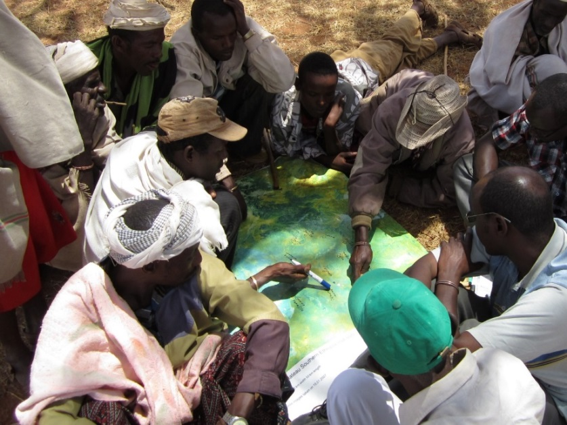
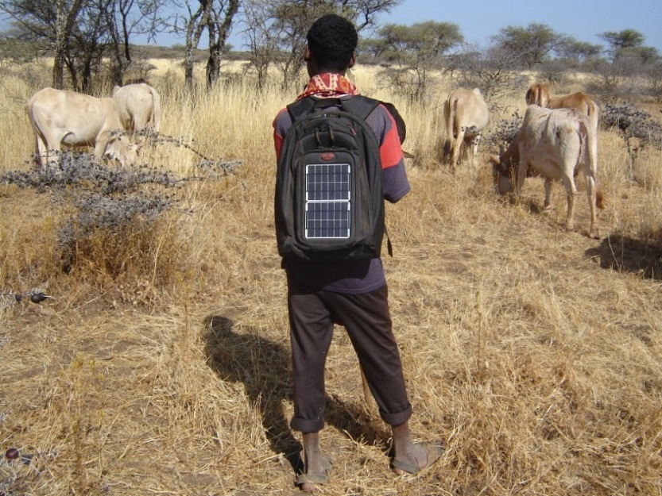
Methods
Spatial
Spatial + temporal
Participatory mapping and analysis of rangeland characteristics and use
Retrospective seasonal calendars interviews (91 herds over 12 months)
Real time GPS tracking - 3 herds for 14 months
Herder interviews
Photography by herders

Slide 8
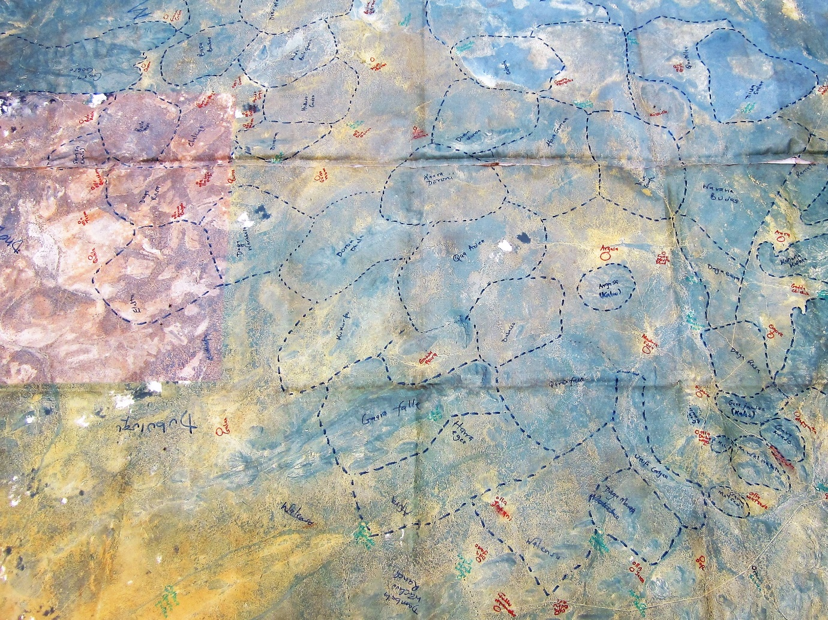
Participatory mapping and analysis of mobility
Google earth image – provided a visual aid
Aided in recall - from mental maps - of the details that distinguished the units.
Showed that location and the borders of each grazing unit is communal knowledge
Ease of geo-referencing

Slide 9
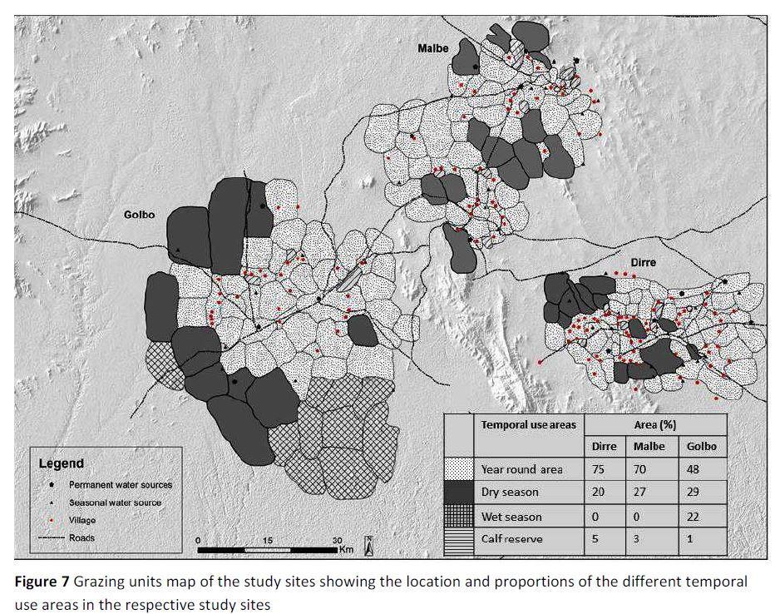
Participatory mapping and analysis of mobility
The method revealed:-
How varied space constraints prompted reorganization of use
Reorganizing of access to grazing spaces as adaptive practice
Localities with more areas under year round use – more constrained
The method provided base on which other aspects of mobility can be plotted

Slide 10
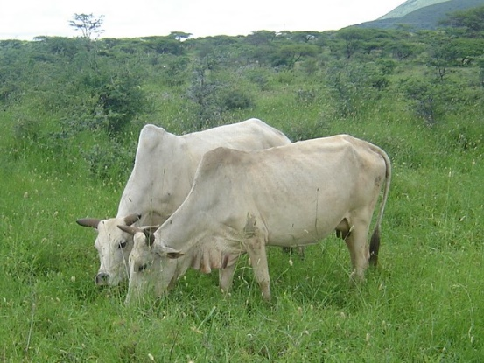
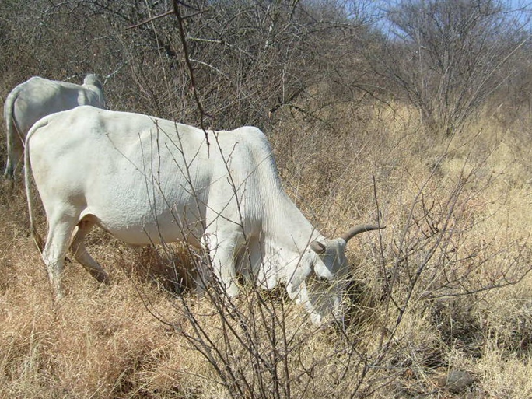
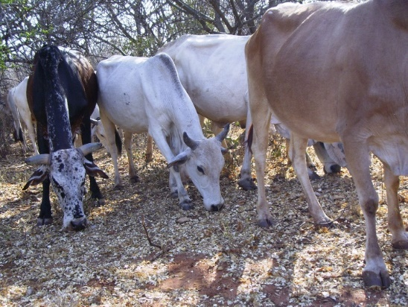
Photos by herders
Complements herder explanations of grazing itineraries and conditions
Important in improving recall

Slide 11
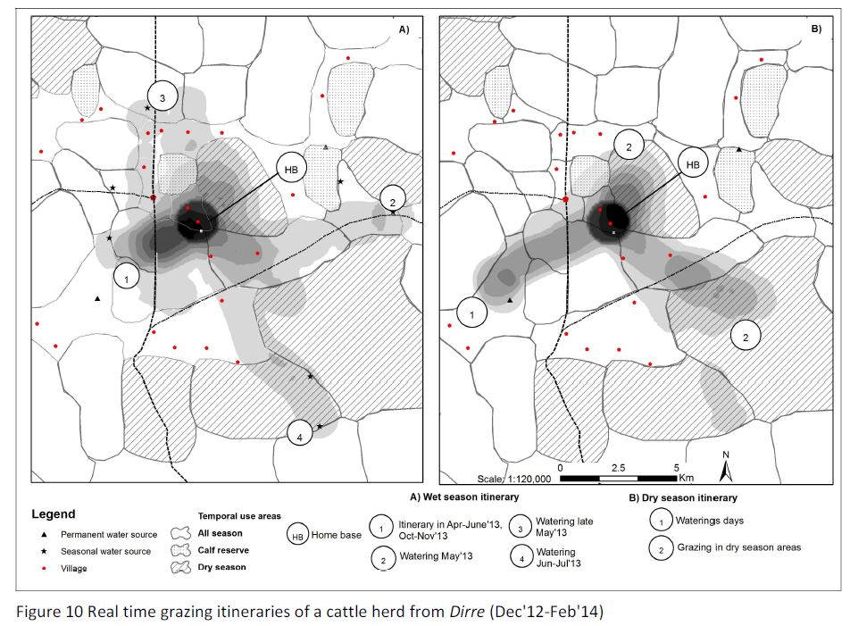
Real time GPS tracking of livestock mobility
Area with high mobility constraints
Wet Season
Dry season
Triangulation with other methods
Constraints visualized
Influence of social controls - grazing and water points regulations
Elaborates decisions by herders
Disparities between regulations and practice can be observed and explanation sort

Slide 12
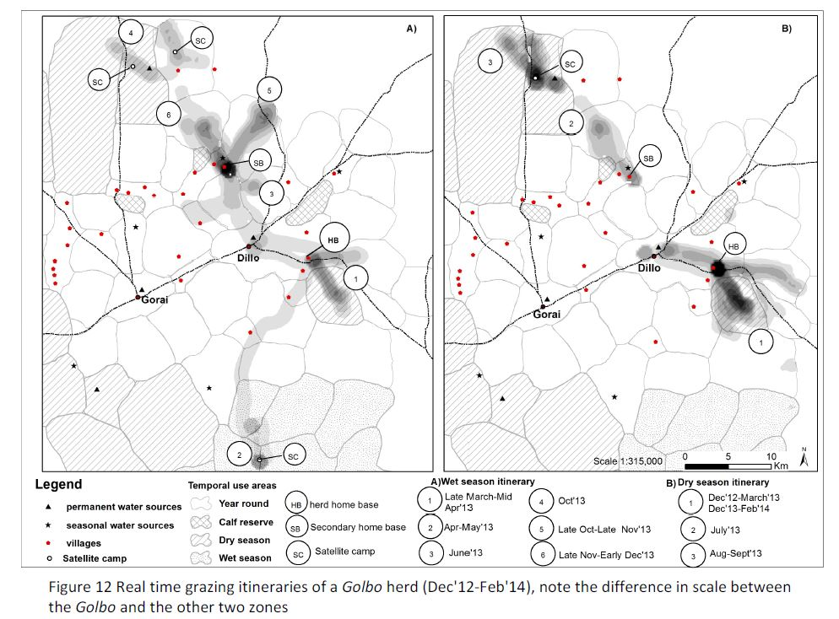
Real time GPS tracking of livestock mobility
Area with low mobility constraints
Wet season
Dry season
Clarifies differences in grazing constraints
Elaborates on production practices such as:
  Access to certain areas to enhance performance
  Mobility of HHs and use of satellite camps to access distant areas

Slide 13
Conclusions
The participatory nature of the methods – had herders involved
Methods built on to each other – enhancing the results
Looking at the varied scale – communal and individual levels provided better insight towards understanding of herding and mobility decisions
This is important as even individual households within the same system, specialize in making use of different sets of scales
Improvement in tracking devices for real time itineraries over extended period

