Slide 1

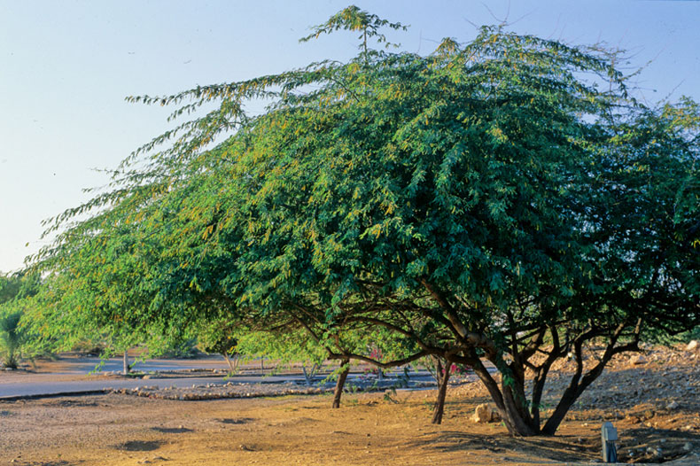
Prosopis julifloris in East Africa
Challenges and Opportunities
Evan Griffith DVM, MPH, MS
Source: https://www.landerprosopis.com/history-of-prosopis-juliflora

Slide 2
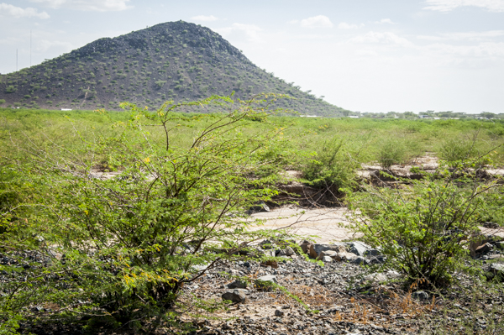
Table of Contents
Ecology
History of introduction
Turkana Case Study
Potential Management Strategies
Conclusions
Unit 2
Invasive Prosopis along the Turkwel River. Source: https://nowater-nolife.org/lake-turkanas-values/

Slide 3
  45 species of Prosopis around the world
  P. juliflora, chilensis, and pallida are the most common spp. in East Africa
  P. julifloris is among the top 100 most invasive plant species - IUCN
  Native to dryland areas of Mexico, South America and the Caribbean
  Prolific pod producer
  Seeds germinate and grow very fast
  Cut stems grow rapidly
  Roots can grow to a depth of 53m in search of water
Prosopis
Ecology
Module 2

Slide 4
Introduction to Africa
  First reported in Senegal in 1822
  Introduced to Ethiopia, Somalia, Sudan, and Kenya in the 1970s
  FAO, NORAD, other NGOs and national governments
  Prevent desertification and soil erosion
  Provide firewood and livestock fodder
  Pastoralism as detrimental narrative
Prosopis
Rapid spread: 500-1300 hectares/year
  Populates littoral zones of lakes, floodplains and inland valley wetlands
  Areas around boreholes, canals, and other irrigation structures
  Outcompetes and suppresses native species (e.g., allelopathic suppression)
  Endozoochorous dispersal of seeds
    livestock coridors
    herd compostion changes from grazers (cattle) to browsers (goats)
Introduction and Spread
Module 2
Notes:
https://www.researchgate.net/publication/330441833_prosopis_leaves
In 1977, as part of its response to severe drought in the Sahel, the United Nations convened a conference on desertification in Nairobi (UNCOD). Kenya’s country position paper at this conference made it clear that the principal causes of desertification in Kenya were envisaged to be ‘improper livestock and range management’ (Republic of Kenya 1984: 5).

Slide 5
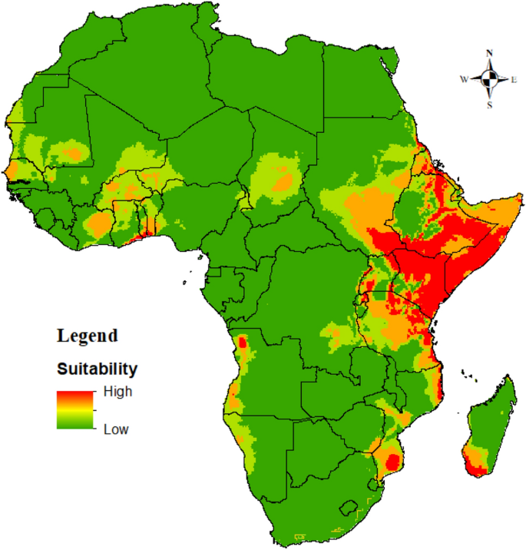
Prosopis distribution
  Somalia
    Dolow and Belet Hawa districts
    550,000 hectares in Somaliland
  Ethiopia
    1 million hectares
    Afar (12%), Somalia regions in the east and southeast
    Also SNNP and Tigray regions
  Kenya
    1.5 million hectares
    Baringo, Tana River, and Turkana
Pastoralism and Transhumanence
Sintayehu et al., 2020
Notes:
https://www.researchgate.net/publication/330441833_prosopis_leaves

Slide 6


Slide 7
Baringo (1988 - 2016)
  Expanded from 882 hectares to 18,792.
  86% decline in grasslands
  57% decline in irrigated cropland
  37% decline in rainfed cropland
  Prosopis caused over 30% of these negative changes; most important cause in decrease in grasslands and croplands in the region
Mbaabu et al. (2019)
Prosopis
Ecological Impact
Module 2
Notes:
https://www.researchgate.net/publication/330441833_prosopis_leaves
https://geohubkenya.wordpress.com/2022/02/22/kenya-faces-devastating-prosopis-invasion-what-can-be-done/#:~:text=We%20found%20that%20the%20shrub%20expanded%20from,the%20same%20period%20grasslands%20declined%20by%2086%

Slide 8
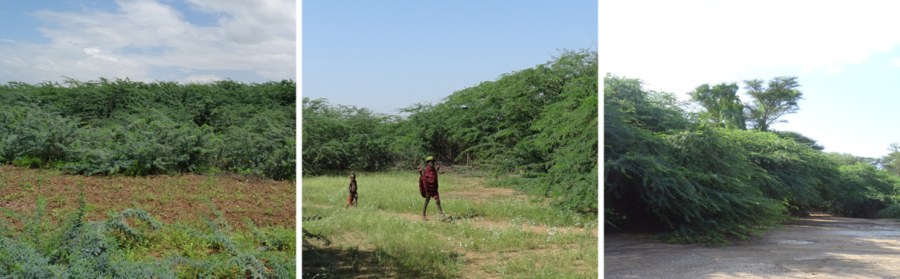
Etirae in Turkana County, Kenya
Etirae is ubiqutious in Turkana, and has spread into farmland, pasture, and along rivers and floodplains
Module 2
Ng et al., 2018

Slide 9
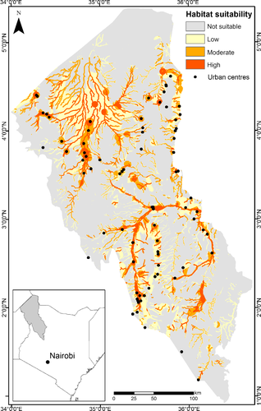
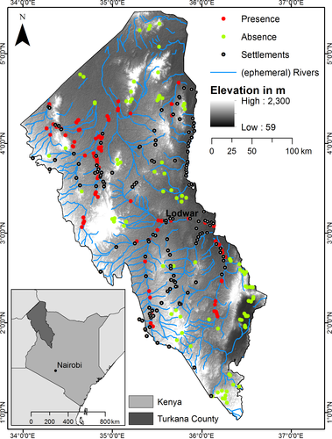
Distribution
  Presence, absence data used to model Prosopis suitability in Turkana - Ng et al., 2018
Module 2
  Tarach and Turkwel River basins
  Kerio river to a lesser extent

Slide 10
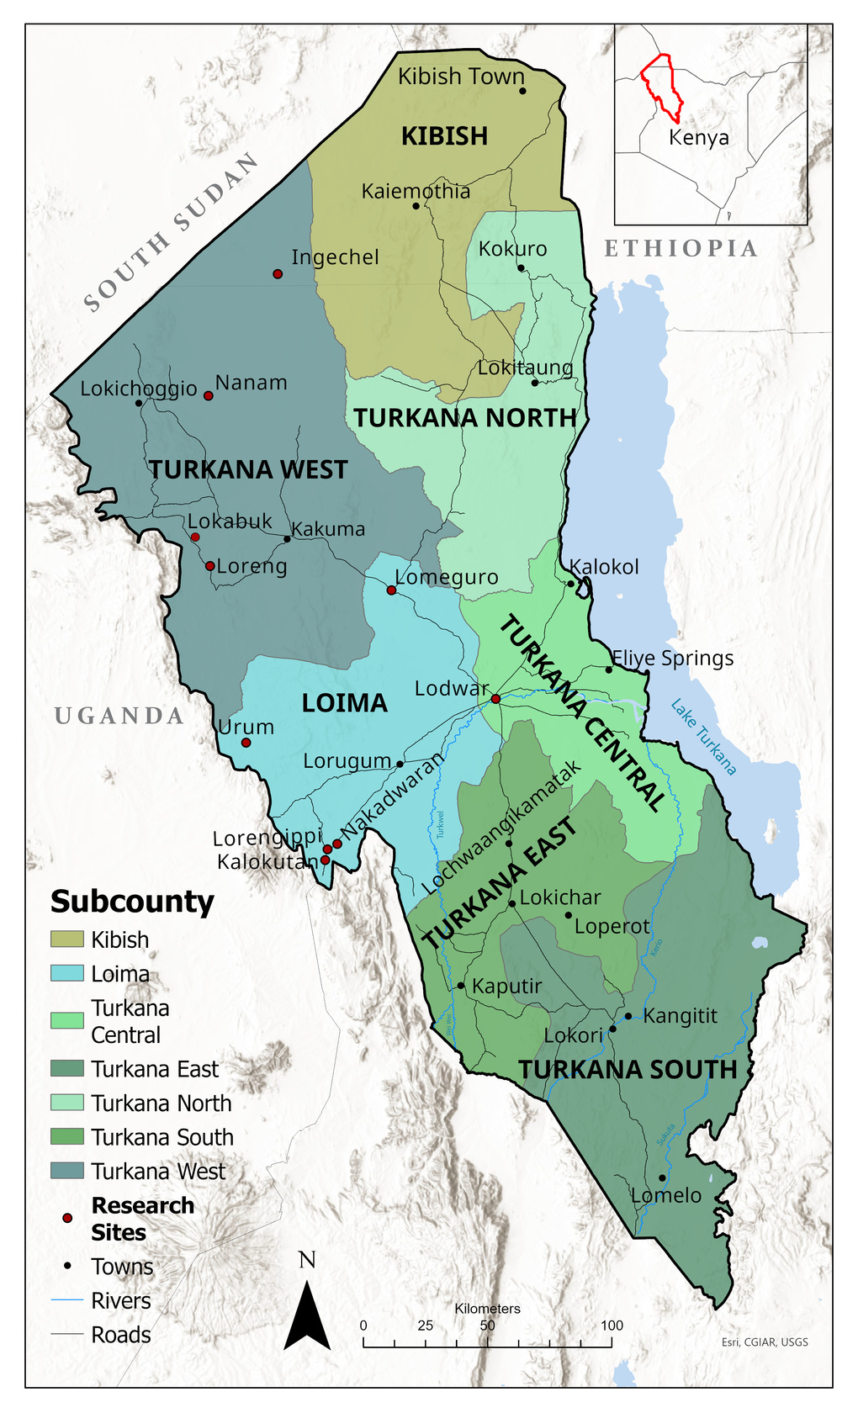
One Health PhD Research
  Identify relationships between people, livestock, and the environment in Turkana
  Men and women focus groups
  Fuzzy Cognitive Mapping and grounded theory qualitative analysis
Module 2

Slide 11
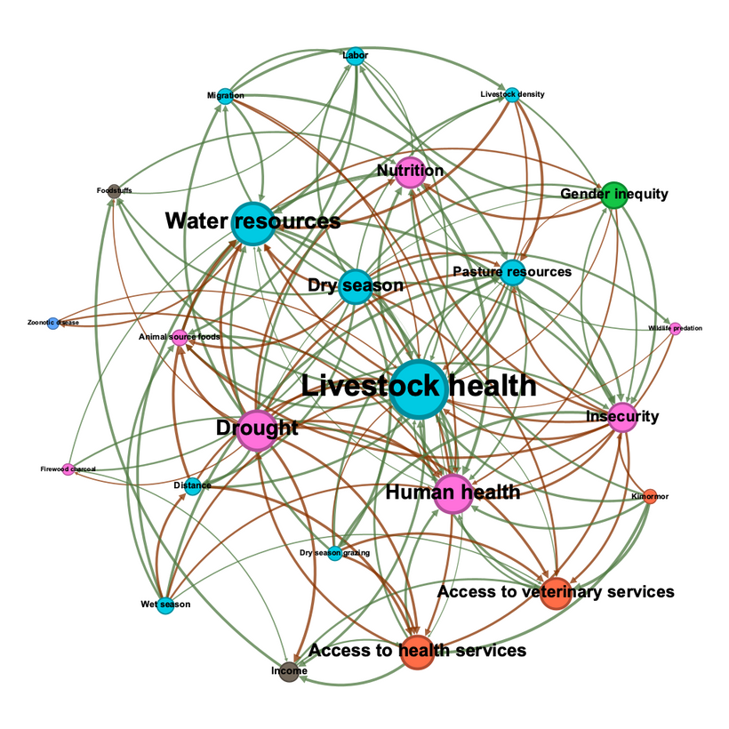
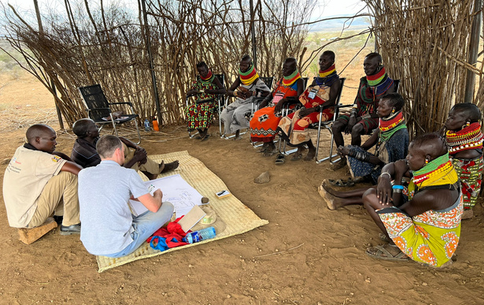
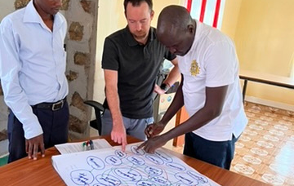
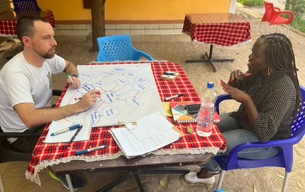
Fuzzy Cognitive Mapping
  Participatory systems mapping
  Combines community and expert perceptions
  What are the components of the OH system in Turkana?
  How are they related?
One Health in Turkana. Green arrows are direct relationships, red indirect. Width of arrows = edge weight. Node size = weighted centrality. Created in Gelphi.
Module 2

Slide 12
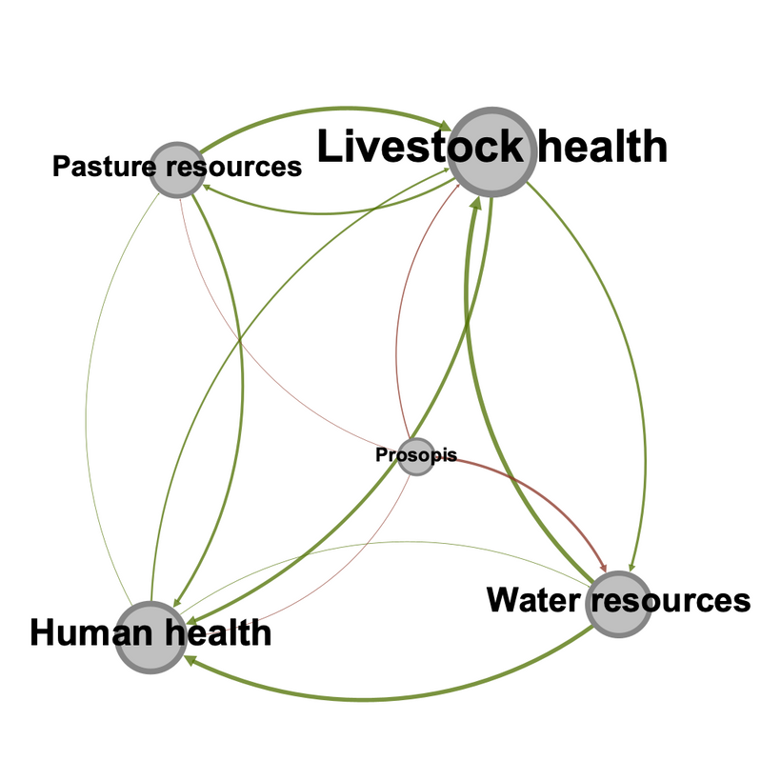
Etirae Impacts
  Decreased water and pasture availability (competition and suppression)
  Decreased access to water and pasture
  Human and livestock health
Green arrows are direct relationships, red indirect. Width of arrows = edge weight. Node size = weighted centrality. Created in Gelphi.
Module 2

Slide 13
“This tree affect grass production, decreases water availability, and absorbs all nutrients, which is why it is always green” - FGD 08
The goats teeth rot and fall out. It finishes the water, it suffocates other trees” - FGD 12
“Etirae causes health issues. If by any chance you have been sting by a thorn, it forms a swelling in the area. These swelling we pierce to remove the fluid, but it might become acute and you will need to see the doctor” - FGD 11
“Sometimes it encloses the paths to the water points because it grows along the river banks too and also it blocks the grasses when the animals are feeding” - FGD 11
Ngiturkana Voices
Etirae impacts

Slide 14
Women and Etirae
  Fetching and watering livestock
  Gathering firewood
Livelihoods
  Can be toxic to livestock (e.g., during drought)
  Sugary pods causes teeth to fall out and animals die
Research Summary
Module 2
Positive aspects?
“We use it for firewood. We don’t have a problem accessing Prosopis, because we have the initiative to chop it down and it never runs out. We use our panga to cut them down” (Women FGD 11).

Slide 15
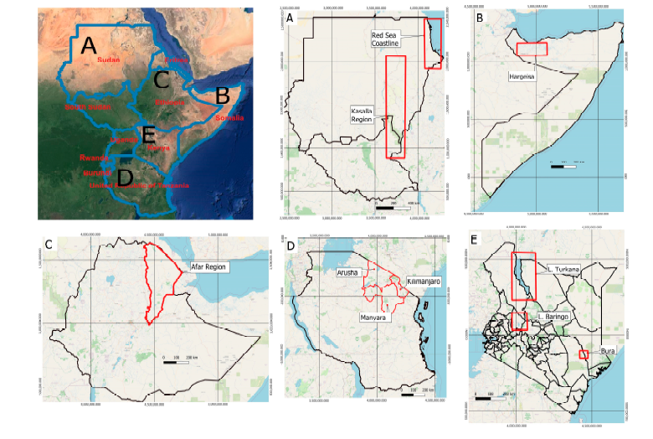
Prosopis management strategies
Module 2
Containment, control, eradication, restoration, and utilization
Kamiri et al., 2024

Slide 16
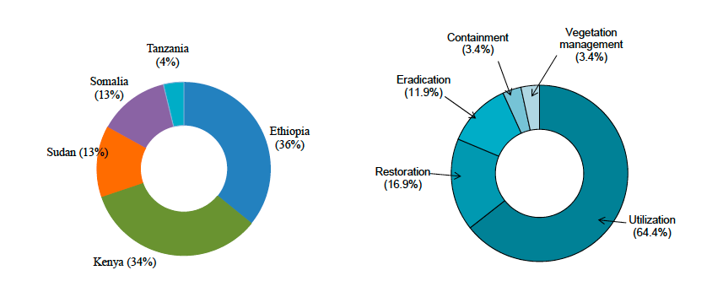
Prosopis management strategies
Module 2
Kamiri et al., 2024

Slide 17
Possible uses
  Charcoal production
    Profitable and widely traded in many regions
  Fuel wood and timber for construction
  Decrease use of native species??
  Animal feeds
    Pods processed into livestock feed
    High in CHOs and Protein
  Human food
    Floor for human consumption
    *experimental stage
  Ecosystem services
    Soil stabilization, erosion control
      Source of all the problems in the first place...
    Source of nectar for pollinating insects
  Unknown to what extent the use of such methods can be practically sustained to control further invasive spread
Utilization
Livelihood benefits?
Module 2

Slide 18
Complete eradication
  Mechanical methods
    High costs, re-infestation, limited long-term effectiveness
  Chemical methods (glyphosate)
    expensive, ineffective for old stands, impractical in East Africa
  Biological control
    Evippe moth (Kenya)
    Proven success in Australia and some limited trials in South Africa
  Containment of livestock
    Fencing infested areas to restrict animal movement (seed dispersal)
    Detrimental to pastoralists
    Won’t seed dispersal by other routes (e.g., waterways, wildlife, etc).
Complete or partial control
Module 2
Feasability

Slide 19
Pastureland
  Process
    Partial removal of Prosopis from pasturelands
    Re-seeding with fast-growing pasture species
  Challenges
    Requires regular control of Prosopis regrowth for sustained benefits
    Reseeding with native trees? - eg Ewoi in Turkana is a critical dry-season browsing resource that is being outcompeted by Etirae
Restoration
Croplands and Pastureland
Module 2

Slide 20
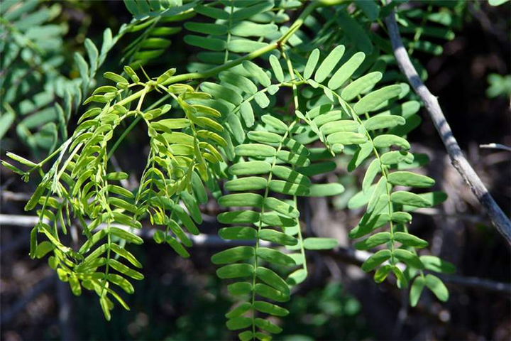
Conclusion
  Prosopis is a remnant, and extension of narratives about pastoralists in EA as destructive
  Ecological impacts: landscape scale changes in vegetation structure across East Africa, especially in riparian habitats
  Exacerbated by climate change and increase in temperature
  Biodiversity loss, loss of ecosystem services
  Significant human and livestock health and well-being impacts
  Requires a combination of management strategies; there’s no one size fits all approach
Module 2
Source: USGS

Slide 21
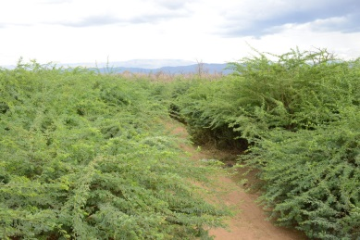
Conclusion continued...
  FCM shows that Prosopis is connected to many aspects of the health, social-ecological system in Turkana
  Need a cross-sectoral approach (e.g., health, social, ecological, economic)
  One Health platforms in East Africa are well established; although generally centered on zoonotic disease prevention and control
  OH platforms and coordination mechanisms can be harness for Prosopis policy, management, and research (e.g., Turkana COHU)
Module 2
Source: CABI

Slide 22
Research and Policy Directions
  Mechanism of spread across different sites
  Consequences and economic impacts
  Site-specific cost effectiveness of control strategies
  Policies and guidelines for management
  Assessment tools for the prevention of future invasion
  Information sharing, education, and awareness is lacking
  Cross-sectoral integration for management decisions is needed
Module 2

Slide 23
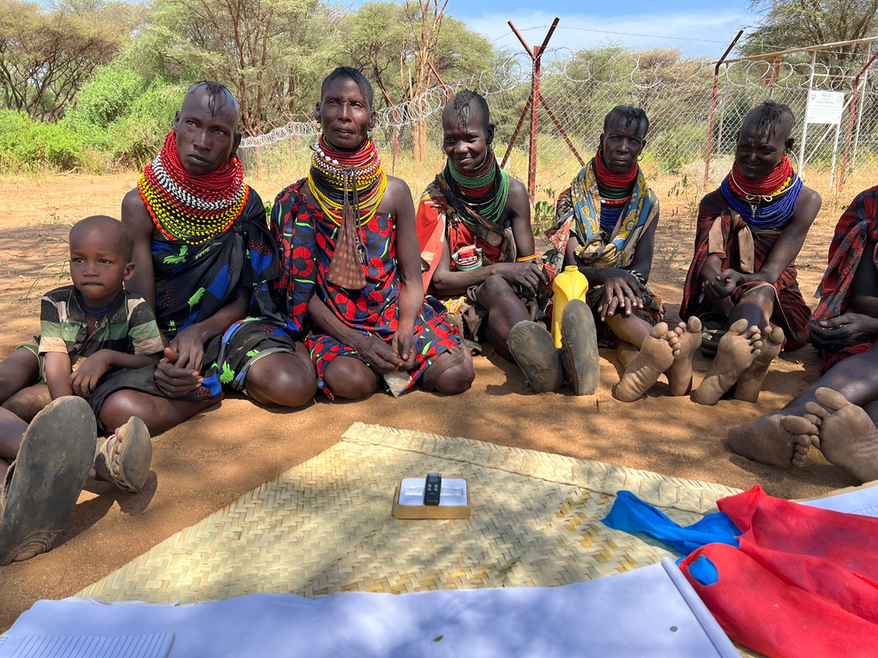
Dicussion Questions
  What is your own experience, if any with Prosopis?
  Based on what you’ve learned in the course so far, how does Prosopis intersect and influence pastoralists’ livelihoods, health, and well-being?
  What management strategies do you think are most suitable for pastoral ASALs?
  What research gaps are there? What should be research priorities?
Module 2
Source: EFG

Slide 24
Resources
  Derbyshire, S. F., Leakey, A., & Lowasa, L. (2023). Tangled crises in Turkana: investigating the spread of Prosopis in Kenya’s northern drylands. Africa, 93(5), 652-673.
  Kamiri, H. W., Choge, S. K., & Becker, M. (2024). Management Strategies of Prosopis juliflora in Eastern Africa: What Works Where?. Diversity, 16(4), 251.
  Mbaabu, P. R., Ng, W. T., Schaffner, U., Gichaba, M., Olago, D., Choge, S., ... & Eckert, S. (2019). Spatial evolution of Prosopis invasion and its effects on LULC and livelihoods in Baringo, Kenya. Remote sensing, 11(10), 1217.
  Mwaja,V. and Maina,J. and Mwangi,H., pwkb.20167800416, PlantwisePlus Knowledge Bank, doi:10.1079/pwkb.20167800416, CABI International, Prosopis juliflora in pastures-Kenya, (2016)
  Ng, W. T., Cândido de Oliveira Silva, A., Rima, P., Atzberger, C., & Immitzer, M. (2018). Ensemble approach for potential habitat mapping of invasive Prosopis spp. in Turkana, Kenya. Ecology and Evolution, 8(23), 11921-11931.
  Ng, W. T., Immitzer, M., Floriansitz, M., Vuolo, F., Luminari, L., Adede, C., ... & Atzberger, C. (2016, October). Mapping Prosopis spp. within the Tarach water basin, Turkana, Kenya using Sentinel-2 imagery. In Remote Sensing for Agriculture, Ecosystems, and Hydrology XVIII (Vol. 9998, pp. 161-173). SPIE.
  PE, A., & GN, N. (2023). Critical Review Of Prosopis Juliflora Species In Turkana County, Kenya: Current Status For Informed Policy Decision And Management Of The Species.
Module 2

Slide 25


