Slide 1



Advance Certificate (Online) | P-001
Pastures, Pastoralism and Rangeland Governance
Community based pasture management in Kyrgyzstan: Achievements challenges and trends
21 November 2024
Ms. Elvira Maratova

Slide 2

Pastures in High Altitude Mountain Areas:
Cases of Kyrgyz Republic
Sub-Topics
Importance of Pastures in the Kyrgyz Economy
Types of Pastures in Kyrgyz Republic
Ecological/Habitat Features of Kyrgyz Pastures
Policy and Legal Framework
Climatic Factors Affecting Pasturelands
Community-Based Conservation Efforts
Sustainable Development of Pastures
Traditional Pasture Management Systems
Pastoralism in Kyrgyz Culture

Slide 3
Introduction
The presentation explores the critical role of pastures in the high-altitude mountain regions of Kyrgyz Republic. Delving into the country's geography and climate, it highlights the significance of pastoralism in Kyrgyz culture and economy. The sub-topics cover different types of pastures, flora, and fauna, along with environmental challenges like climate change and overgrazing. Solutions for sustainable pasture management, case studies, and economic implications are examined.
Additionally, the presentation delves into the policy and legal framework, paving the way for future prospects and recommendations to preserve these valuable landscapes. With its comprehensive analysis, the presentation underscores the importance of protecting Kyrgyz pastures for cultural, ecological, and economic reasons.

Slide 4

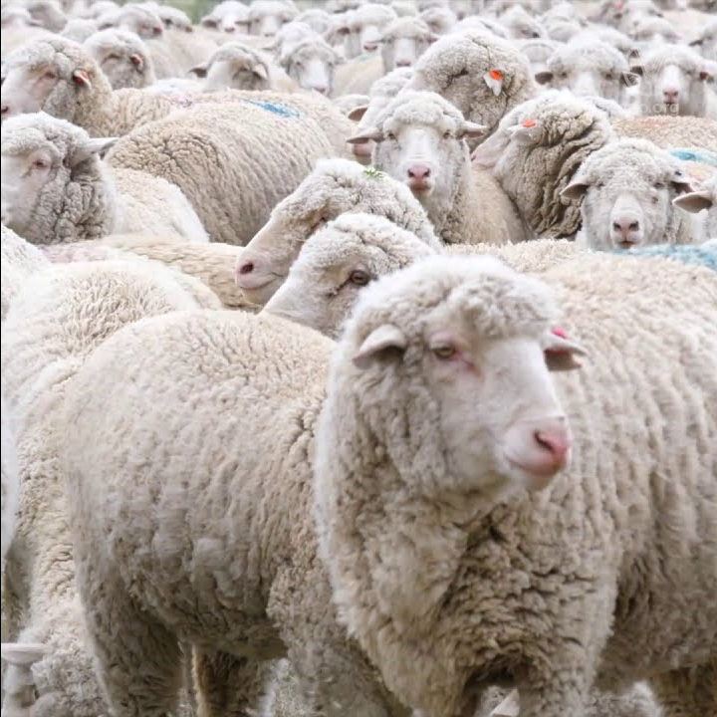
Importance of Pastures in the Kyrgyz Economy
Livestock Production:
Livestock Rearing.
Protein Supply.
Export Opportunities.
Employment and Rural Livelihoods:
Employment Generation.
Rural Livelihoods.
Reducing Urban Migration.
Socio-Economic Impact:
Community Resilience.
Income Distribution.
Cultural Continuity.

Slide 5

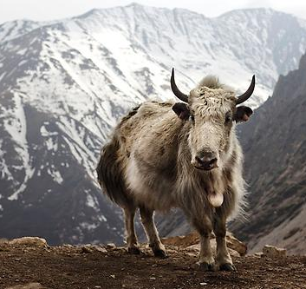

Types of Pastures in Kyrgyz Republic

Slide 6



Ecological/Habitat Features of Kyrgyz Pastures
Biodiversity Hotspots:
Rich Species Diversity
Endemic Species
Microhabitats and Niche Creation:
Altitudinal Zonation
Rocky Outcrops
Wildlife Habitats:
Biodiversity Corridors
Habitat for Herbivores
Ecosystem Services:
Water Regulation
Carbon Sequestration
Traditional Knowledge and Cultural Significance:
Indigenous Wisdom
Cultural Value

Slide 7

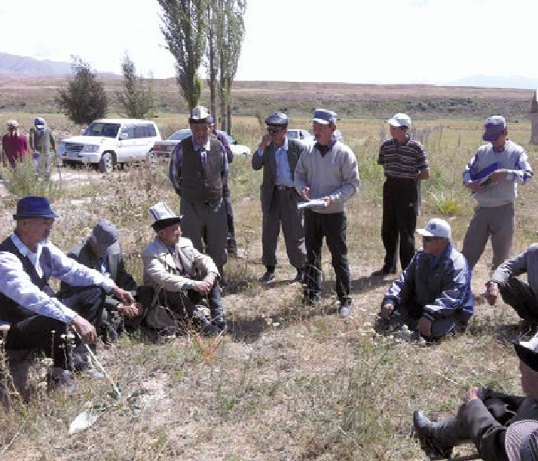
Policy and Legal Framework
National Legislation:
Pasture Law
Environmental Legislation
Key Elements of the Policy:
Community Involvement
Sustainable Use
Zoning
Conservation Areas
Government Agencies:
Ministry of Agriculture
State Agency for Environmental Protection and Forestry
Community Initiatives:
Local Associations
Traditional Practices
Regional Cooperation

Slide 8
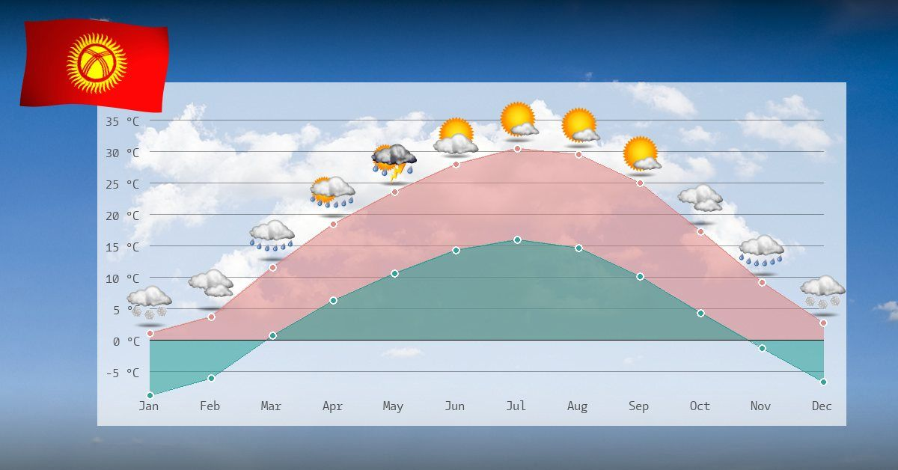
Climatic Factors Affecting Pasturelands
Altitude and Temperature:
Temperature Variation
Frost and Freezing
Seasonality and Growing Period:
Short Growing Season
Limited Biomass Accumulation
Precipitation and Water Availability:
Precipitation Patterns
Water Scarcity
Extreme Weather Events:
Snowstorms and Blizzards
Summer Droughts
Adaptation Strategies:
Rotational Grazing
Diversification
Water Management

Slide 9
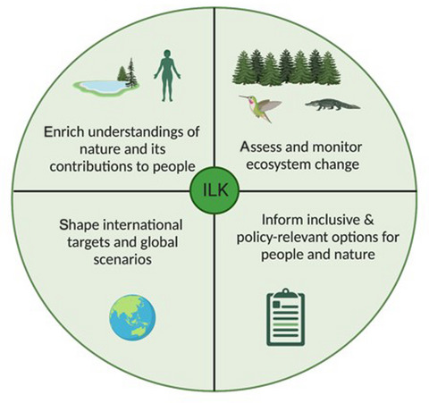
Community-Based Conservation Efforts
Collective Management:
Pasture User Associations: Local communities establish user associations to collectively manage and regulate pasture use, implementing rules that ensure sustainable grazing practices.
Traditional Ecological Knowledge: Indigenous knowledge about pasture ecology and management is integrated into modern conservation efforts, respecting centuries-old practices.

Slide 10
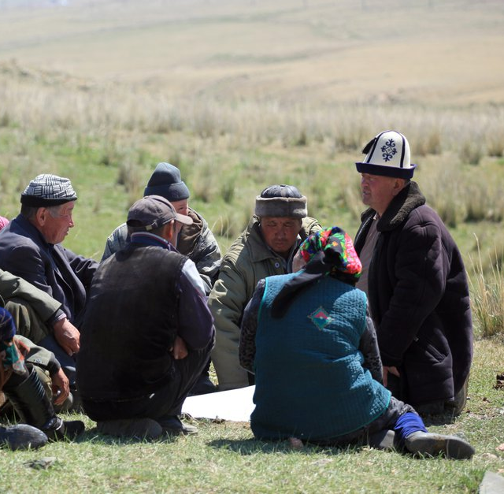
Community-Based Conservation Efforts
Benefits of Community-Based Conservation:
Local Ownership
Cultural Preservation
Economic Resilience
Challenges and Opportunities:
External Pressures
Capacity Constraints
Collaborative Partnerships

Slide 11
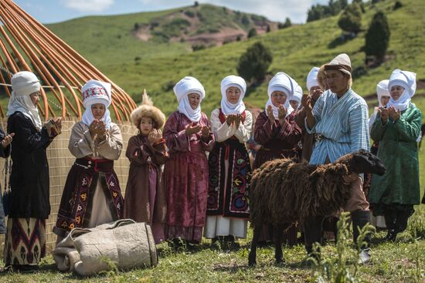
Traditional Pasture Management Systems
Transhumance:
Seasonal Migration
Optimal Resource Use
Nomadic Patterns
Flexibility and Adaptability
Minimal Environmental Impact
Traditional Ecological Knowledge:
Plant Diversity.
Grazing Timing
Fire Management
Prescribed Burning
Habitat Improvement

Slide 12
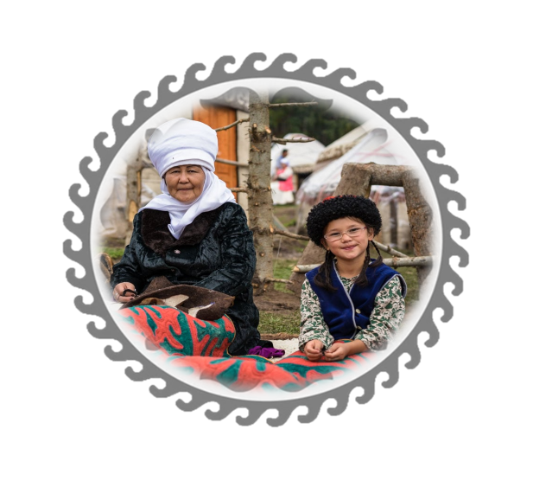
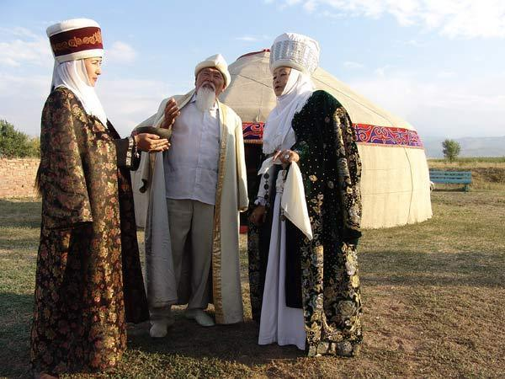

Pastoralism in Kyrgyz Culture
Cultural Significance:
Heritage and Identity
Nomadic Spirit
Cultural Expressions:
Oral Traditions
Festivals and Celebrations
Social Fabric:
Social Bonds
Hospitality
Art and Craftsmanship:
Traditional Crafts.
Livestock Imagery
Economic Aspects:
Livestock Wealth
Barter Traditions

Slide 13
Pastoralism in Kyrgyz Culture
Challenges and Adaptation:
Modernization: Urbanization and changing economic dynamics have led to adaptations in pastoral practices and cultural expressions.
Cultural Revival: Efforts to preserve traditional knowledge, festivals, and craftsmanship contribute to the revival of pastoral culture.
Sustainable Future:
Balancing Progress: Nurturing pastoral culture while embracing modern development is essential for a sustainable and culturally rich future.

Slide 14

Thank you!
PF “Rural Development Fund”
102-104, Toktogul Street, office 1
Bishkek, 720040, Kyrgyz Republic
Mobile: + 996 770 33 01 06
Phone: +996 755 330106
Email: ruraldevelopmentfund2020@gmail.com
Website: www.rdf.kg
IT Map: http://rdfmap.kg/

