Slide 1



Traditional Knowledge and Biodiversity
Akmatova Kuluipa
PF «Rural Development Fund»
October, 2024
Notes:
1.7.2013
1
‹#›

Slide 2

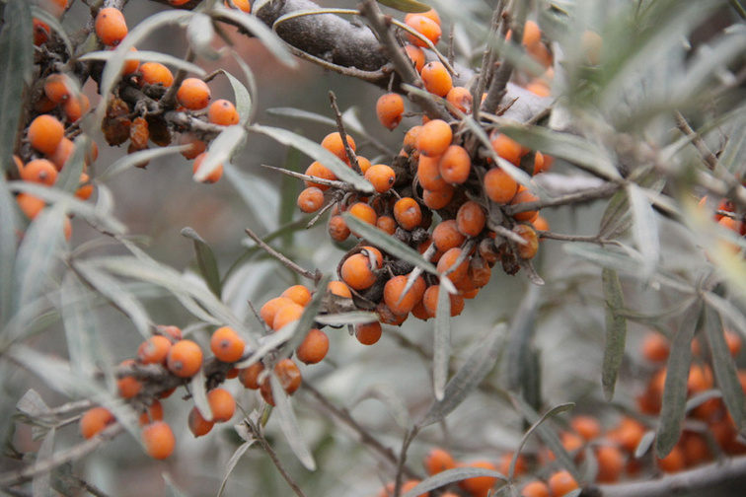
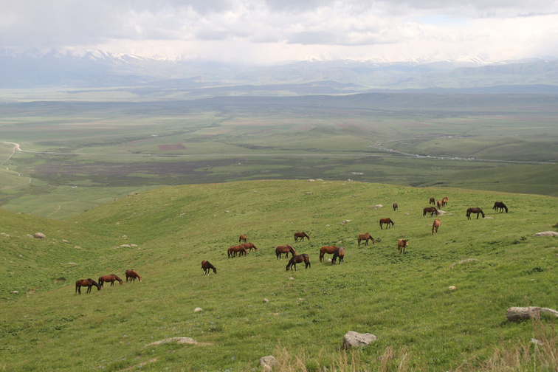
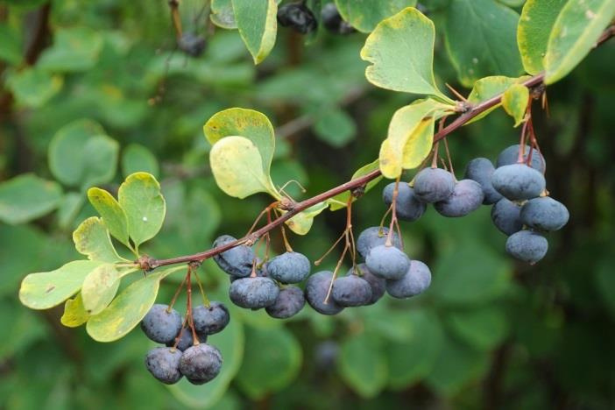
Biodiversity and Traditional Knowledge
Traditional knowledge is a form of knowledge representing the set of collective experience accumulated over centuries and adapted to geographical and cultural needs. Traditional knowledge (TK) is an important tool for supporting biodiversity conservation. It includes information, practices, and wisdom based on continuous human observation and interaction with natural ecosystems and landscapes. The loss or reduction of biodiversity can lead to the loss of TK, and vice versa.
2
Notes:
1.7.2013
2
‹#›

Slide 3

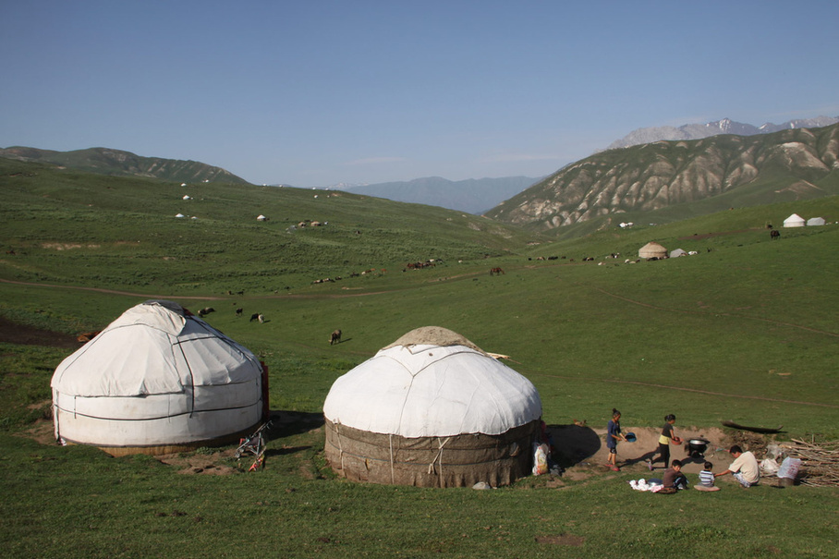
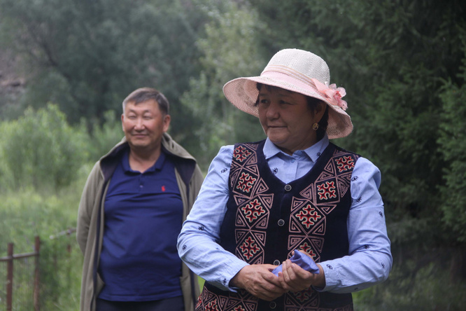
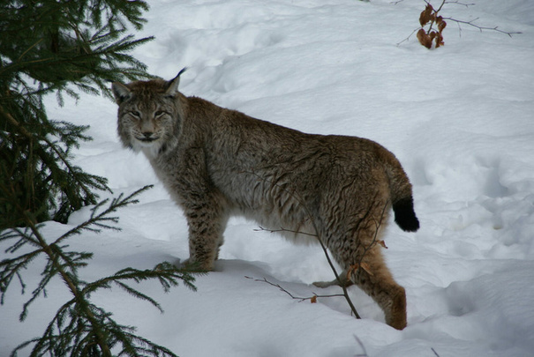
Local communities acknowledge that biodiversity is important for their livelihoods and survival. Biodiversity directly relates to the sustainable economic development of local communities involved in collecting herbs and berries, beekeeping, using forest products, and other genetic resources.
Local communities possess a unique knowledge and understanding of the landscapes and ecosystems, which is the basis for the conservation and sustainable use of biodiversity, as well as cultural diversity.
RDF research shows that the loss and reduction of biodiversity is becoming one of the significant challenges that local communities face today.
The well-being of local communities is closely linked to the well-being of natural ecosystems
3
Notes:
1.7.2013
3
‹#›

Slide 4

Types of TK and TEK related to biodiversity and its conservation
Notes:
1.7.2013
4
‹#›

Slide 5

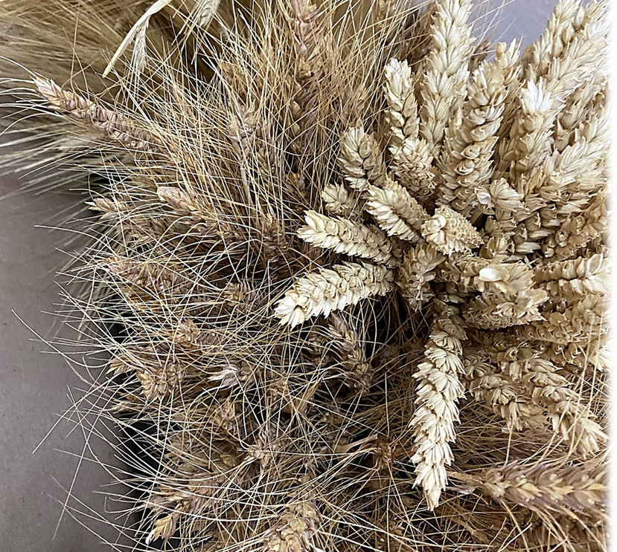
Rational Use of Natural Resources
TK and TEK are based on the principles of rational use of resources necessary for communities to support their livelihoods:
for traditional treatment (medicinal herbs),
to ensure food security and nutrition (berries, fruits, nuts, root crops, traditional crops);
Rational use is an important aspect of Traditional Ecological Knowledge, consisting of a local approach to sustainable management of natural resources. For example, seasonal use of pastures, cultivation of medicinal plants, etc.
5
Notes:
1.7.2013
5
‹#›

Slide 6
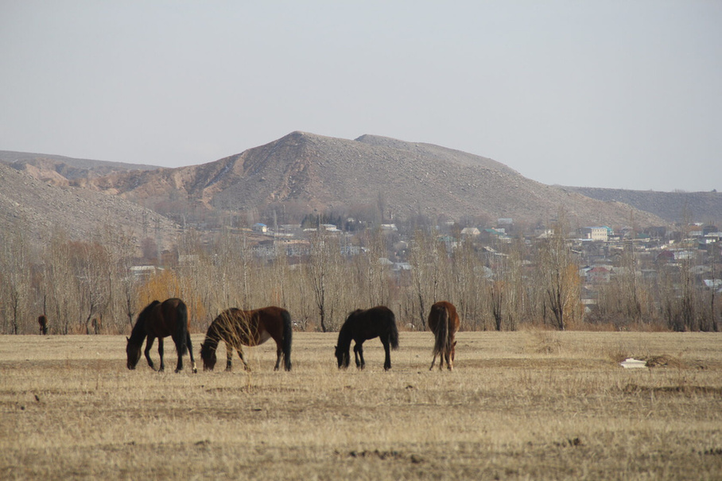
2. Management of Natural Resources
Traditional ecological knowledge is an important tool for local communities specific to each ecosystem or landscape and connected to deep and practical knowledge about the ecosystems and natural resources, as well as relationships between people and ecosystems.
It includes ecosystem management practices. For example, traditional practices of livestock grazing, forest management, crop management, collection of medicinal herbs, biodiversity conservation etc.
Social institutions play an important role through participation in the management of natural resources and decision-making.
6
Notes:
1.7.2013
6
‹#›

Slide 7
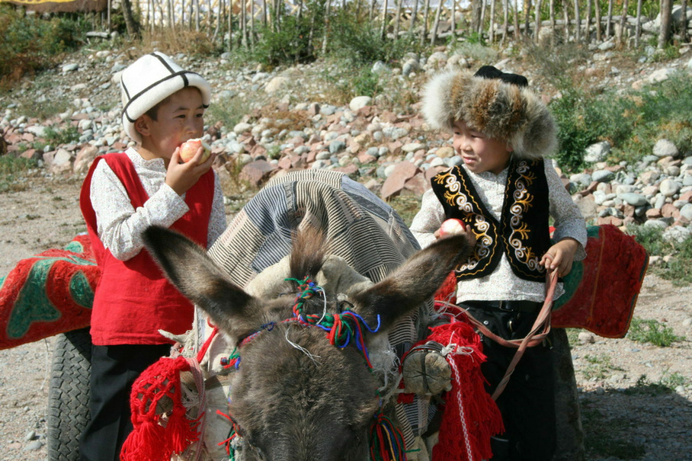

3. Fairy tales or information?
Many TK and TEK are reflected in the form of fairy tales, legends, myths and proverbs. In practice, this is aimed at disseminating information focused on the protection of biodiversity, natural ecosystems and landscapes.
This knowledge is expressed in folklore about wild animals, plants, and sacred places. It is focused on forming environmental awareness among the younger generation about the unbreakable connection between nature and man.
7
Notes:
1.7.2013
7
‹#›

Slide 8

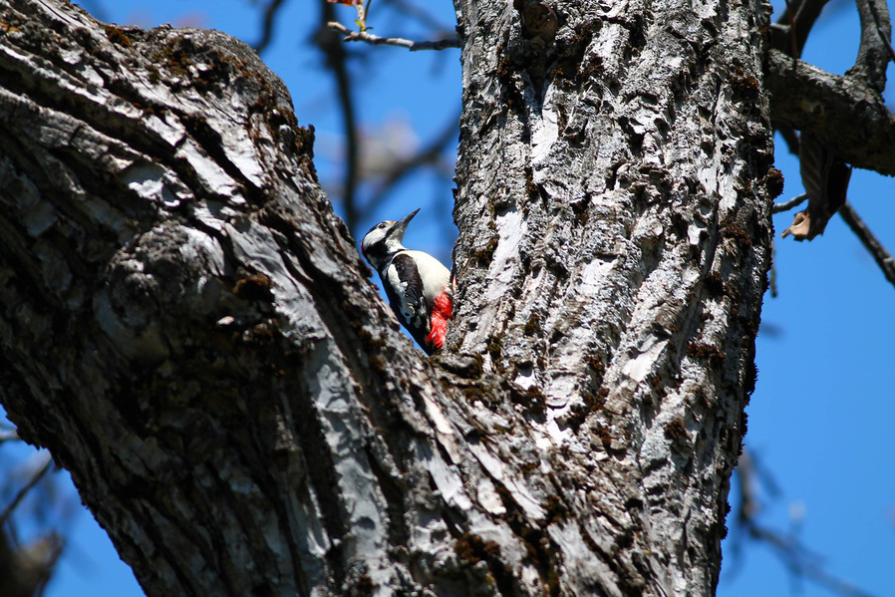
4. Protection and Taboo
TK and TEK are aimed at protecting "sacred places" – mazaars, natural objects, caves and water springs. These places are usually home to many wild animals or linked to vegetation of rare plants or sources of clean water.
This category of TK includes taboos and prohibitions, rituals and rules regulating the relationship between local communities and ecosystems, thus protecting and preserving biodiversity. For example, taboos associated with the pollution of water sources and sacred places, hunting wild animals and cutting down trees.
8
Notes:
1.7.2013
8
‹#›

Slide 9
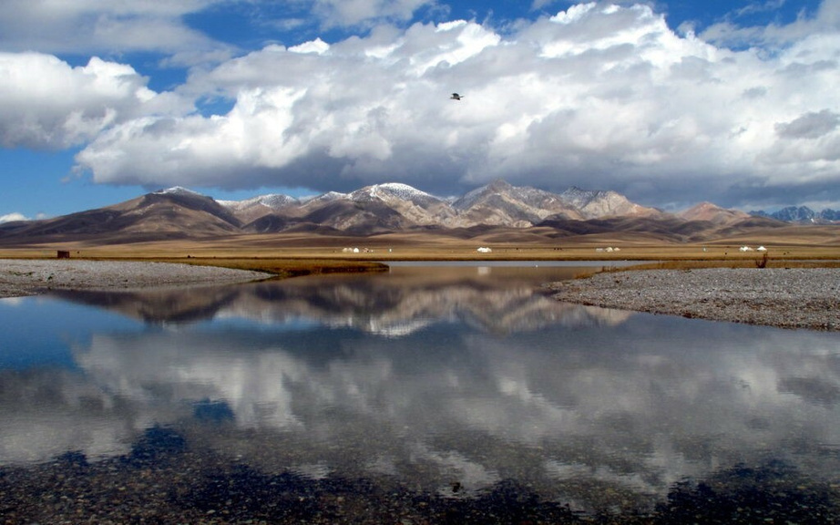
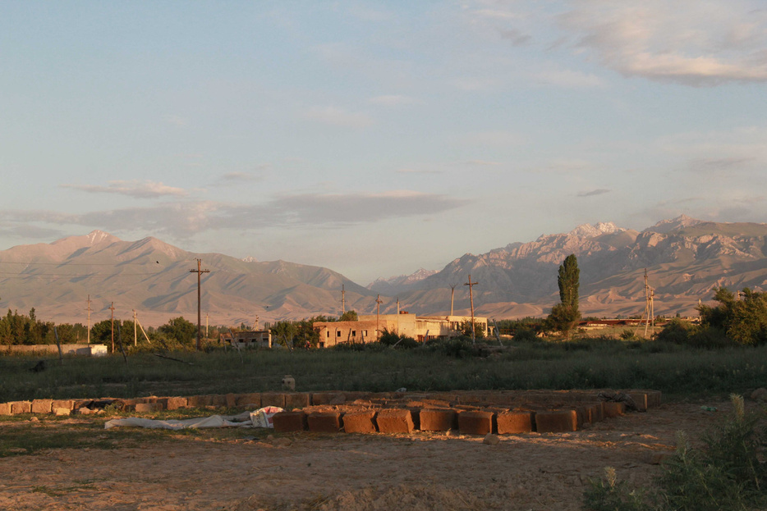
5. TK as a source of data or system of early warning
TK and TEK are not considered as scientific knowledge, however, TK can be a timely and effective source of information about extreme natural and climatic disasters, including changes in biodiversity and climate.
These TK are based on observations of changes in nature or animal behaviour and can help in preventing natural disasters, reducing risks and preserving biodiversity.
9
Notes:
1.7.2013
9
‹#›

Slide 10
TK and Biodiversity Conservation Issues
Issues of non-rational use of biodiversity; biodiversity and natural resources are under high pressure with limited or no time to recover. As a result, natural resources and biodiversity are subject to severe degradation;
Unclear, not fully agreed and fragmented responsibility for the conservation of natural resources of different institutions and local communities. It results in weak regulation of the access and use of natural resources;
- Weak monitoring of the condition of biodiversity and natural resources;
Insufficient recognition of the role of local communities in co-management, as well as the importance of TK in preserving biodiversity;
Transmission of traditional knowledge to the younger generation and weak interaction between TK and scientific knowledge.
10
Notes:
1.7.2013
10
‹#›

Slide 11
The strengthening of the role of local communities and custodians of traditional knowledge to highlight the importance of TK and TEK among civil society, local people and the young generation.
RDF conducts activities focused on the collection and systematization of TK and TEK to revive traditional practices on the protection and conservation of biodiversity and ecosystems, as well as the popularization of TK and TEK among young people, local communities and civil society.
Main challenges/issues on conservation of TK and biodiversity
11
Notes:
1.7.2013
11
‹#›

Slide 12
Access and Benefit-Sharing
An important aspect associated with the conservation of biodiversity and traditional knowledge, raised by local communities, is the issue of access to biodiversity and associated TK and fair distribution of benefits from the use of genetic resources and associated TK:
- the use of certain types of medicinal plants for pharmaceutical purposes based on traditional healing practices; the use of berries, other forest products, etc.
traditional practices of cultivation of local crops or collection of endemic plants.
traditional practices on land, water, and forest management.
It is important to introduce the regulations for the process of commercial use of biodiversity and associated TK, as well as recognition of the role of communities in preserving TK.
Main challenges/issues on conservation of TK and biodiversity
12
Notes:
1.7.2013
12
‹#›

Slide 13
Access and Benefit Sharing in Kyrgyzstan
RDF research shows that in Kyrgyzstan, genetic resources and TK are still transferred without prior informed consent and participation of the local population and custodians of TK due to the absence of any regulations for benefit sharing between end users and the local population.
Genetic resources on their own are not intellectual property, and cannot be protected by intellectual property rights. Importance is represented by traditional knowledge and practices on the use of genetic resources, and knowledge of the qualities and properties of genetic resources available to indigenous people and local communities.
Access and Benefit Sharing from the use of genetic resources and associated TK can be considered as an efficient approach to biodiversity conservation. That is why prior informed consent and participation of the local population is an important issue in the introduction of the ABS in Kyrgyzstan.
13
Notes:
1.7.2013
13
‹#›

Slide 14
To ensure access to the ABS, the parties should provide:
- Legal clarity and transparency in the development of home policy and legislation on ABS,
- clear and fair rules and procedures for access to genetic resources,
- information on how to apply for PIC - prior consent,
- development of procedures for establishing conditions for mutual agreement
- clear, cost-effective and timely decision-making,
- development of criteria for involving local people and custodians of TK in ABS
The policy related to the introduction of ABS will not be efficient until local communities’ rights for TK are recognized and their active participation in management is secured.
14
Notes:
1.7.2013
14
‹#›

Slide 15
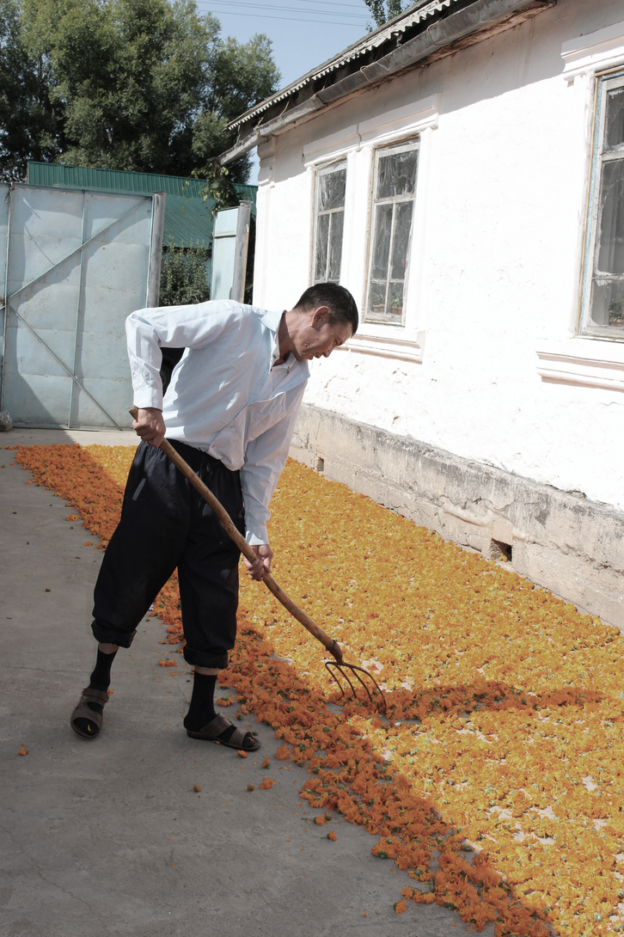
Participation of the local population should not be just a consultation, but an opportunity to influence the decision-making process.
The participation process should be an ongoing process, rather than a one-time action to collect information at the local level.
15
Notes:
1.7.2013
15
‹#›

Slide 16
    Revival and dissemination of TK and TEK (2007 till present)
    Access to genetic resources and associated TK (2007 till present)
    Go Green Project on medicinal herbs cultivation (2020-2024)
    Access and Benefit Sharing research (2017 till present)
    Protection of Snow Leopard and its habitat through TEK (2018 till 2022);
    Support of local communities in conservation of protected territories (2020-2022);
    Sustainable management of forest and forest resources (2010 till present);
    Support of local communities in beekeeping (2014, 2024).
    Aboriginal livestock keeping research (2020 till present)
RDF’s projects on biodiversity conservation
16
Notes:
1.7.2013
16
‹#›

Slide 17
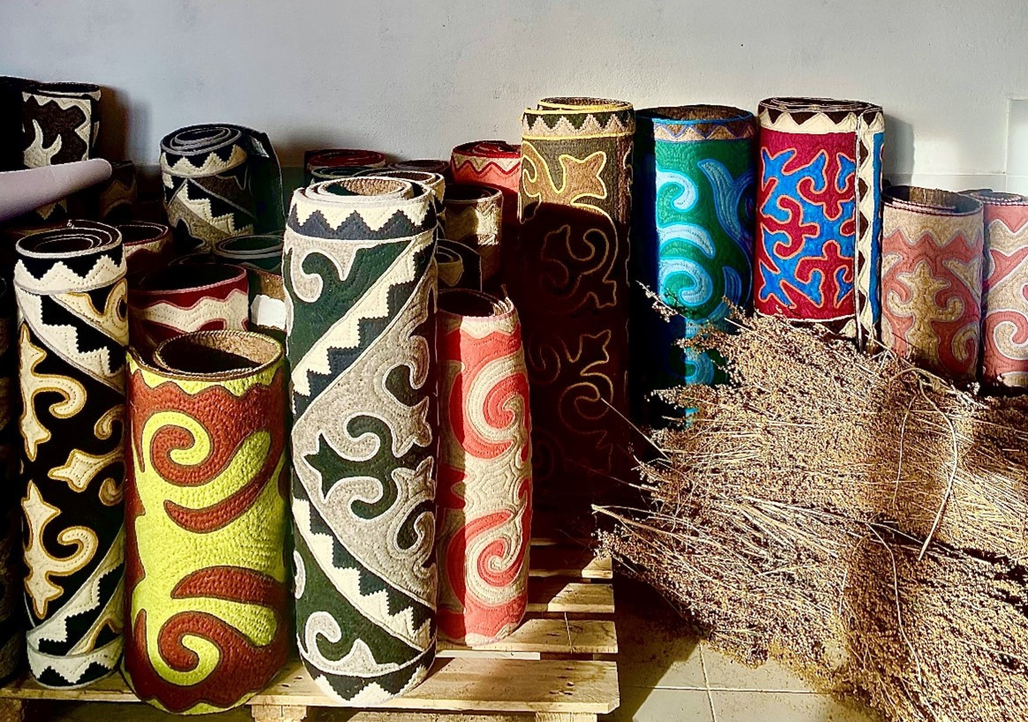
Thank you!
www.rdf.kg
www.en.rdf.kg
Пример текста
17
Notes:
1.7.2013
17
‹#›

