Slide 1
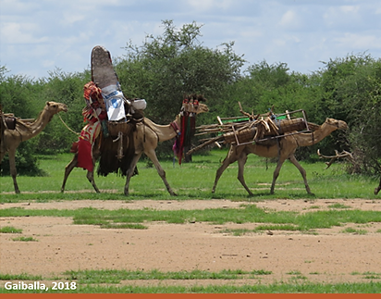
PASTORALISM AND TRANSHUMANCE IMPORTANCE AND CHALLENGES.

Slide 2
PASTORALISM AND TRANSHUMANCE IMPORTANCE AND CHALLENGES.
PASTORALISM is a LAND USE SYSTEM that relies mainly on livestock Herding as a main assets, it is a system that associated with the use of natural rangeland by pastoralists.
TRANSHUMANCE is a form of pastoralism practices where herders move in a regular and seasonal pattern. looking for feed and good environment for livestock herding. Movement vary in distances and directions as, relevant to herding conditions, resources and other influencing factor s.

Slide 3
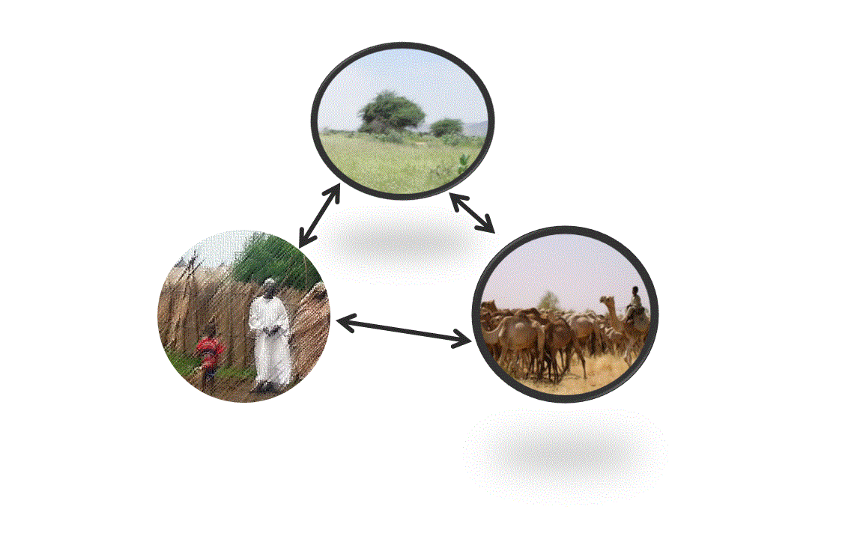
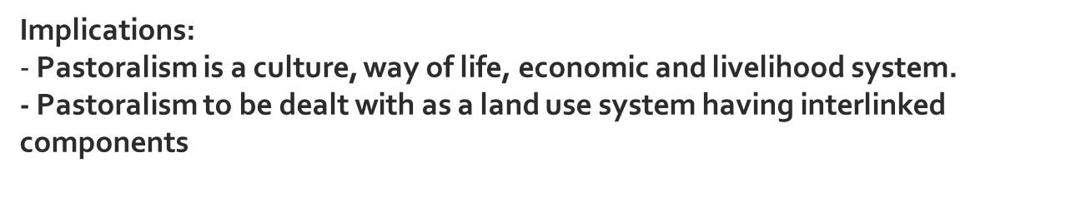
Pastoralism
(Rangelands resources – Communities - Herds)
Enabling environment
Gaiballa-Sudan_2014

Slide 4
Important
Rangelands: Constitute vast areas of land with permanent and/or seasonal cover of herbaceous, shrubby and/or trees cover and representing source of feed and habitat for domestic and wild animal and serving economic, environmental and social purposes.
Pastoralists: Are those for whom livestock raising is economically and culturally important, viable and dominant.
Shepherd: Is a person whose task is to look after sheep or other reared animals.

Slide 5
Rangelands and Pasture
The two terms range and pasture are used interchangeably in many texts even within some publications of wide coverage, but there is a difference between them as detailed in the second expert meeting on harmonizing forest-related definitions for use by various stakeholders (FAO, 2002).
Rangelands are mainly natural, native and have social, economic and environmental importance; while pasture is more influenced by human activity (planted or intensively altered by management) with an objective oriented more towards animal production.
FAO (2002) Proceeding of the second expert meeting on harmonizing forest – related definitions for use by various stakeholders – FAO. Rome.

Slide 6
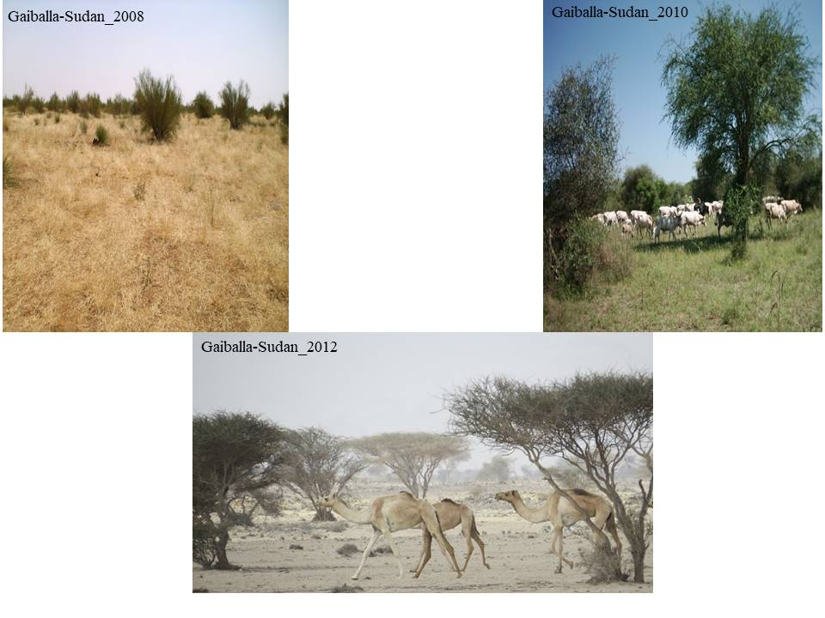
Logic of mobility
Efficient livestock raising systems in terms of natural resource use and land management.
Highly sustainable and economically rational system that makes most of the earth’s considered less productive areas, unsuitable for crop production.
Ability to provide the highest levels of animal welfare among livestock husbandry.
Contribute to environmental conservation and sustainability.

Slide 7
Categorizing pastoralists
Why categorization?
According to families settlement status:
  Nomads
  semi-nomads
  semi-settled
  settled
According to type of livestock : (Mainly in arid and semi-arid areas)
  Mainly , cattle herders
  Mainly, sheep and goats herders
  Mainly sheep herders

Slide 8
Categorizing pastoralists
Why categorization?
According to scale of involvement:
Semi-nomadic pastoralists: are those who leave part of the family in the (homestead) while part of the family moves seasonally with the herd to areas where pasture and water are available and conditions are favorable.
Nomadic pastoralists are characterized by high mobility where the entire families and herds move between dry and rainy season domains in the search of pasture and water.
Agro-pastoralists - normally practice significant cultivation alongside with livestock raising.

Slide 9
Rangelands management and grazing management.
Rangeland management deals with all the details required to achieve the various economic, environmental and social purposes and objectives,
while grazing management deals with the details of the animal’s use of the pasture and the sustainability of its use.

Slide 10
Common Property Resources (CPR) is the condition where natural resources are owned, managed and/ or used by several users, simultaneously or sequentially.
Overgrazing.
Rangelands not at equilibrium (arid and semi arid areas rangelands).
Conflicts.

Slide 11
Rangeland Health
The degree to which the integrity of the soil and ecological processes of rangeland ecosystems are sustained.
Rangeland Health Attributes:
Soil/site
Hydrologic function.
Integrity of the biotic community
Climate change opportunities

Slide 12
Economic importance:
Pastoralism is the main livelihood for an estimated 268 million people and represents 10 to 44 percent of the gross domestic product (GDP) of African countries.
https://documents.worldbank.org/en/publication/documents-reports/
According (ILRI), the economic value of pastoralism in Africa is estimated at US$1.3 trillion; this is equivalent to 30% of the continent's gross domestic product (GDP).
In Central Asian countries like Kyrgyzstan pastoralism represents about 20% of GDP (WISP, 2008)
World Initiative for Sustainable Pastoralism (WISP)

Slide 13
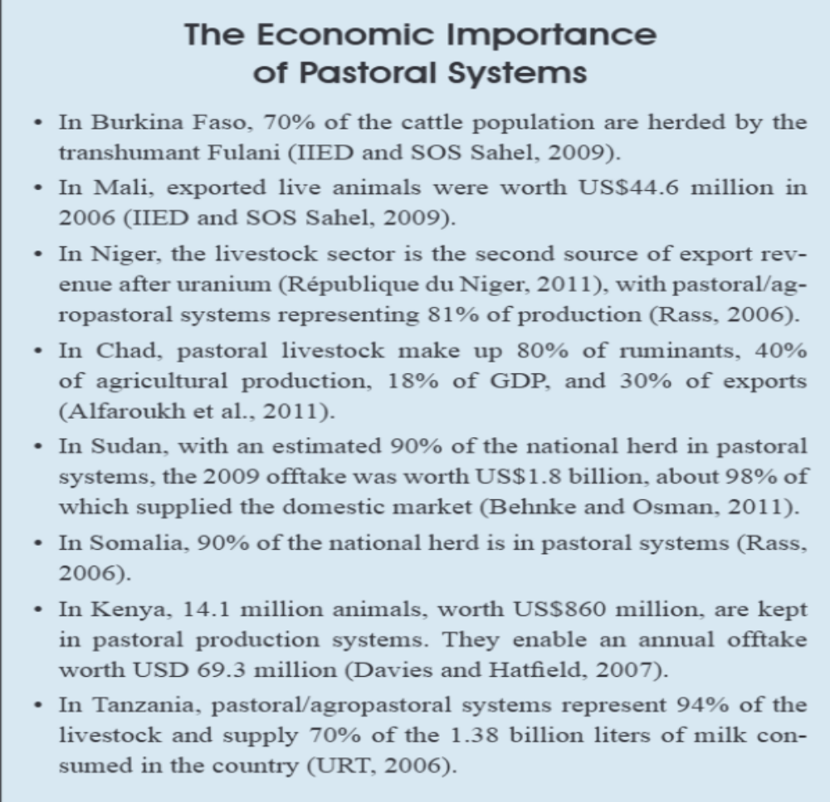

Slide 14
Environmental Importance
Biodiversity conservation
Animal and plant genetic resources
Environmental health
General environmental services
maintaining vegetation
Capture carbon,
reducing erosion, improving soils and facilitating
Water holding capacity and regulation services
Climate change
Adaptation through mobility
Carbon Sequestration potential of grasslands
A herd of 1000 transhumant sheep in Spain:
Transports as many as 200 million ingested seeds along routes during their 1,500 Km long migration. with a mean dispersal distance of 40 Km – other means of dispersal such as seeds attached to the fleece, or seed spitting should be added to this figure.

Slide 15
Challenges facing measuring value of pastoral systems
1. Data is scarce regarding the value of sales and consumption of
Livestock and livestock products
2. Indirect values associated with pastoralism, such as tourism, the
and ecosystem health that are poorly understood;
3. The social and cultural values of livestock and livestock products,
Including the value of social capital, are rarely measured.
WISP (2007). Squandered wealth: a global economic review of pastoralism - WISP Policy Issues Paper 2

Slide 16
Misconceptions about pastoralism
Pastoralism is an ancient form of production, whose time has passed.
Pastoralists contribute little to national economic activity
Livestock mobility is unnecessary and outdated.
Most rangelands have deteriorated as a result of overgrazing."
Pastoralists do not take care of the land due to the tragedy of the commons."
Pastoralists contribute little to national economic activities.
Pastoralism has very low productivity, and sedentary livestock farming is more productive than mobile systems.
Pastoralists need to settle in order to benefit from services

Slide 17
Pastoralism Development
Policies, legislations and strategic plans
Clear definitions of the rangeland resources and pattern of pastoralism development
Land ownership
Organization and legalizing pattern of pastoralism resources use.
Relationships between supervisory and beneficiary bodies
Powers and levels of law enforcement.
Cross borders transhumance.
Rights and duties.
Sensitizing decision makers and awareness raising.
Research.

Slide 18
Sustainability
Sustainability is not only about considering natural rangelands resources only for wild or domestic livestock. It is for ecological and environment balance, it is for soil and water systems and the safeguard for the production environment (Koochek and Gliesman, 2005)
Kookcheki, A. & S.R. Gliessman. 2005. Pastoral nomadism, a sustainable system for grazing land management in arid areas. Journal of Sustainable Agriculture 25(4): 113-131.MARF (2007). Ministry of Animal Resources, Fishery and Range and Pasture.

