Slide 1
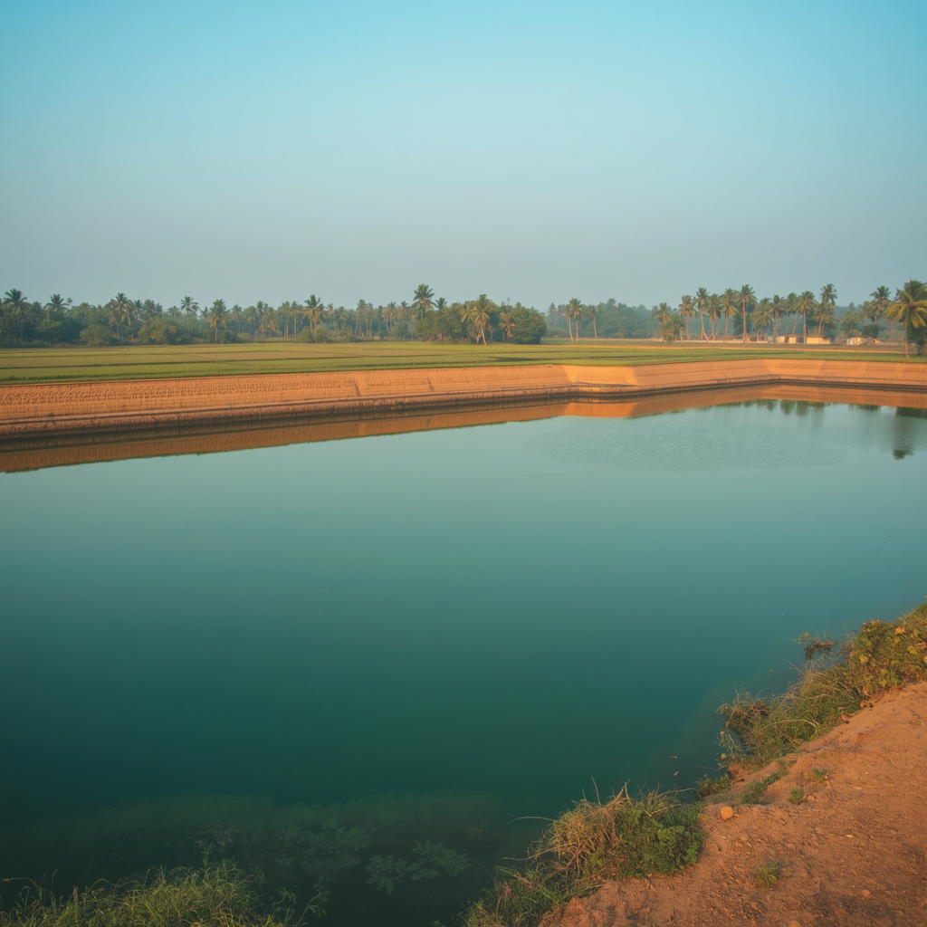






Water Wisdom of Tamil Nadu
WATER WISDOM OF TAMIL NADU
Science, Management and Governance of a Thousand-Tank Landscape
A P Mayandi | 19 July 2026

Slide 2


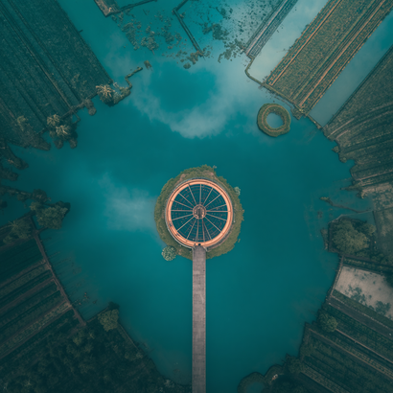
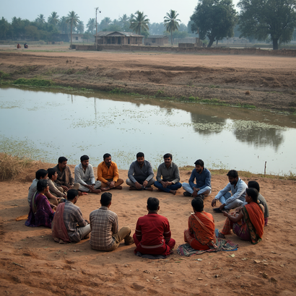
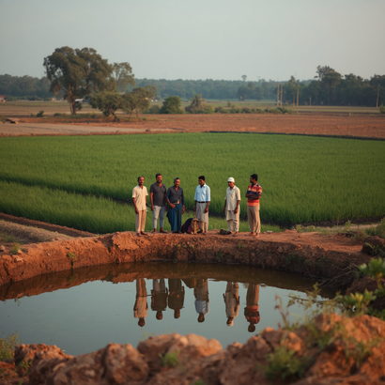
Roadmap for Today's Briefing
Water & Science
Governance & Reform
Case Study & Policy
  Water Context in Tamil Nadu — rainfall patterns, tank heritage, and the 35% decline in irrigated area
  Science of the Eri Cascade — hydrology, groundwater recharge, and multi-use cascade logic
  Governance Then and Now — from community kudimaramathu to colonial PWD split, and participatory reform since 2000
  Villur Chain of Tanks Case Study — participatory rehabilitation of an interconnected cascade
  Lessons for Policy — cascade-scale planning, equity, and institutional strengthening

Slide 3

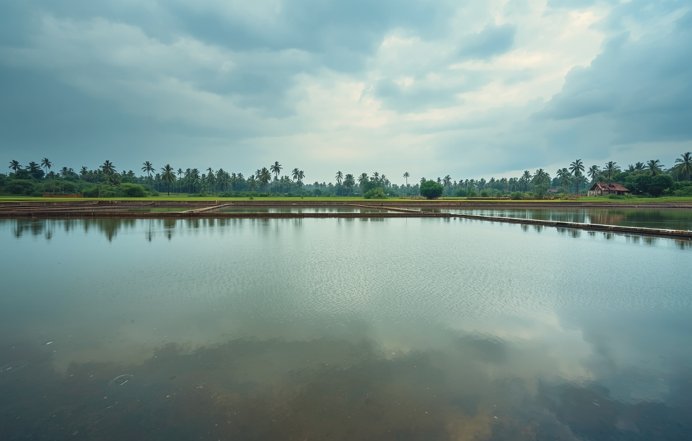


Water Context in Tamil Nadu
Tamil Nadu faces a uniquely precarious water situation. No major perennial rivers originate within the state, leaving communities almost entirely dependent on seasonal rainfall. Nearly all precipitation — concentrated in just 60 days — arrives during the northeast monsoon between October and December. This narrow window of water availability has shaped the landscape, agriculture, and society of Tamil Nadu for centuries, giving rise to one of the world's most extensive traditional water harvesting systems.
Key Water Facts and Challenges
41,000+ traditional tanks (eri/kanmai) recorded in early 2020s
~60 rain days per year, concentrated in northeast monsoon (Oct–Dec)
35% drop in tank-irrigated area from late 1970s to mid-2000s
No major perennial rivers originate in Tamil Nadu
Sources: Vaidyanathan (2001); Palanisami & Meinzen-Dick; Tamil Nadu Water Resources Dept

Slide 4

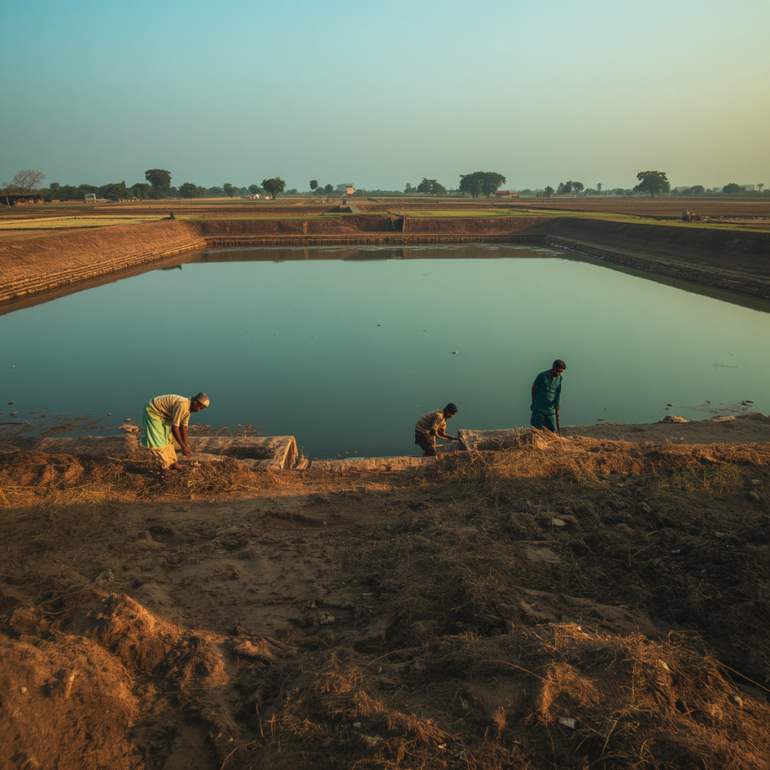


Science of the Eri Cascade
Tanks are linked along a natural gradient; surplus water (kalingu/weir overflow) from one tank flows into the next, creating a self-regulating cascade that distributes runoff across the landscape.
Cascade
Hydrology
Tank-bed percolation slowly recharges shallow aquifers, sustaining wells between monsoon seasons. The cascade buffers flood peaks by absorbing and staggering runoff across multiple storage units.
Groundwater
Recharge
Each tank supports layered uses: irrigation of paddy and dry crops, drinking water supply, livestock watering, inland fisheries, and silt harvested as organic fertiliser for fields.
Multiple
Uses

Slide 5

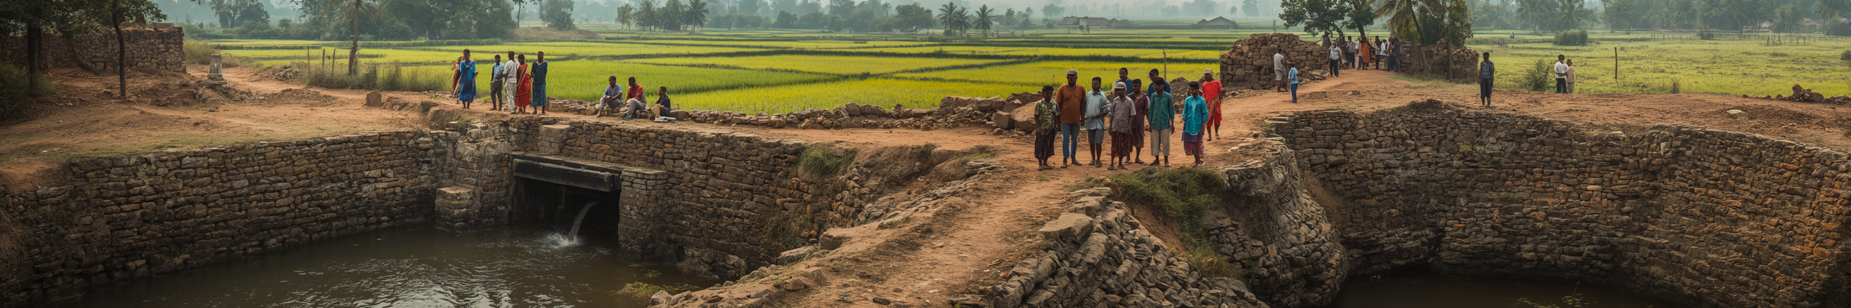
Governance History
Pre-colonial: Community stewardship via village bodies and kudimaramathu labour
Tamil Nadu's tank governance evolved from vibrant community stewardship to colonial centralisation, post-independence decline, and a gradual return to participatory reform since 2000.
Colonial era: PWD centralisation split tanks between departments
Post-independence: Community roles declined due to free inputs and groundwater
Since 2000: Participatory reform via TNFMIS Act and 2017 Kudimaramathu Scheme

Slide 6

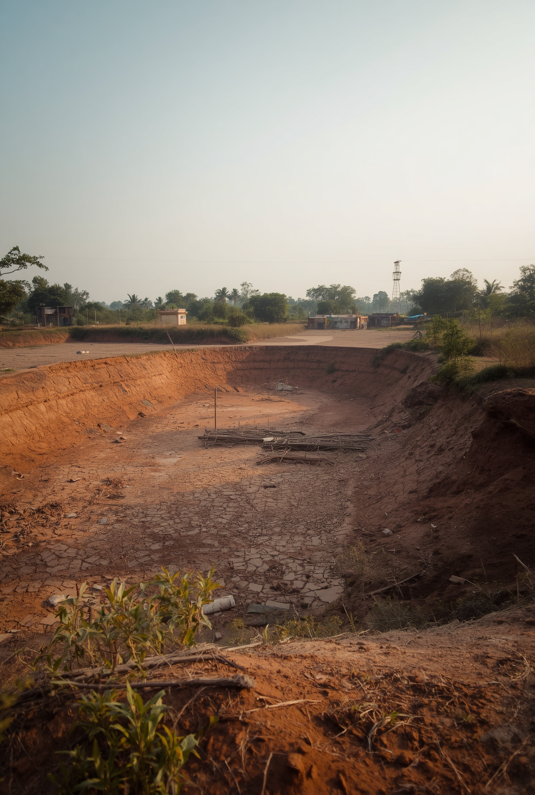

The Cost of Losing Institution, Not Just Infrastructure
When collective systems unravel, landscapes pay the price.
Private borewells enable individual exit from the collective system — eroding the incentive to maintain shared tanks. Encroachment into tank beds, foreshores, and feeder channels by housing, agriculture, and roads reduces storage capacity. Kudimaramathu labour obligations weaken, and WUAs exist on paper only — especially for smaller tanks.

Slide 7



2000 TNFMIS Act — WUA Formation
Two Reforms, Two Decades Apart
Water User Associations created on a hydraulic basis for larger PWD tanks. Mandate covered warabandi planning, routine maintenance, and Distributary Committee coordination.
2017 Kudimaramathu Scheme — Community Desilting
Phase I: 1,519 minor tanks, ₹100 crore. Phase II: 2,065 tanks, ₹332 crore. Community-led participatory desilting with local labour contribution at the core.
Shared Goals, Different Gaps
Tamil Nadu introduced two landmark reforms to revive its tank irrigation systems. The 2000 TNFMIS Act formalised Water User Associations for larger PWD tanks, while the 2017 Kudimaramathu Scheme mobilised communities for participatory desilting of minor tanks across the state.
Both reforms target tank revival but differ in scale and approach. TNFMIS focused on institutional structures; Kudimaramathu on physical restoration. Activists continue to push for legal backing for panchayat-managed minor tanks.
The Institutional Gap
WUAs under TNFMIS remain weak for smaller tanks. Kudimaramathu's desilting gains risk erosion without sustained institutional support. Cascade-level planning and legal recognition remain unfinished agenda items.

Slide 8

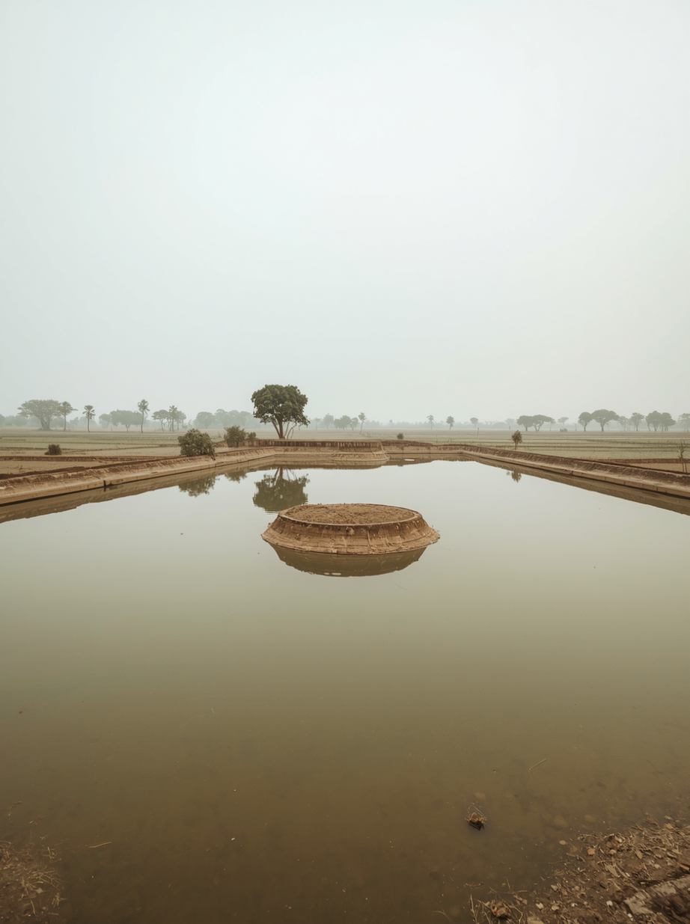


Villur Chain of Tanks
Case Study Introduction: A Model for Participatory Rehabilitation
The Villur Chain of Tanks, documented in a landmark IIED (2001) participatory study, offers a compelling model for how interconnected tank cascades — not isolated tanks — should be the unit of planning. By studying the full hydraulic chain, researchers and communities together revealed the hydrological and institutional logic that single-tank approaches routinely miss.

Slide 9
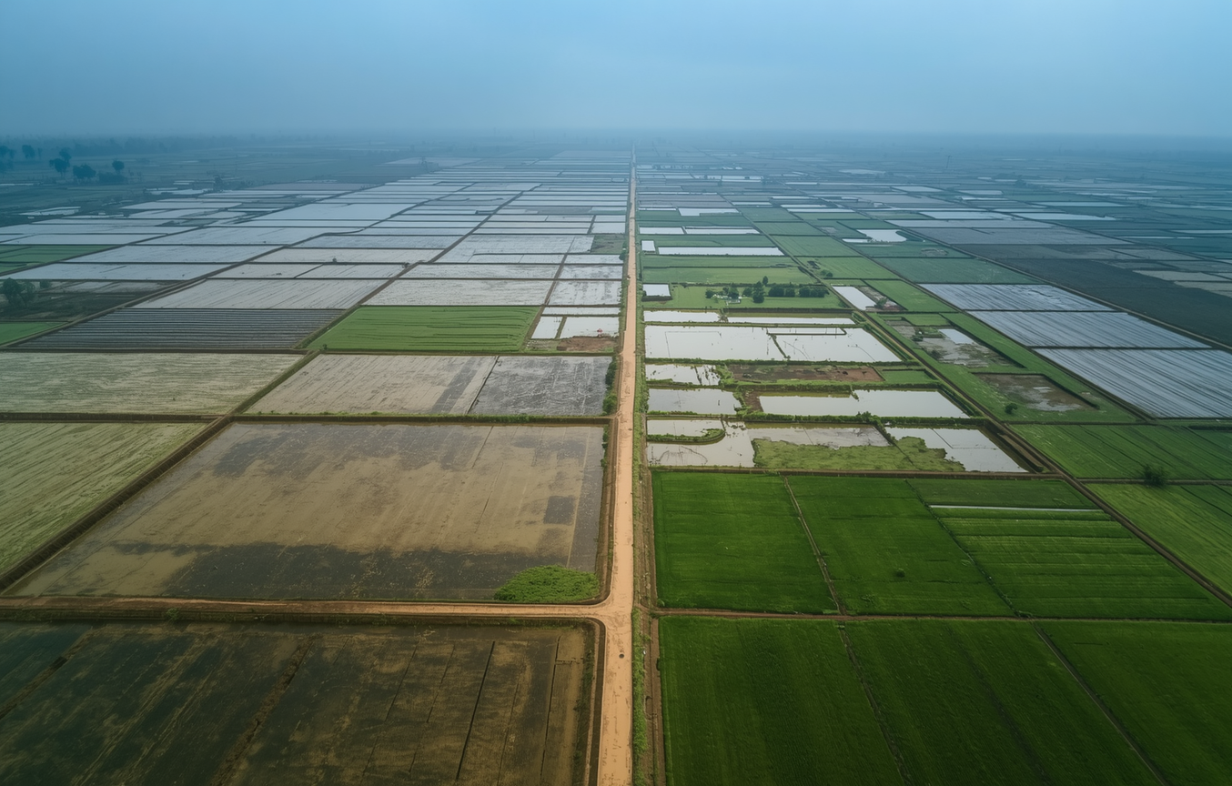
Why a Chain of Tanks, Not a Single Tank?
Rehabilitating a single tank in isolation misses the fundamental hydrological reality of Tamil Nadu's tank landscape. Tanks are not independent units — they are nodes in a cascade system, where surplus water from one tank flows via weirs and surplus channels into the next downstream tank. A repair that ignores the chain may solve one problem while creating or worsening another. The Villur study, grounded in Participatory Rural Appraisal (PRA), was designed to capture this interconnected reality — bridging the gap between the 2000 TNFMIS Act and the 2017 Kudimaramathu Scheme.
Cascade Logic: The Core Principle
Surplus (kalingu) from upstream tank feeds the next downstream tank
Single-tank fixes disrupt cascade water balance and equity
Tail-end farmers bear the cost of upstream-only rehabilitation
PRA tradition: farmers map the full cascade, not just their own tank
Villur study bridges TNFMIS Act (2000) and Kudimaramathu (2017)

Slide 10
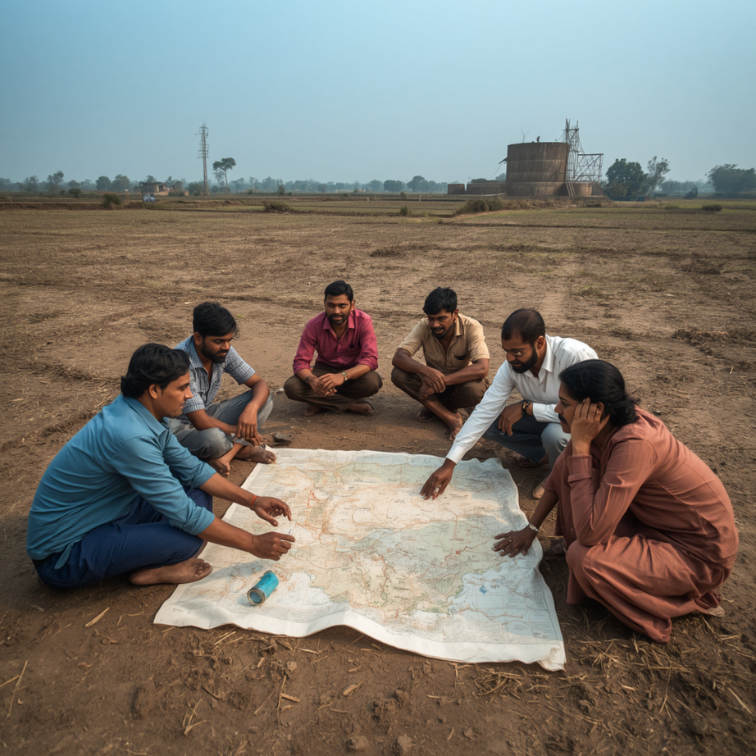
Methodology: PRA Approach
Participatory Rural Appraisal conducted across the full Villur cascade, engaging farming communities at each tank in the chain to document hydrological and institutional conditions.
Field-Based PRA
Farmers mapped physical layout of sluices, surplus weirs, feeder channels, and encroachments — capturing local knowledge unavailable in official engineering records.
Farmer-Led Mapping
Farmer knowledge on siltation, breach history, and cropping patterns was cross-checked against engineering survey data, bridging community insight with technical measurement.
Cross-Validation

Slide 11
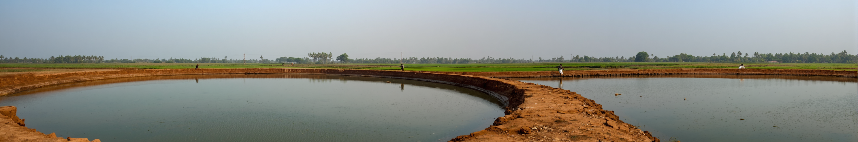
What the Chain Revealed
Cascade logic more effective than isolated single-tank rehabilitation
The Villur participatory study produced findings that challenged conventional single-tank engineering approaches and demonstrated the value of cascade-scale, community-led rehabilitation across interconnected tank systems.
Local farmer knowledge outperformed generic engineering design
Equity of water access to tail-enders required active, deliberate attention
Institutions revived faster than infrastructure had deteriorated

Slide 12

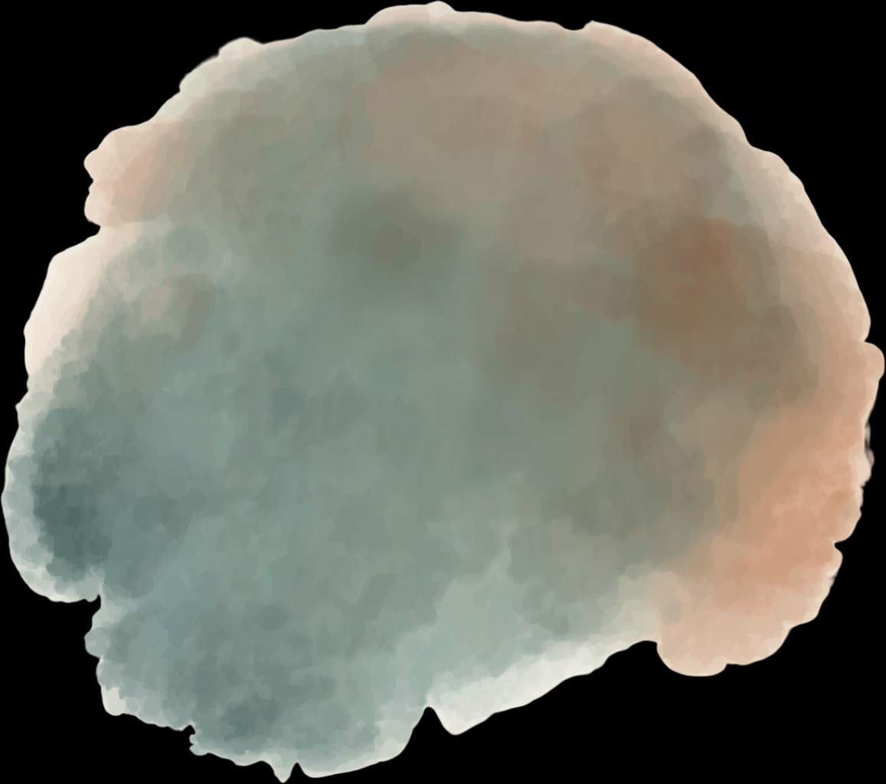
Unit of Planning
Old default: single tank treated in isolation. Villur-informed: whole cascade and hydraulic chain planned and funded as one integrated unit.
Governance Design Comparison
Design Authority
Old default: engineer alone determines design. Villur-informed: engineer and farmer knowledge cross-checked and validated together before works begin.
Beneficiary Equity
Two contrasting approaches to tank rehabilitation: the old default practice that treated each tank in isolation, versus the Villur-informed model that recognised the hydraulic chain as the true unit of planning and management.
Old default: head-reach farmers prioritised; tail-enders marginalised. Villur-informed: tail-enders and marginal farmers included deliberately as a funded condition.
Institutional Legacy
Old default: institution dissolves when project ends. Villur-informed: rehabilitation seeds an ongoing WUA or Kudimaramathu-style body with clear roles and mandate.

Slide 13

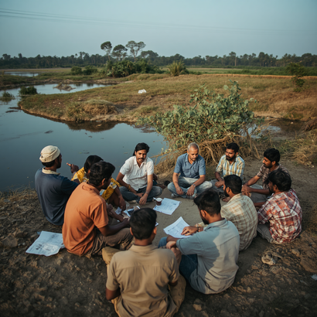
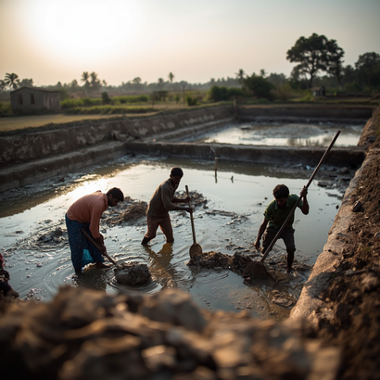
From Evidence to Policy: 2001 Field Study and 2017 Programme
2000 TNFMIS Act
2001 Villur Chain Study
2017 Kudimaramathu Scheme
Water User Associations (WUAs) established on hydraulic basis for larger PWD tanks; introduced warabandi planning, maintenance roles, and Distributary Committees.
IIED participatory study of Villur Chain of Tanks demonstrated cascade-scale rehabilitation, bridging farmer knowledge and engineering practice — a critical evidence milestone.
Community participatory desilting of minor tanks: Phase I (1,519 tanks, ₹100 crore); Phase II (2,065 tanks, ₹332 crore). Policy choices in the gap years 2001–2017 remain critical.

Slide 14


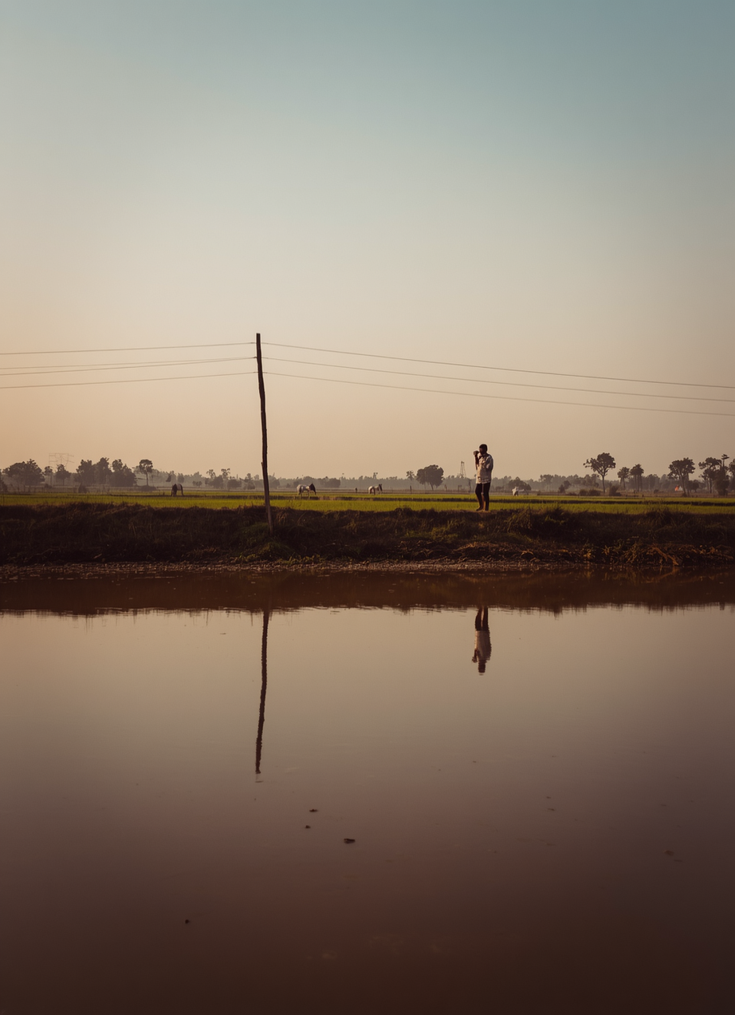

Five Asks for Policymakers
Tamil Nadu's tank heritage offers a proven blueprint. The following five asks translate field evidence—from Villur and beyond—into concrete policy commitments. Each ask targets a specific gap between current practice and what cascade-scale water management requires to succeed at scale.
From Evidence to Action: Policy Recommendations
Plan and fund rehabilitation at the cascade level, not tank by tank
Extend legal backing and formal recognition to minor panchayat tanks
Build in equity checks: tail-ender and marginal-farmer representation as funding conditions
Fund institutions, not just desilting—WUAs need resources and legal standing
Monitor and publish outcomes: storage, cropping intensity, and institutional survival post-Kudimaramathu

Slide 15
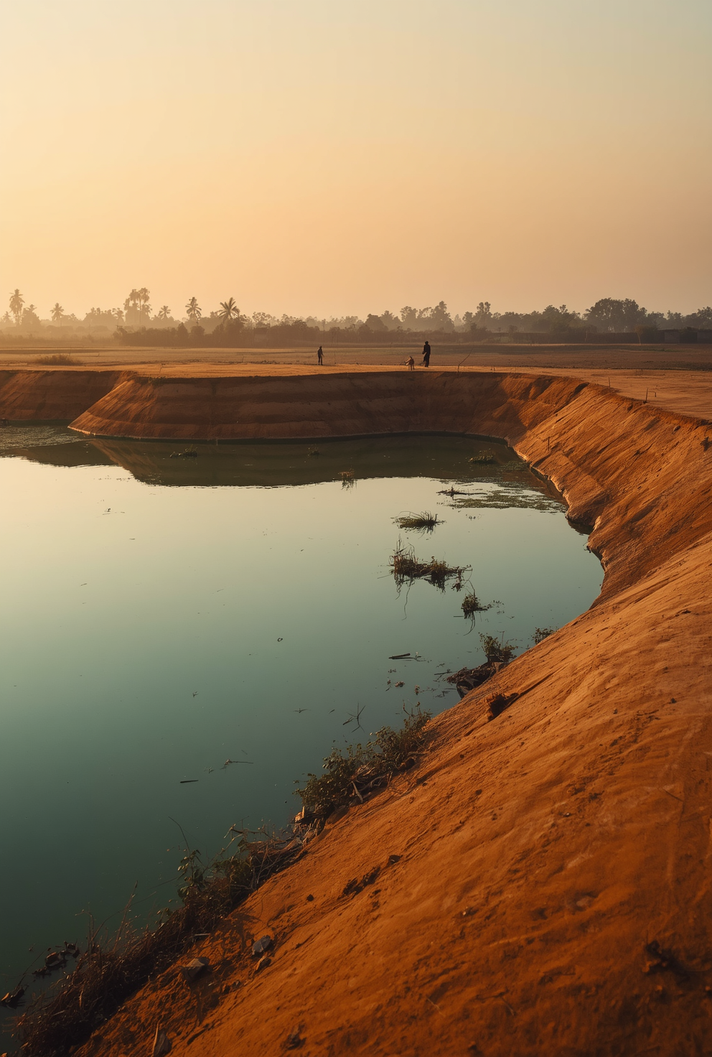
Closing Thought: Institutional Task Ahead
Tamil Nadu wrote the playbook — tank by tank.
In the 1990s and early 2000s, Tamil Nadu pioneered participatory water governance through field studies, community desilting, and cascade-level thinking. The science is understood. The models exist. The current challenge is entirely institutional: fund rehabilitation at cascade scale, legislate protection for minor tanks, and monitor outcomes beyond project closure.

Slide 16
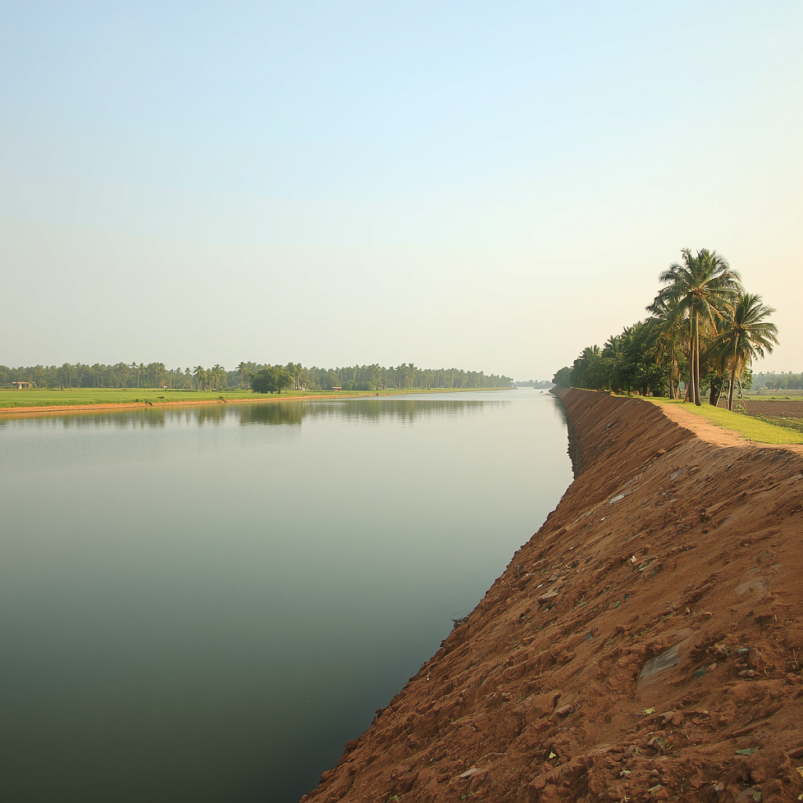
Water Wisdom of Tamil Nadu
DEEP DIVE:
VILLUR CHAIN OF TANKS
An in-depth exploration of participatory rehabilitation across an interconnected cascade of tanks in Tamil Nadu
Case Study Extension

Slide 17
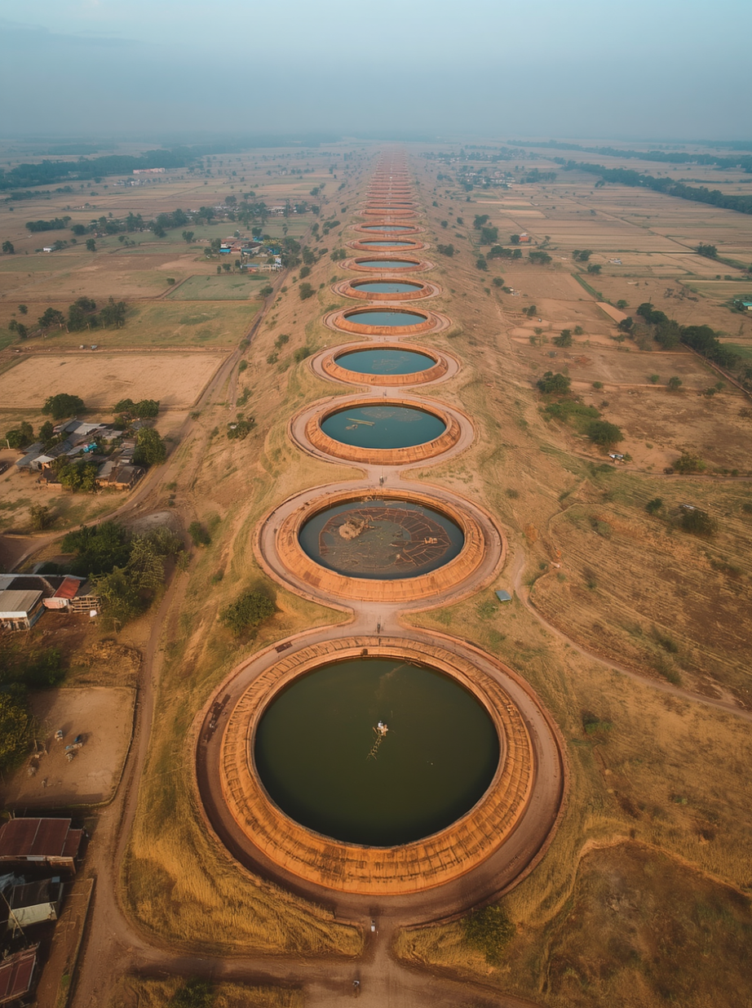
Villur Chain of Tanks: Location & Map
Geographical Context: Spatial Layout within Tamil Nadu
The Villur chain of tanks is situated in the rain-fed agricultural belt of Tamil Nadu, within a sub-watershed defined by gentle topographic gradients. The cascade comprises multiple interconnected tanks aligned along a natural drainage corridor. Total ayacut (command area): [placeholder]. Key features include upstream storage tanks, surplus weirs (kalingus), feeder channels, and tail-end irrigation zones serving marginal farmers. Surrounding villages and water bodies confirm the hydraulic interdependence of the chain.

Slide 18
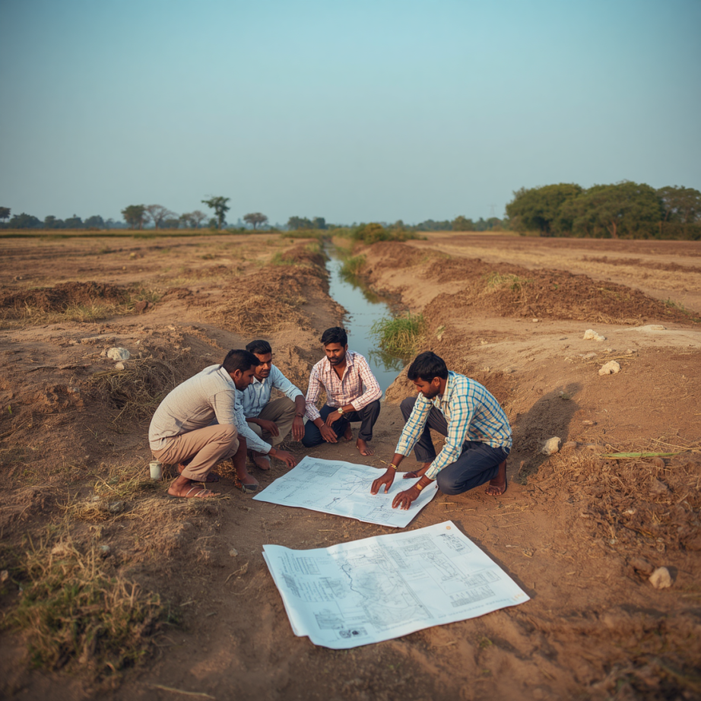
Villur Methods and Fieldwork Details
PRA Sessions
Multiple participatory rural appraisal sessions conducted across the full Villur cascade, engaging farmers, women irrigators, and tail-end cultivators in structured group discussions and field walks.
Tools Used
Participatory mapping of sluices, surplus channels, and encroachments; transect walks along feeder channels; focus group discussions on siltation history, breach records, and seasonal cropping patterns.
Farmer-generated spatial and historical data cross-checked against engineering survey measurements and water-flow records, bridging local knowledge with technical assessment to produce a validated rehabilitation plan.
Cross-Validation

Slide 19
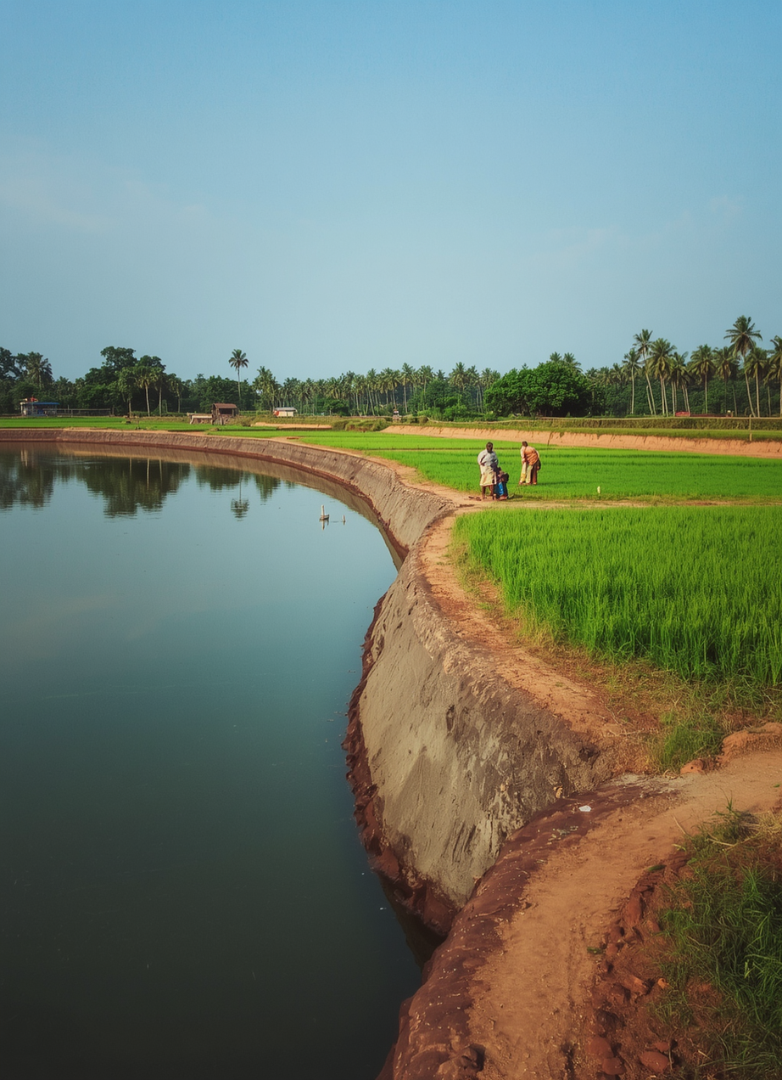
Villur Results and Lessons Learned
The Villur Chain of Tanks rehabilitation demonstrated that cascade-scale, participatory interventions deliver measurable gains in storage, equity, and institutional resilience—outcomes unachievable through single-tank, top-down engineering alone.
Key Outcomes and Wider Implications
Storage & command area restored across multiple linked tanks in the chain
Community labour contributions reduced external costs; farmer–engineer synergy proved essential
Cropping intensity increased and diversification improved post-rehabilitation
Institutional revival: active WUAs re-established; kudimaramathu practices renewed
Cascade-scale planning outperformed single-tank fixes—hydrological reality respected
Local knowledge integration improved design accuracy and equity of water access

