Slide 1
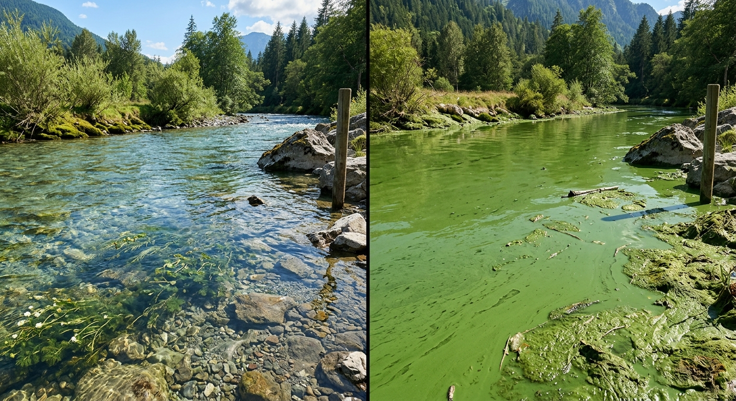
Water Scarcity Beyond the Numbers: Practical Lessons from Global Water Crises
Theme: The Crisis of Degradation
By
Mr Kartik Omanakuttan

Slide 2

Ecosystem Degradation
Ecological & Health
Toledo Toxic Crisis
Global Coral Bleeching
Governance Mismatch
Aquatic Connectivity

Slide 3
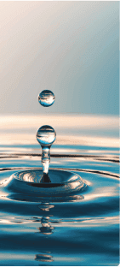
Water Quality — Recap
Natural water is never just H2​O; its chemistry serves as a diagnostic record of every landscape, farm, and settlement it has travelled through.
Water quality is not an absolute physical property but a functional relationship between chemistry, biology, and the intended purpose, such as drinking, irrigation, or ecosystem support.
Quality is often the final arbiter of water availability; a river with adequate flow remains unavailable if it cannot support the life or uses for which it is needed.
Transparency is a deceptive indicator, as dangerous chemical risks—such as arsenic or nitrate—are often colourless, odourless, and entirely invisible to the naked eye.

Slide 4
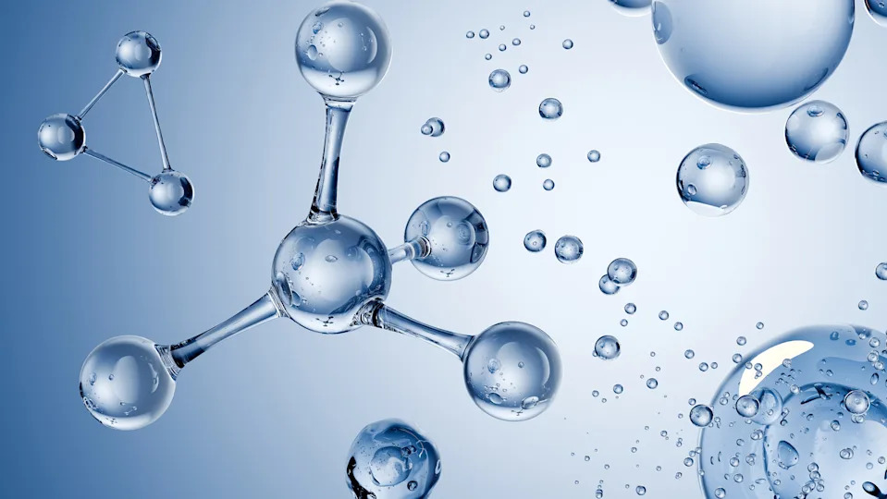
Chemical Parameters:
  pH: Influences the solubility and toxicity of metals and determines the survival range for most aquatic organisms.
  Electrical Conductivity (EC): A proxy for total dissolved ions, used to detect salinity intrusion, industrial discharge, or irrigation return flows.
Oxygen Dynamics:
  Biochemical Oxygen Demand (BOD): A primary indicator of organic pollution, measuring the oxygen required by microbes to decompose organic matter.
  Hypoxia Threshold: When dissolved oxygen falls below 2 mg/L, "dead zones" form where most fish and invertebrates cannot survive.
Eutrophication:
  Nutrient enrichment (Nitrogen and Phosphorus) triggers a chain reaction where algal blooms cloud water, shade out plants, and eventually consume all available oxygen during decomposition.

Slide 5
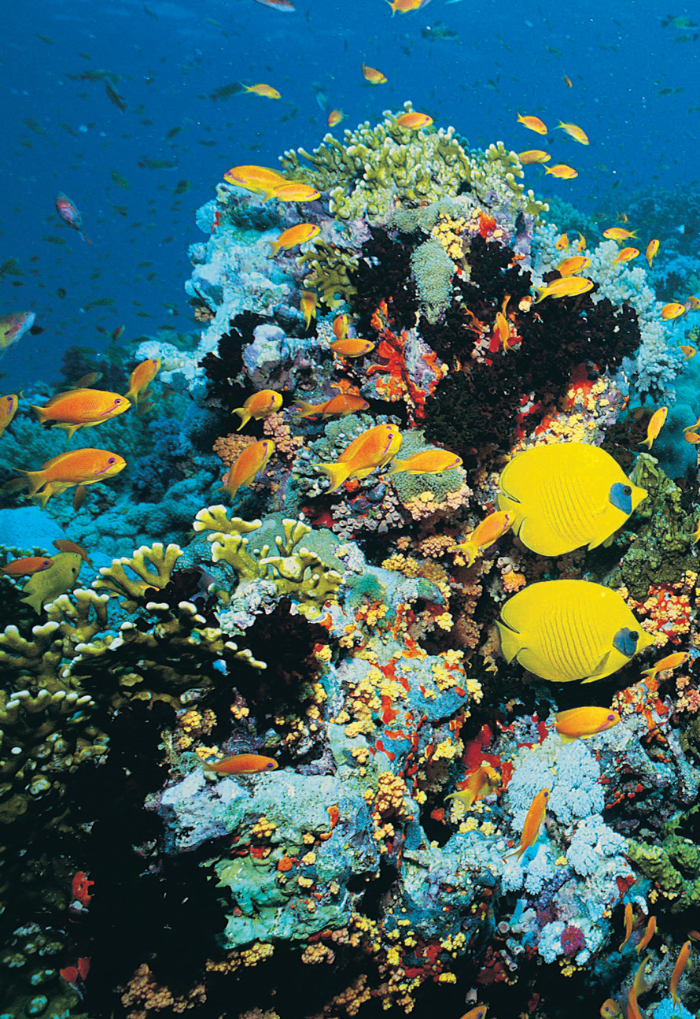
Aquatic Biodiversity — Recap
A river must be understood as a living community of organisms and functional relationships, rather than merely a pipeline for conveying water.
Biodiversity depends on 3D connectivity: longitudinal (headwaters to sea), lateral (river to floodplain), and vertical (surface to groundwater).
Biodiversity loss is rarely a single event; it is a path-dependent process where each incremental stress makes the system's eventual recovery progressively harder.
This Photo by Unknown Author is licensed under CC BY-SA-NC

Slide 6
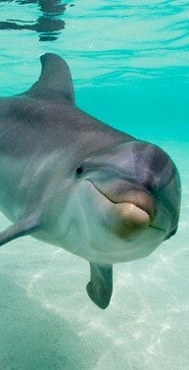
Approximately one-quarter (25%) of all known freshwater species are currently threatened with extinction.
Species loss is technically the removal of "nodes" in a network, which simplifies food webs and destroys the functional redundancy that provides ecosystem resilience.
Hydrological Fragmentation:
  Infrastructure Impact: Over 60% of large rivers globally are fragmented by dams and diversions.
  Flow Disruption: Dams flatten the natural hydrograph, removing the seasonal "flood pulse" cues required for fish reproduction and sediment transport.
Invasive Species and Economic Cost:
  The spread of invasive species like Zebra mussels, cause roughly $1 billion in annual infrastructure damage in North America alone.
This Photo by Unknown Author is licensed under CC BY-NC

Slide 7
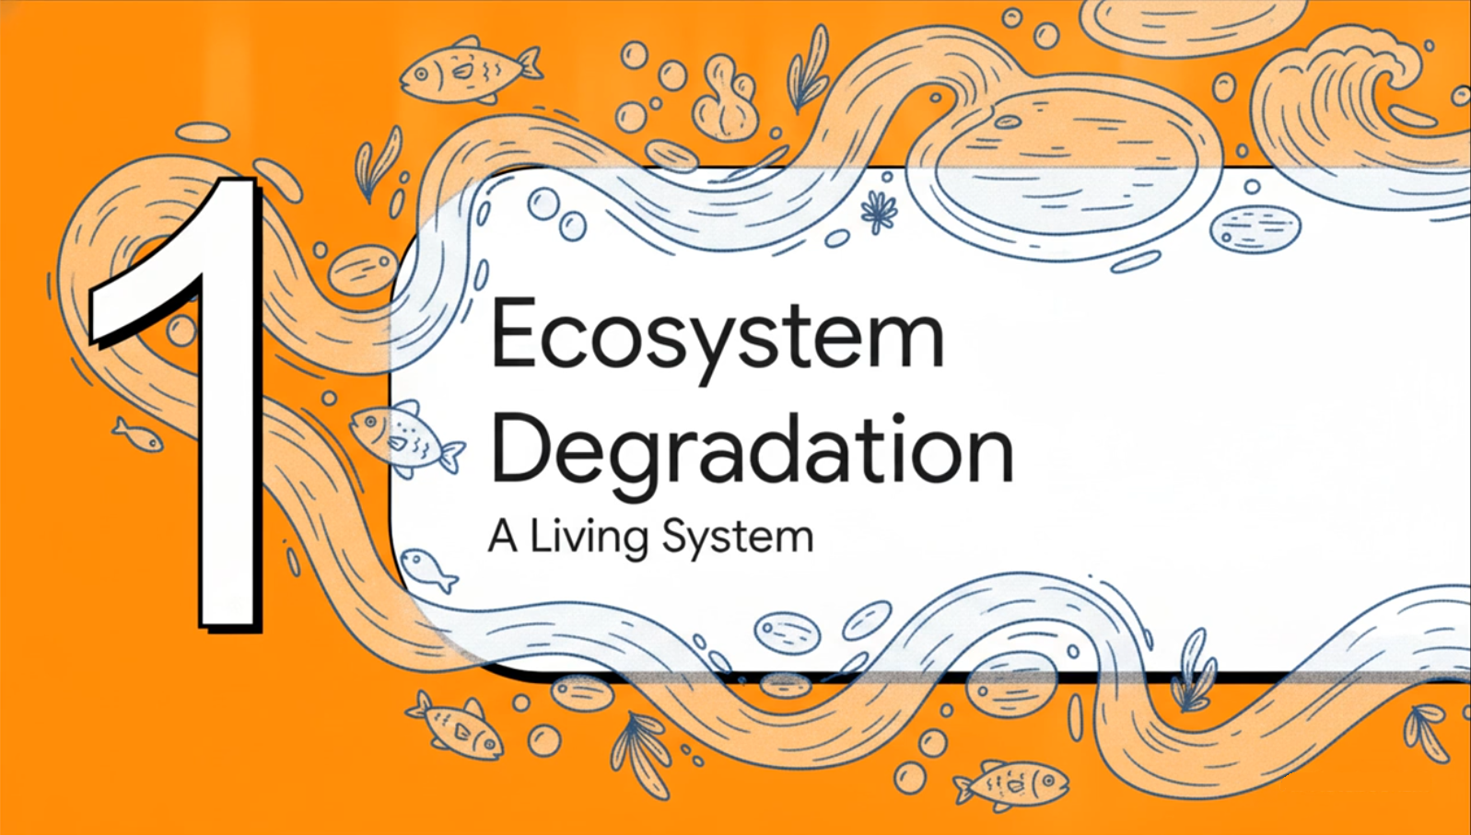

Slide 8
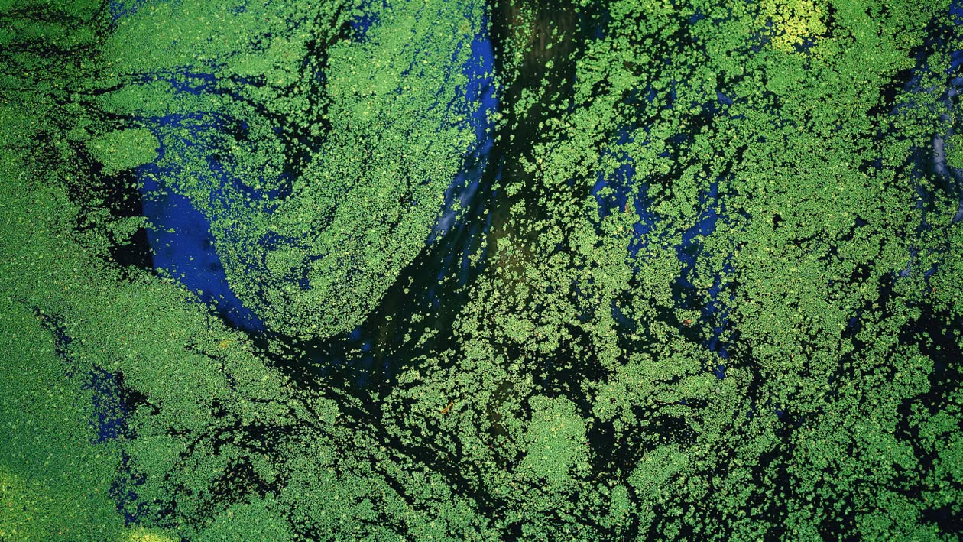
Loss of Biological Integrity
Degradation is defined as the progressive loss of biological integrity—the weakening and eventual collapse of the structures and processes that allow an ecosystem to function. This results in a reduced capacity for the system to deliver essential ecosystem services, such as:
  Regulating services: Flood buffering and natural water purification.
  Provisioning services: Sustainable fisheries and clean freshwater.
  Cultural services: Recreational, spiritual, and aesthetic values.

Slide 9
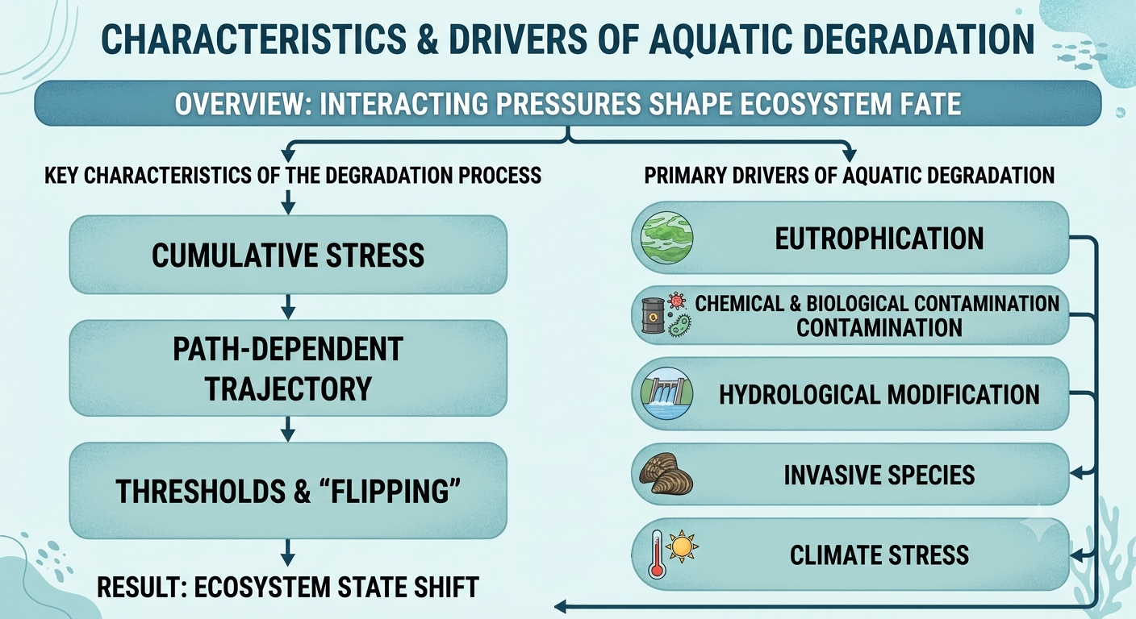

Slide 10
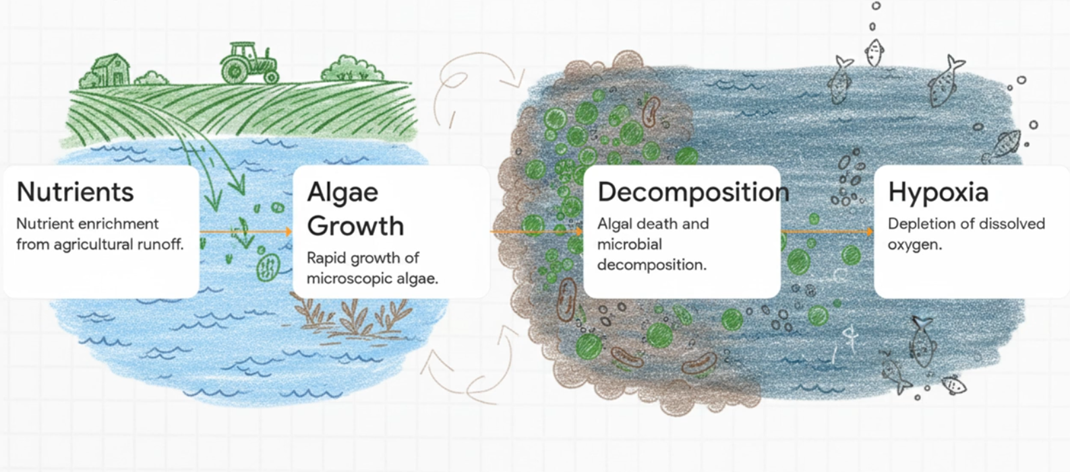
Eutrophication

Slide 11
Nutrient Enrichment: The "Fuel" for Degradation
Eutrophication is primarily driven by excessive loads of nitrogen (N) and phosphorus (P). While urban wastewater contributes, the dominant driver is agricultural runoff, where fertilizers move from fields into water bodies through landscape drainage.
Eutrophication follows a predictable sequence:
Algal Blooms: High nutrients trigger the rapid growth of microscopic algae (phytoplankton).
Light Blocking: These algae cloud the water, shading out bottom-dwelling plants (macrophytes) that provide habitat and oxygen.
Death & Decay: As the short-lived algae die and sink to the bottom, they create a massive amount of organic "waste".
Oxygen Depletion: Bacteria move in to decompose this organic matter, consuming dissolved oxygen in the process. This leads to hypoxia (oxygen levels below 2 mg/L), often resulting in "dead zones".
Eutrophication
Light Blocking
Death & Decay
Oxygen Depletion
Algal Bloom

Slide 12
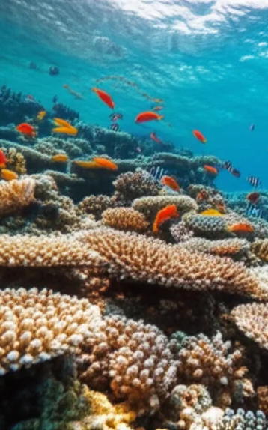
The Tipping Point
Ecosystems do not always change gradually. Once a specific nutrient threshold is crossed, a lake can suddenly "flip" from a clear-water, plant-dominated state to a turbid, phytoplankton-dominated state.
System Transformation: This is a fundamental transition between ecological states where the biological integrity and functioning are severely compromised.
But why recovery is difficult?

Slide 13

Why recovery is difficult?
Self-reinforcement
Resilience
These mechanisms make the turbid condition highly stable and difficult to reverse, even if the original nutrient inputs (from farms or factories) .are significantly reduced.
Legacy effects
Nutrients stored in the bottom sediments may continue to "feed" the cycle for years, a challenge known as internal loading.
Once a system has "flipped" into a degraded state, it develops feedback loops that work to keep it there.
No recovery

Slide 14

"Invisibility in Time" and Governance Gaps

Slide 15
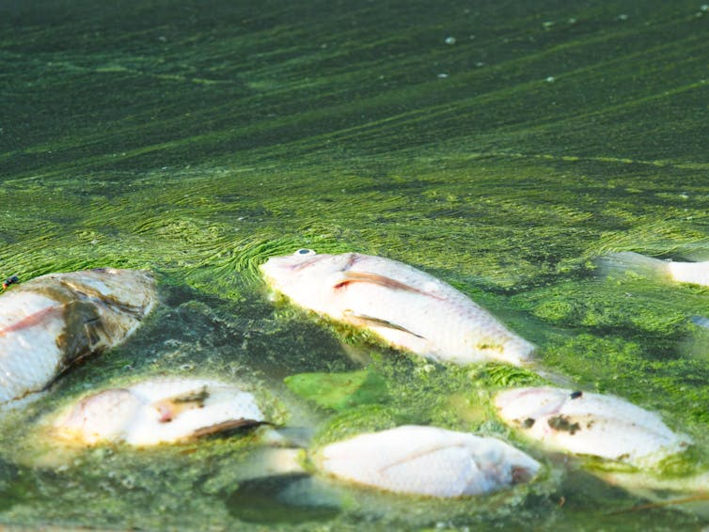
Sub-Surface Decay
Contrast with Visible Disasters: Unlike a factory fire or a sudden flood, aquatic degradation is often invisible to the naked eye because it proceeds silently below the water's surface.
Incremental Loss: The system does not collapse all at once; it erodes species by species and function by function. This gradual decay makes it difficult for the public to perceive the scale of the damage until it is advanced.
This Photo by Unknown Author is licensed under CC BY-SA

Slide 16
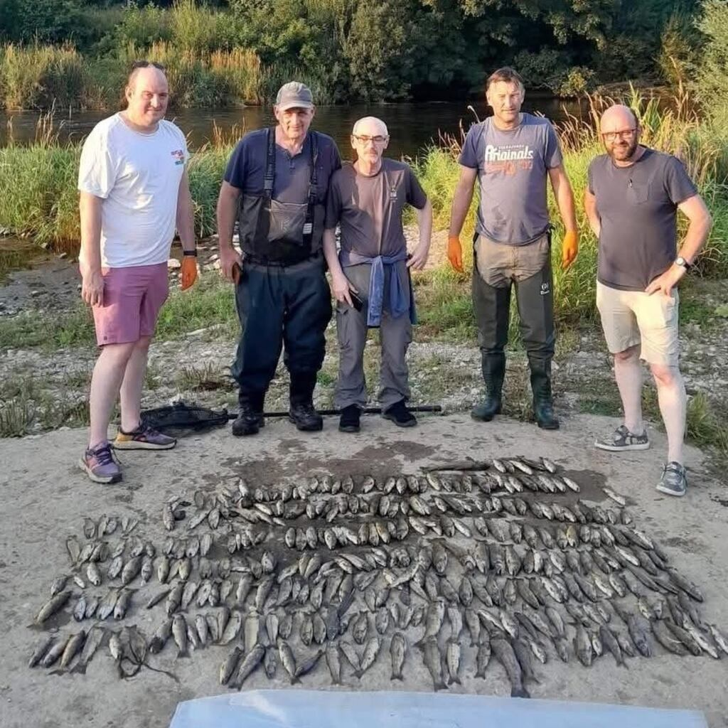
Diffuse Signals vs. Institutional Inertia
The "Silent" Warning Signs: Early indicators—such as a slow decline in dissolved oxygen or the gradual disappearance of a specific fish species—are often diffuse and gradual.
Delayed Response: Because these signals are not dramatic, governance institutions rarely take action until a visible crisis occurs, such as a mass fish kill, a drinking water failure, or a toxic algal bloom. By then, years of accumulated damage are already embedded in the system.

Slide 17
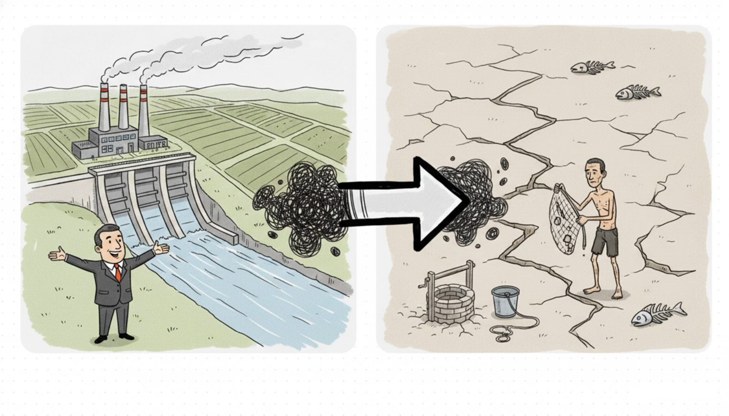
Governance Failure: The Externalisation of Costs
Not an Accident: Ecosystem degradation is not simply a result of nature being fragile; it is a predictable governance outcome.
Private Profit vs. Public Cost: "Powerful economic actors" (e.g., industrial agriculture, hydropower, and mining firms) are frequently permitted to externalise the environmental costs of their activities onto shared water resources.
Social Stratification: While these actors capture the benefits, the costs, such as ruined fisheries or contaminated water, are absorbed by subsistence fishers, indigenous communities, and future generations.

Slide 18
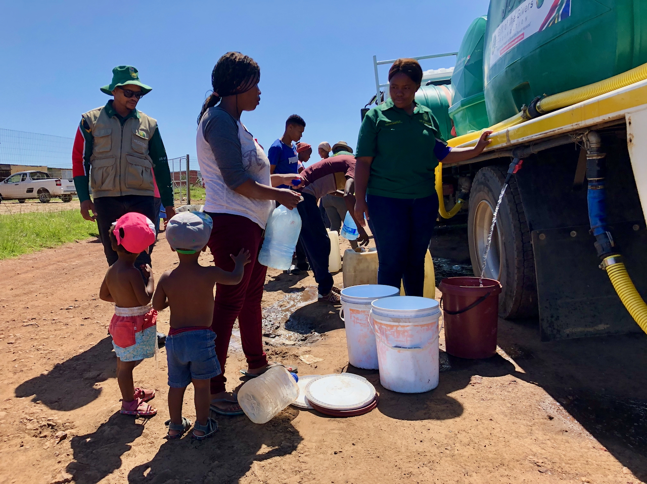
Legal Bias: Designed for Extraction
Economic Priority: Most national legal frameworks were historically designed to facilitate economic use and resource extraction rather than to protect biological integrity.
"Degradation as Policy": Because laws often prioritise single-purpose human uses (like waste disposal or irrigation) over ecological health, the resulting degradation can be seen as a literal product of existing policy.
Anthropocentric Standards: Regulations typically focus on thresholds safe for human use (drinking or swimming) but remain insufficient to protect the complex functional relationships required for a healthy ecosystem.
This Photo by Unknown Author is licensed under CC BY-ND

Slide 19
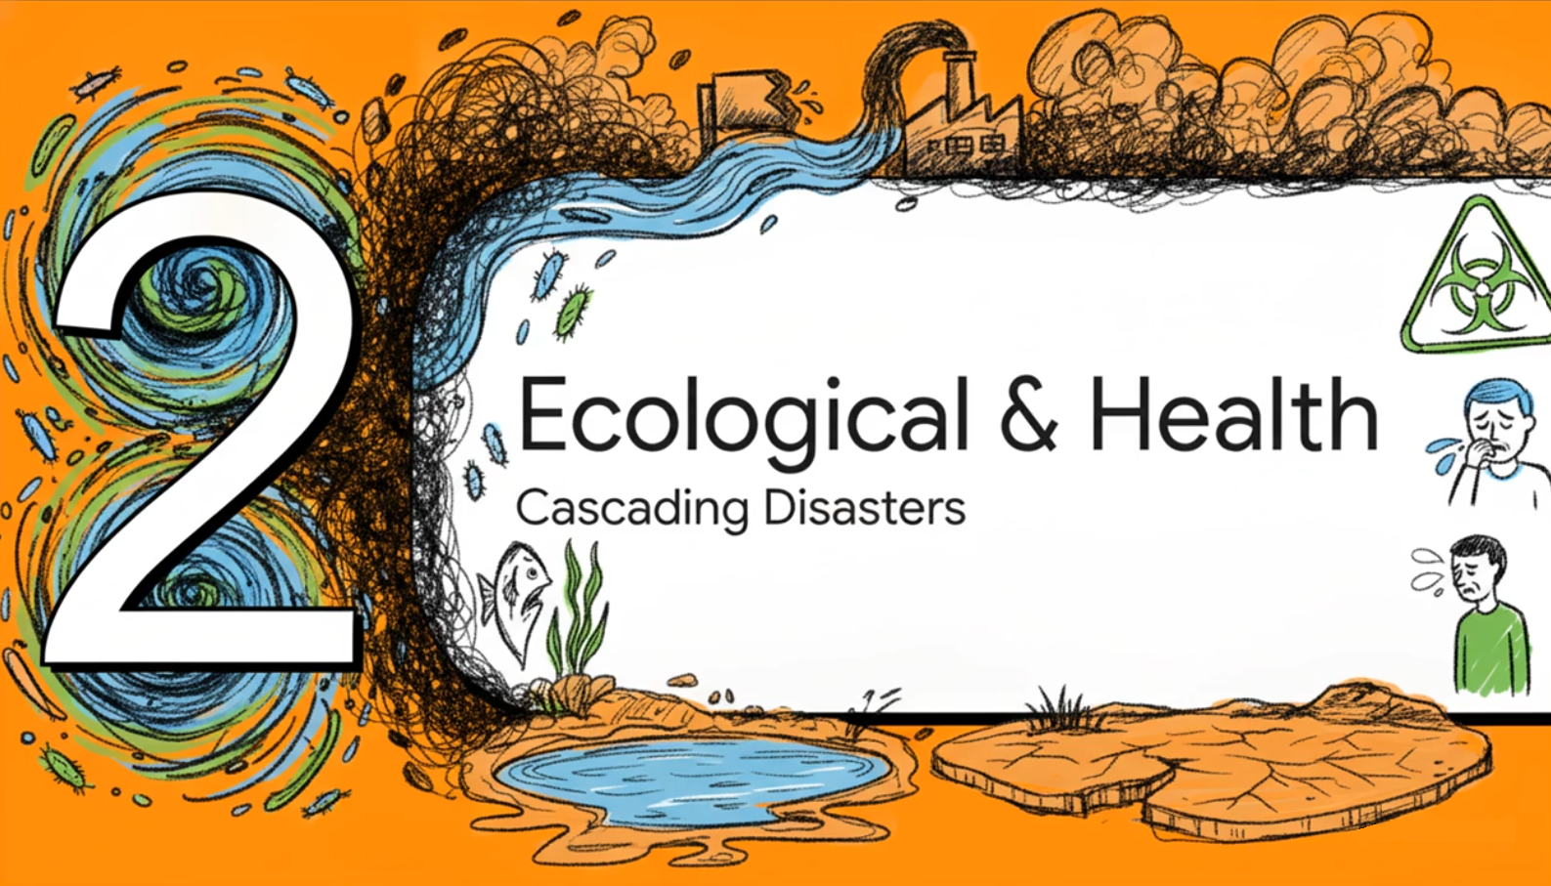

Slide 20
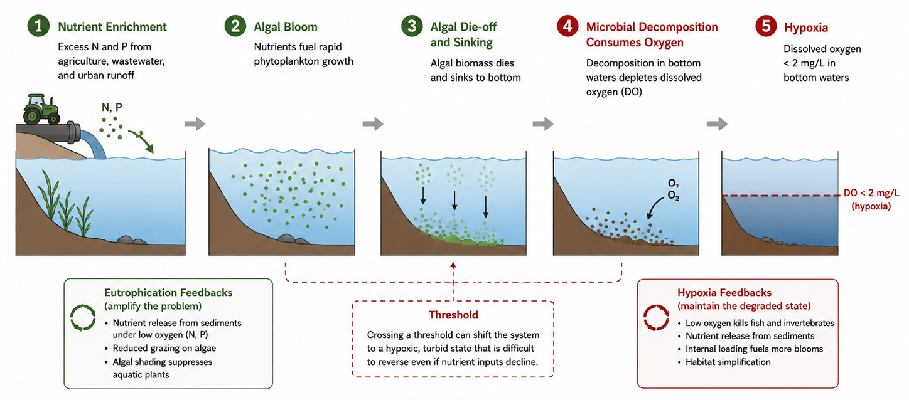
Hypoxia
Hypoxia is scientifically defined as a condition where dissolved oxygen (DO) levels fall below 2 mg/L.
While some organisms can tolerate low oxygen for short periods, this level is the critical threshold at which most fish and bottom-dwelling invertebrates cannot survive.
Mobile species (like fish and shrimp) are forced to migrate to oxygenated areas, while less mobile organisms suffocate, leading to mass mortality events known as "fish kills".

Slide 21
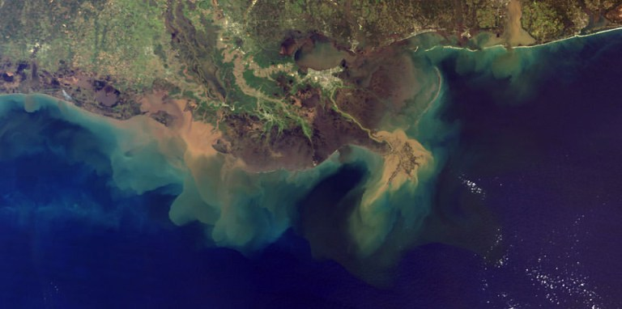
These "dead zones“, the areas where productivity collapses and biodiversity is dramatically reduced, are no longer isolated incidents.
They have been documented in more than 500 coastal systems worldwide and across hundreds of inland lakes and rivers.
In peak years, the famous "dead zone" in the northern Gulf of Mexico has exceeded 20,000 square kilometres (area larger than the state of New Jersey).
Every species in an aquatic system acts as a node in a network of ecological relationships.
These nodes include predators that regulate prey populations, invertebrates that process organic matter, and fish that transport nutrients between habitats.
Healthy ecosystems have "redundancy," meaning multiple species perform similar roles. As species are lost to hypoxia, this redundancy vanishes, leaving the system highly vulnerable to future disturbances.
The Vulnerable System
The loss of species simplifies the food web, making the entire ecosystem less stable and less capable of recovering from further pollution or climate stress.
Once these nodes are dismantled, the system often enters a degraded stable state that is resistant to restoration, even if nutrient inputs are later reduced (feedback loops).
This Photo by Unknown Author is licensed under CC BY-ND

Slide 22
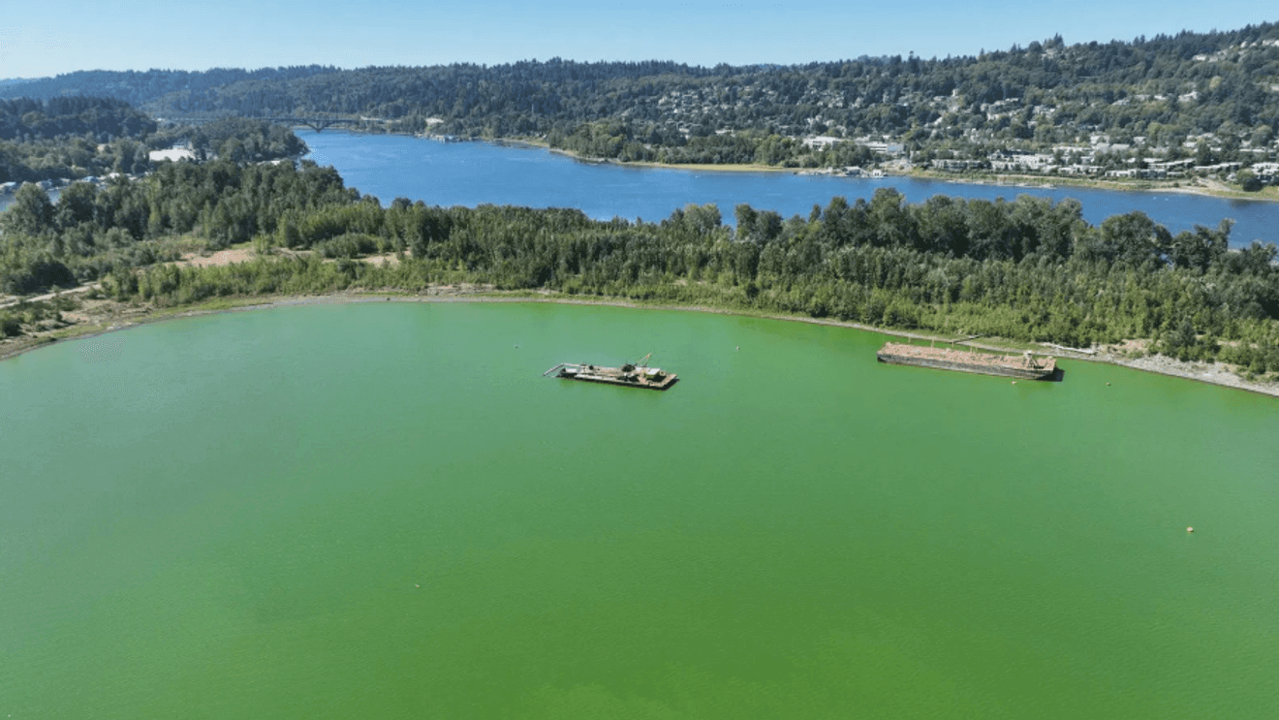
Public Health—The Cyanotoxin Threat

Slide 23
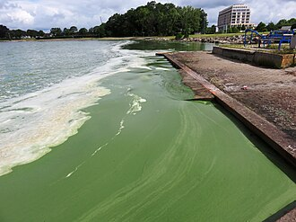
Harmful Algal Blooms (HABs): The Biological Source
HABs in freshwater systems are frequently dominated by cyanobacteria, most notably the species Microcystis aeruginosa.
Toxic blooms are no longer isolated incidents; they now affect more than 100,000 freshwater bodies globally.
These blooms are the direct result of eutrophication, where excessive nitrogen and phosphorus (often from agricultural runoff) fuel rapid, toxic biological growth.
Microcystins: Potent Biological Toxins
The primary concern with these blooms is the production of microcystins, which are classified as potent liver toxins and probable human carcinogens.
Beyond acute poisoning, long-term exposure to these toxins is linked to elevated rates of liver disease, bladder cancer, and neurological effects.
These toxins can move through the food web, concentrating in the tissues of aquatic organisms.
This Photo by Unknown Author is licensed under CC BY-SA

Slide 24
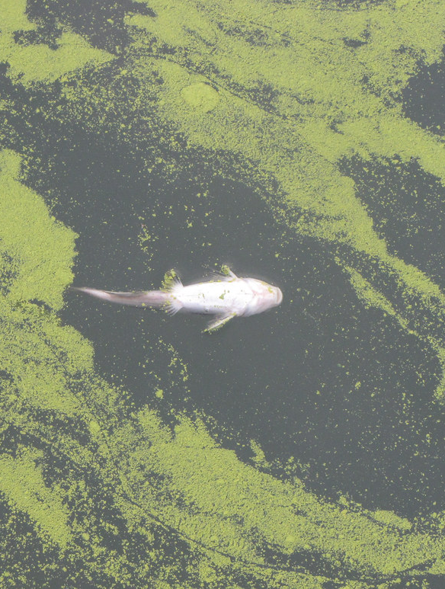
The Failure of Conventional Safeguards
Unlike many bacterial pathogens, microcystins are heat-stable. This means that boiling water does not destroy the toxin; in fact, the 2014 Toledo crisis required a "Do Not Drink, Do Not Boil" advisory.
Microcystins are resistant to many conventional water treatment methods. Removing them often requires expensive, advanced infrastructure such as activated carbon filters or advanced oxidation.
How Humans are Exposed?
Contamination of municipal supplies, which can lead to large-scale urban emergencies.
Direct exposure through the skin or accidental ingestion during swimming and boating in affected waters.
Consumption of fish or shellfish that have accumulated toxins from the environment.
Lower-income residents are disproportionately affected as they often lack the financial resources to purchase bottled water or private filtration during a bloom crisis.
This Photo by Unknown Author is licensed under CC BY-SA

Slide 25
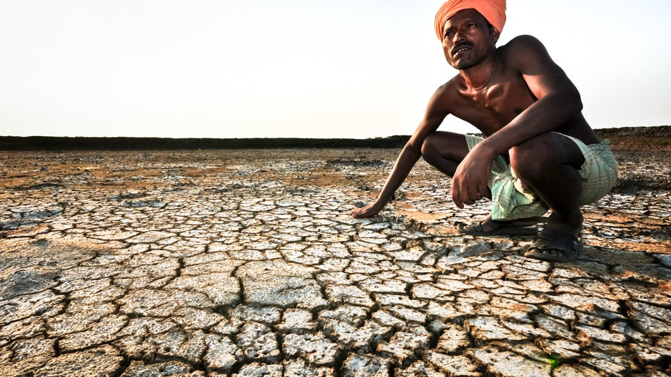
The Economic Impact of Aquatic Degradation
This Photo by Unknown Author is licensed under CC BY-SA-NC

Slide 26
Direct Cost
Loss of Wetland function
Indirect Costs
Advanced Water Treatment
Infrastructure damage
Coral reefs

Slide 27
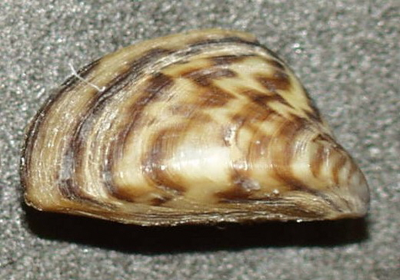
Advanced Water Treatment: When biological integrity collapses, conventional treatment is often insufficient. Utilities must invest in expensive advanced oxidation and activated carbon filters specifically to remove microcystins (cyanotoxins) from drinking water. These infrastructure upgrades can cost large utilities hundreds of millions of dollars.
Infrastructure Damage from Invasive Species: Biological degradation often includes the introduction of non-native species. For example, Zebra mussels (Dreissena polymorpha, shown below) clog industrial and municipal water intake pipes, requiring constant, costly maintenance. In North America alone, this damage is estimated at approximately US$1 billion per year.
Loss of Wetland Functions: Healthy wetlands act as natural "kidneys" for the landscape, providing water purification and flood buffering at no cost. When wetlands are drained or converted, these services must be replaced by engineered substitutes (like levees or treatment plants) that are vastly more expensive to build and maintain.
The Trillion-Dollar Value of Coral Reefs: Global reef systems provide essential services including fisheries, tourism revenue, and natural coastal wave protection. Contemporary estimates value these services at roughly US$9–11 trillion annually. As reefs bleach and die, nations lose this sovereign revenue and must spend more on artificial sea walls to protect shorelines from storms.
This Photo of Zebra mussels by Unknown Author is licensed under CC BY-SA
Notes:
The "Political Geometry" of Economic Loss
Externalisation of Costs: Degradation often allows powerful economic actors to capture private profits while externalising environmental costs onto shared water resources.
Who Pays? These economic burdens are eventually socialised. While urban areas may buffer costs through technology, low-income and subsistence-dependent communities bear the brunt of the loss through ruined livelihoods and diminished food security without any compensation.

Slide 28
“Aquatic system do not degrade because nature is fragile. They degrade because powerful economic actors are permitted to push the cost of their activities onto our shared water”

Slide 29
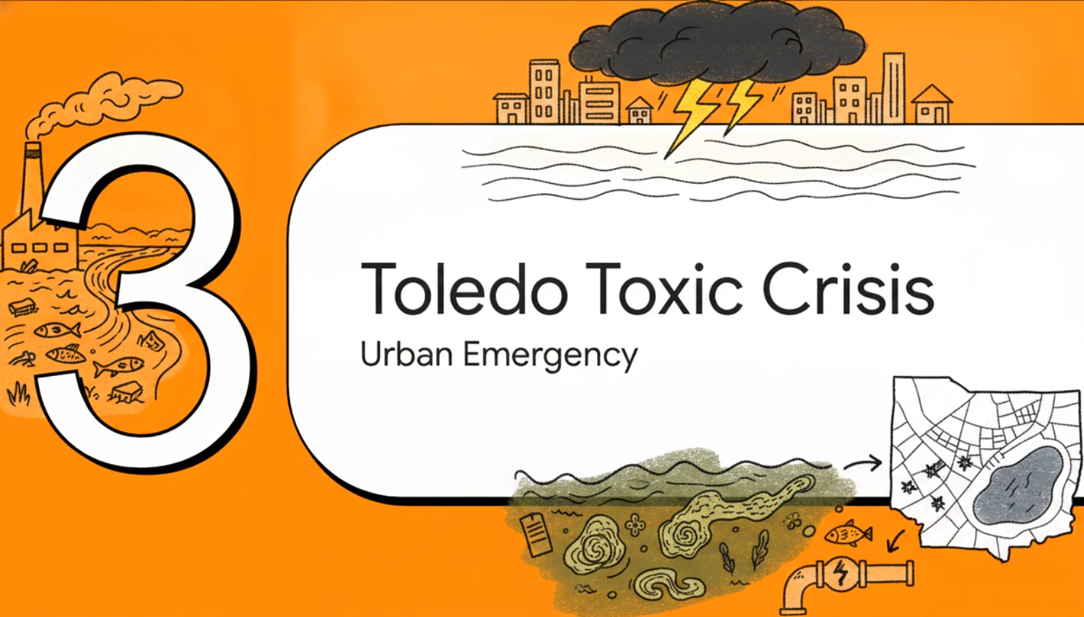

Slide 30
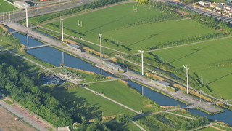
Testing at the Collins Park Water Treatment Plant in Toledo, Ohio, detected microcystin toxins above the WHO guideline of 1 µg/L in the city’s treated water. Immediately, a "do not drink, do not boil" advisory was issued, affecting approximately 500,000 people for three days.
Unlike many bacteria, microcystins are heat-stable; boiling the water does not destroy the toxin and can potentially concentrate it.
Supermarkets were stripped of bottled water within hours (described by residents as looking like "Black Friday"), and a state of emergency was declared to truck in safe water.
Massive loads of dissolved reactive phosphorus from millions of hectares of agricultural land, primarily dedicated to corn and soybean production.
Extensive networks of underground tile drains efficiently move nutrients from fields into ditches and waterways, eventually feeding the shallow, warm western basin of Lake Erie.
Satellite data shows a clear upward trend in bloom intensity since the 1990s, fueled by these nutrients and warming temperatures.
This Photo by Unknown Author is licensed under CC BY

Slide 31
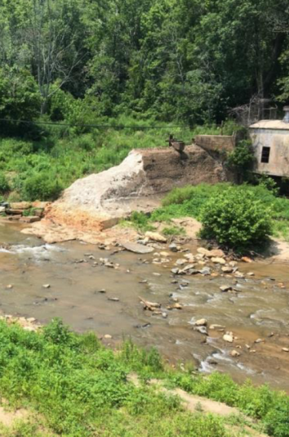
The Regulatory Gap
In most jurisdictions, agricultural runoff is classified as "non-point source pollution".
This classification places it outside the strict permitting and enforcement frameworks (discharge consents) that govern industrial "pipes" (point sources).
Farmers often follow state agricultural guidelines, yet these guidelines do not constrain total phosphorus loading to levels that protect the lake’s ecological health.
Institutional Fragmentation
Responsibility is fragmented across thousands of individual farmers, drainage districts, multiple state governments (Ohio, Indiana, Michigan), and federal bodies.
There is no single authority held accountable for lake-scale outcomes.
Water utilities, at the end of this governance chain, must spend millions on advanced treatment to "treat symptoms" at the tap, passing those costs to ratepayers rather than the actors generating the pollution.
Lower-income households suffered disproportionately, as they had fewer resources to stockpile water or adapt to the sudden loss of a basic urban service.
This Photo by Unknown Author is licensed under CC BY

Slide 32
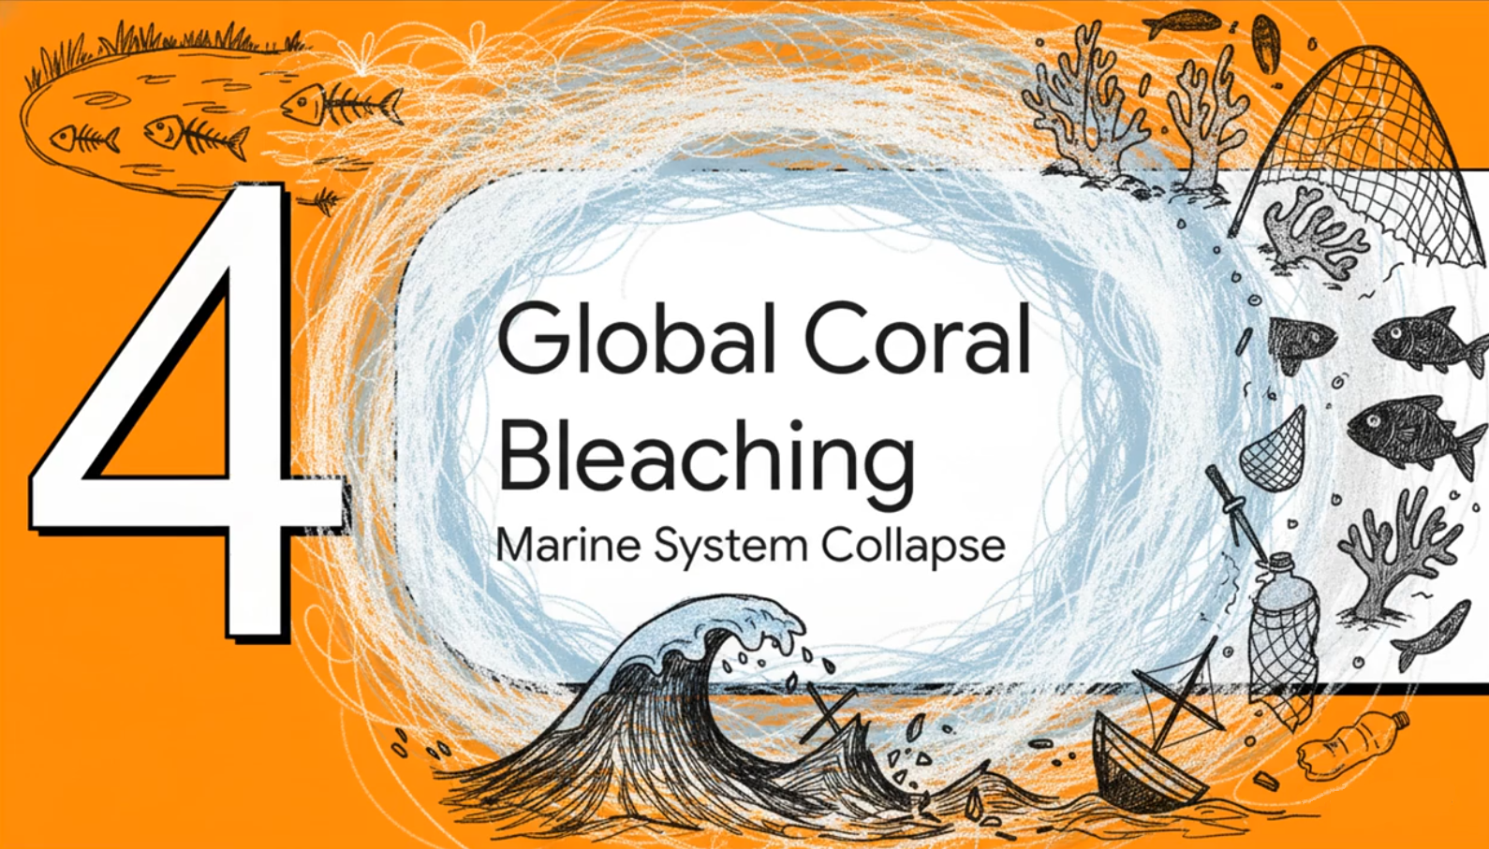

Slide 33
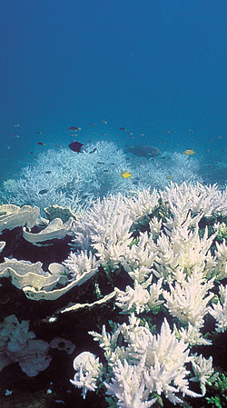
The 2023–25 Events
From January 2023 to March 2025, the world witnessed the most spatially extensive coral-bleaching event on record.
Approximately 84% of global reef locations experienced bleaching-level heat stress, affecting at least 82 different countries and territories.
While this figure refers to reefs experiencing sufficient heat stress to cause bleaching, it signals a new, dangerous baseline of repeated and severe cardiac stress on reef ecosystems worldwide.
This Photo by Unknown Author is licensed under CC BY-NC-ND

Slide 34
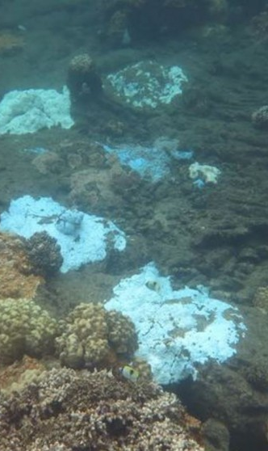
The Biological Mechanism
Symbiotic Relationship: Corals rely on symbiotic algae (zooxanthellae) living in their tissues to provide most of their energy and their vibrant colours.
When sea temperatures rise, stressed corals expel these algae. Without them, the coral appears white ("bleached") and begins to starve.
A single heatwave can kill large proportions of a reef; repeated events leave no time for recovery, leading to structural simplification where the reef loses its complex three-dimensional habitat.
This Photo by Unknown Author is licensed under CC BY

Slide 35
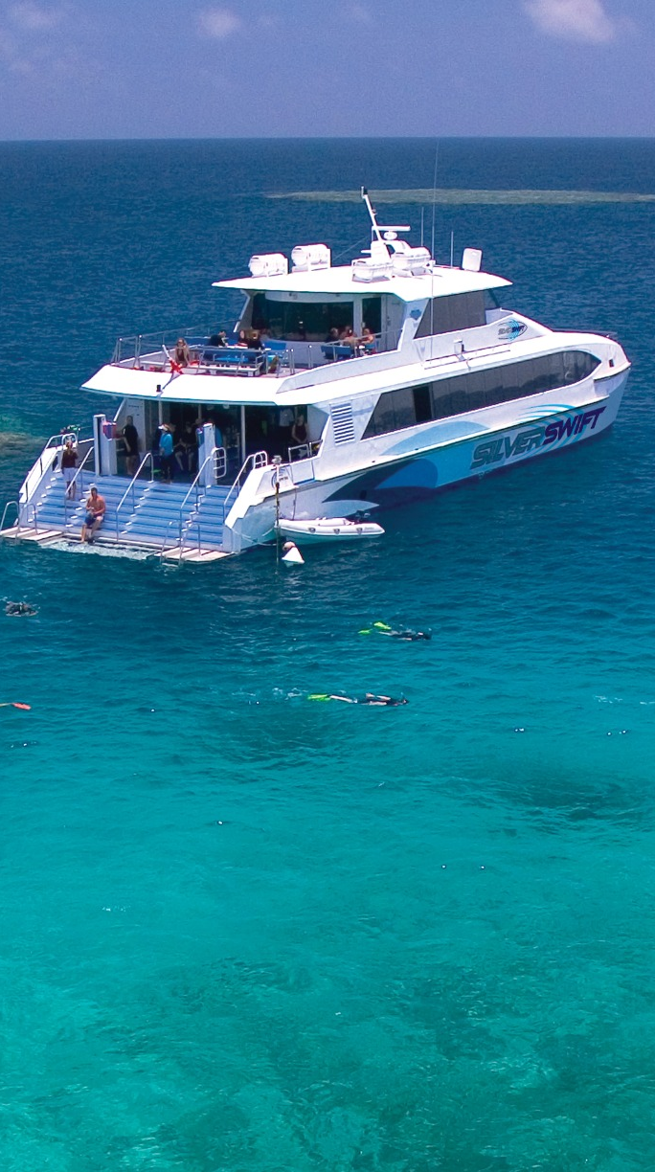
Livelihood Connection: The Human Cost for Island Nations
Reefs are the "nursery" of the ocean; their decline means fewer fish for communities that derive most of their animal protein from the sea.
For many small island states, reef-based tourism represents a massive share of GDP. Reef loss translates directly into lost sovereign revenue and fewer jobs.
Healthy reefs act as a natural, "free" buffer that reduces coastal wave energy. When reefs die, island nations lose protection from storm waves, requiring massive investments in artificial sea walls.
This Photo by Unknown Author is licensed under CC BY-NC-ND

Slide 36
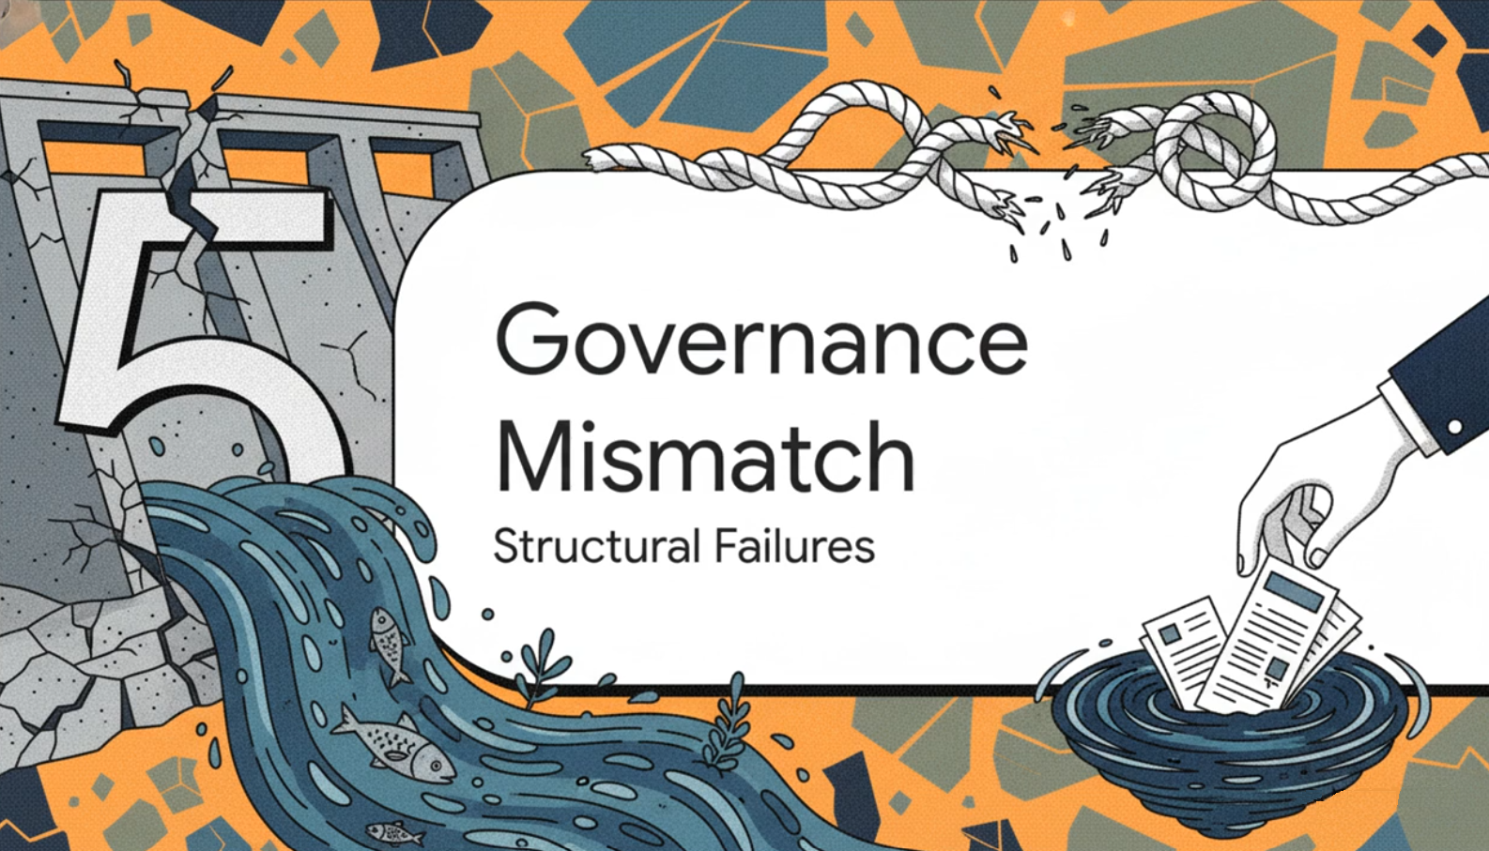

Slide 37
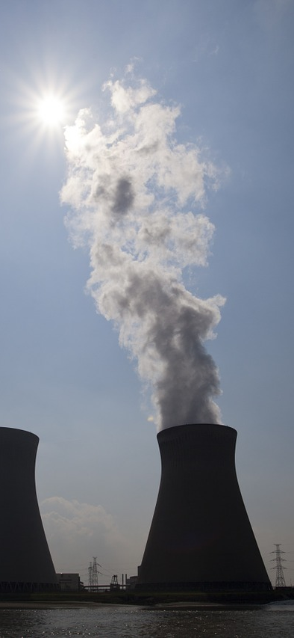
The Governance Challenge: A Fundamental Scale Mismatch
There is a systematic mismatch between the driver of bleaching (global greenhouse gas emissions) and the tools available to reef managers (local conservation).
Limitations of Local Action: While managers can reduce local stressors like pollution or overfishing to "buy time," these measures cannot replace the need for rapid global decarbonization.
As leaders from nations like Palau emphasize, reef damage is a direct threat to human security and cultural identity, yet those most affected have the least influence over the global climate trajectory.
This Photo by Unknown Author is licensed under CC BY-ND

Slide 38

Why Traditional Policy Often Fails

Slide 39
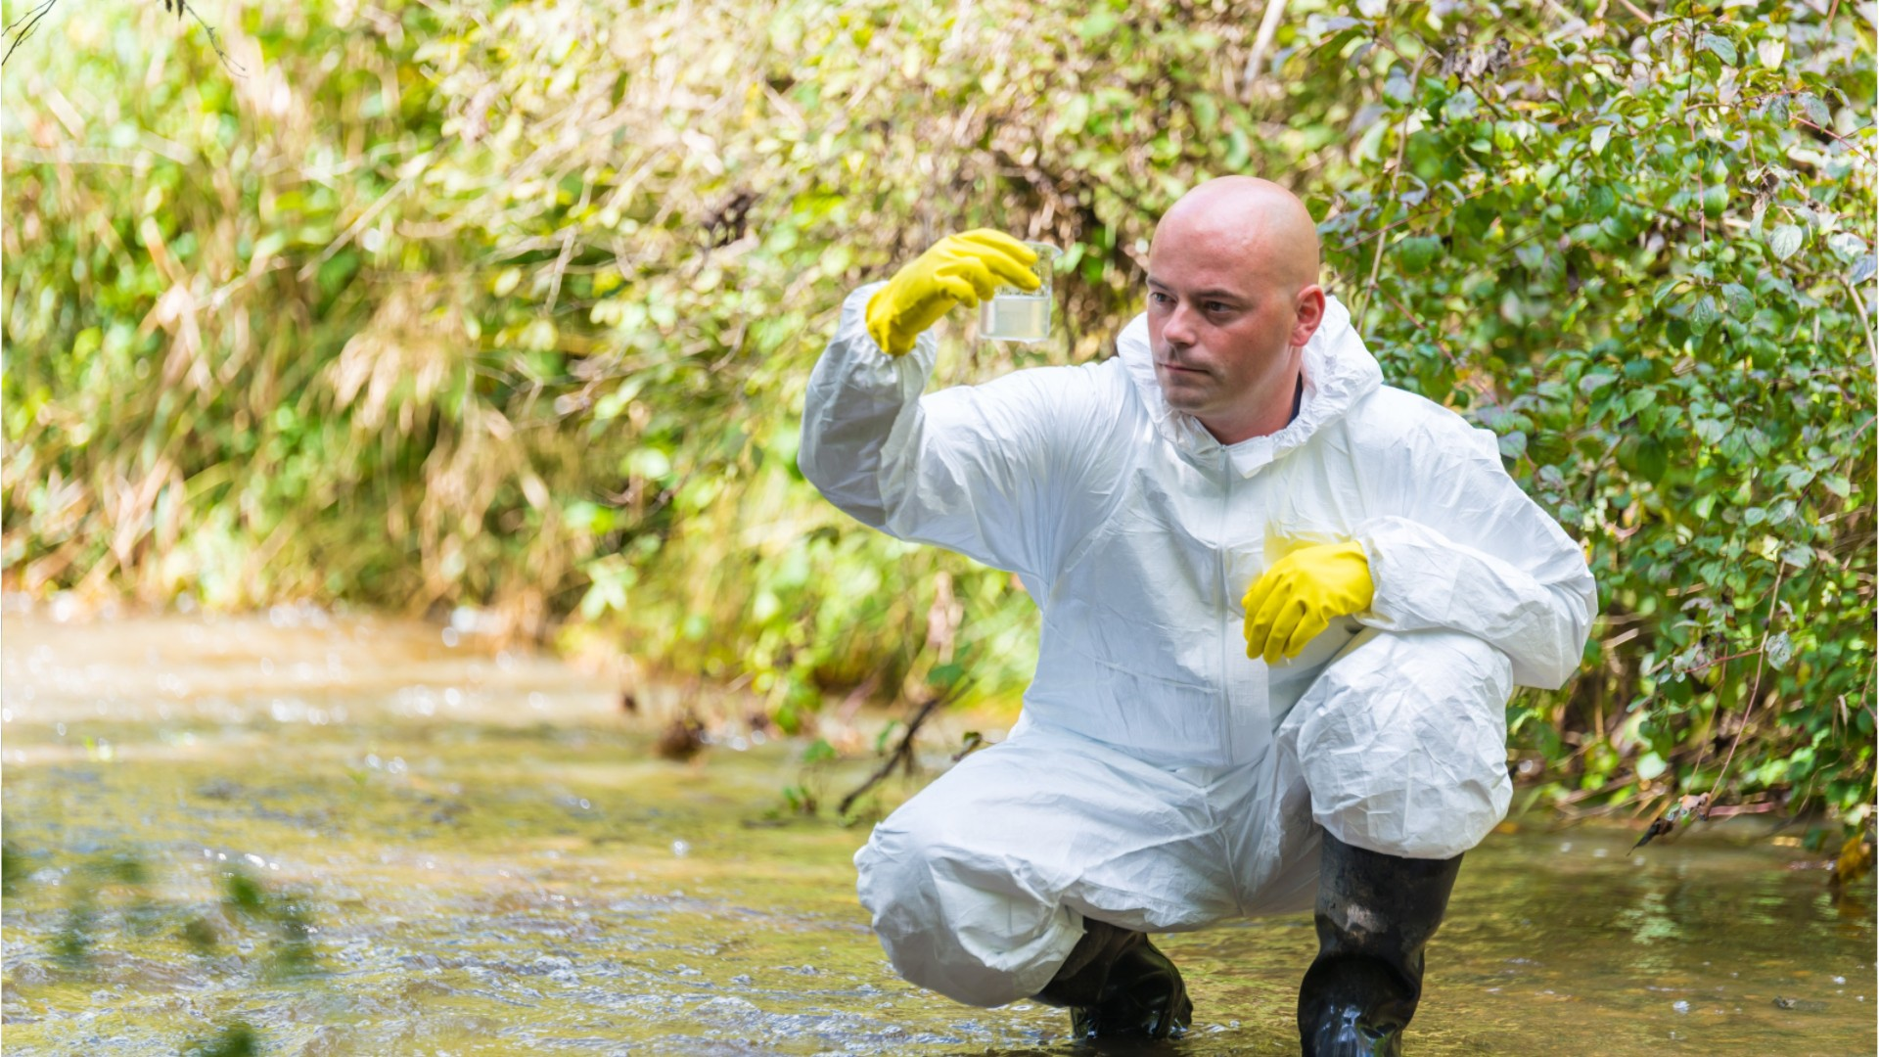
Anthropocentric Standards
Most water quality targets are anthropocentric, meaning they are designed primarily to ensure water is safe for human consumption, swimming, or irrigation.
Standards that protect humans are often insufficient for aquatic life. For example, nitrate concentrations considered safe for drinking water can still be high enough to trigger eutrophication and destroy a lake’s ecosystem.
The result is a dangerous paradox: a river or lake can be declared legally "compliant" with national laws while its biological communities are simultaneously profoundly impaired or collapsing.
This Photo by Unknown Author is licensed under CC BY

Slide 40

Legal Mismatches
Spatial Mismatch: Ecological processes function at the catchment scale (the entire land area draining into a river), but governance is restricted by administrative borders (cities, states, or countries). Pollution from an upstream state becomes a "downstream problem" that the local government has no power to regulate.
Temporal Mismatch: There is a structural conflict between political cycles and ecological time:
  Political logic: Operates on short-term annual budgets or 4-year election terms, seeking immediate, visible results.
  Ecological logic: Recovery from degradation (like flushing out stored nutrients) can take decades or centuries. This mismatch discourages politicians from investing in long-term stewardship.
This Photo by Unknown Author is licensed under CC BY-NC-ND

Slide 41
The Gulf of Mexico Hypoxic Zone
This Photo by Unknown Author is licensed under CC BY-ND

Slide 42
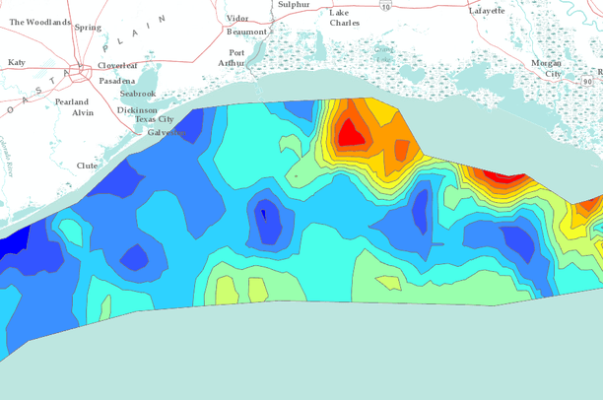
This Photo by Unknown Author is licensed under CC BY
This hypoxic zone forms annually in the northern Gulf of Mexico, off the coast of Louisiana.
In peak years, the area of oxygen-depleted water has exceeded 20,000 square kilometres (an area larger than the state of New Jersey).
Within this zone, dissolved oxygen levels fall below 2 mg/L, a level at which shrimp, crabs, and most fish cannot survive.
Benthic (bottom-dwelling) organisms die or are displaced, and mobile species are compressed into small oxygenated areas, altering competition and disrupting the entire food web.

Slide 43
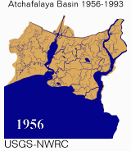
The Scientific Cause
The zone is fueled by nutrients from the Mississippi-Atchafalaya River Basin, which drains approximately 41% of the contiguous United States.
Enormous quantities of nitrogen and phosphorus, primarily from intensive maize and soybean agriculture across the Midwest, are delivered into the Gulf.
This Photo by Unknown Author is licensed under CC BY-SA
The Mechanism
Nutrient-rich freshwater flows into the Gulf > stimulates rapid phytoplankton growth > algae sink and are decomposed by bacteria > oxygen is consumed.
A layer of warm, lighter freshwater sits on top of saltier marine water (stratification), preventing vertical mixing and stopping oxygen from being replenished from the surface.

Slide 44
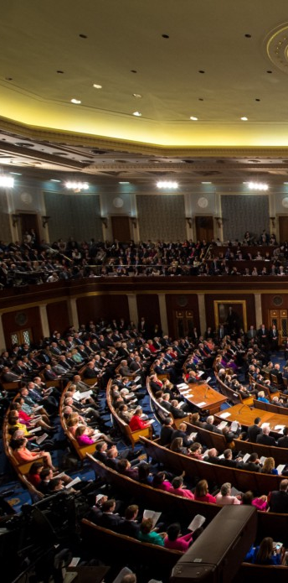
The crisis is driven by thousands of individual farmers making rational economic decisions based on market prices, subsidies, and crop insurance.
The Governance Trap: No single farmer’s decision to apply fertiliser causes a measurable "dead zone"; the catastrophe only emerges from the aggregate of millions of individual decisions.
Because the harm is diffuse (non-point source), no regulatory instrument holds any single actor accountable for the total ecological outcome.
Accountability: "Responsibility is Distributed, but Accountability is Diffused"
This case represents a failure of knowledge application, not a failure of science. The causes have been understood since the 1970s, yet the zone persists.
Even if all nutrient inputs stopped today, nitrogen stored in agricultural soils and moving slowly through groundwater pathways would continue to reach the Gulf for decades.
Short-term political and electoral cycles consistently favour immediate agricultural production over the long-term stewardship required for ecological recovery.
This Photo by Unknown Author is licensed under CC BY

Slide 45
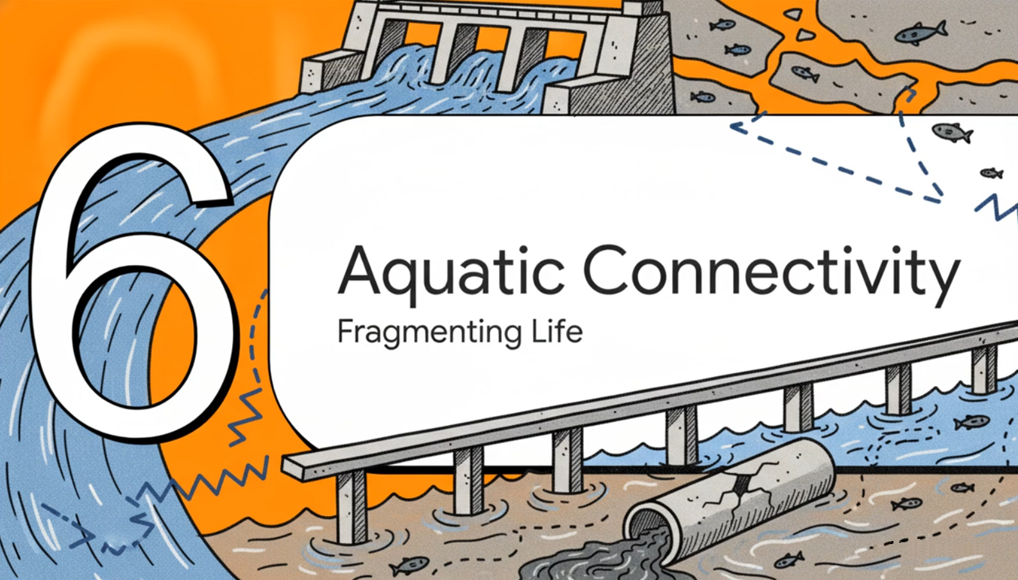

Slide 46
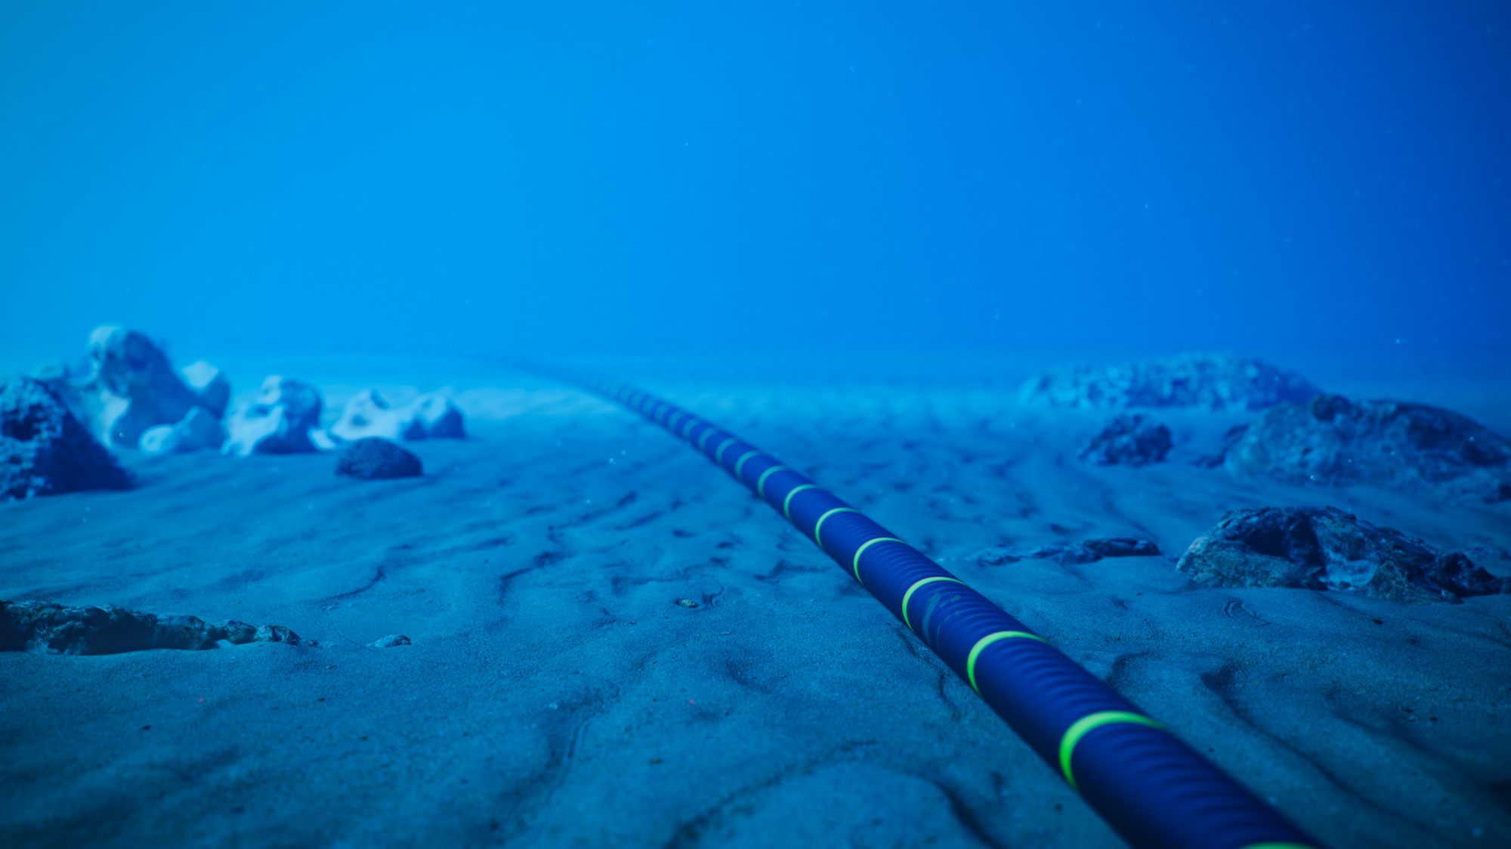
The Three Dimensions of Connectivity
This Photo by Unknown Author is licensed under CC BY

Slide 47
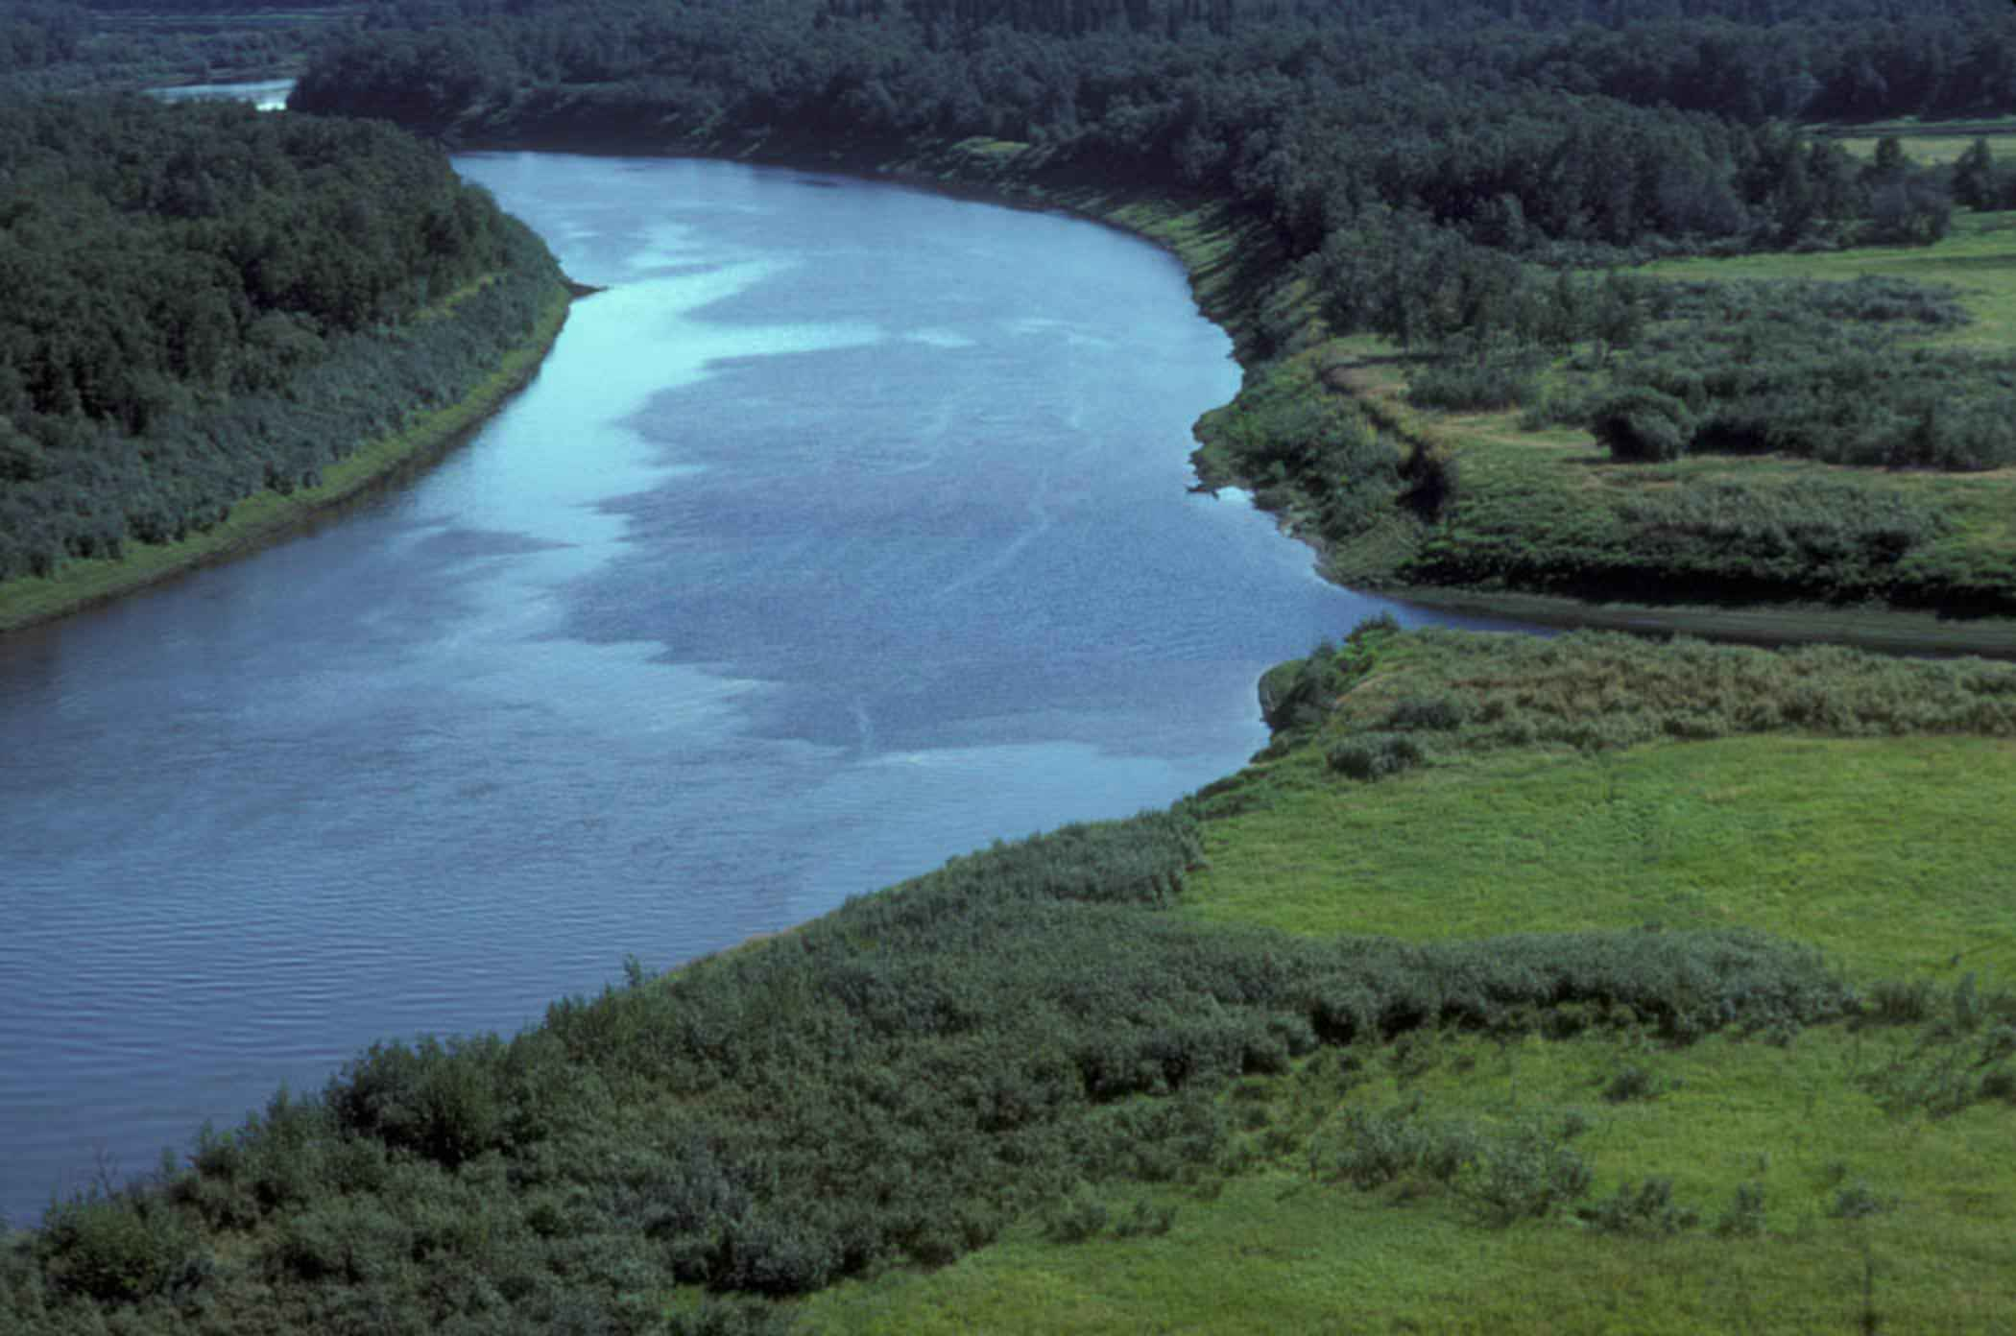
A healthy river functions as a living system only when it is connected in three dimensions: longitudinal, lateral, and vertical.
1. Longitudinal Connectivity (Headwaters to the Sea): This plane links habitats along the entire length of a river system. It is essential for fish migration to spawning grounds and the downstream transport of sediments and organic matter that sustain deltas and coastal ecosystems. Primarily disrupted by dams and weirs that truncate the range of migratory species and trap vital sediments.
2. Lateral Connectivity (River to Floodplain): This plane links the main river channel to its adjacent floodplains and wetlands. It relies on seasonal flood pulses to move nutrients and organisms onto the floodplain, recharging wetlands and providing the productive, shallow waters necessary for fish breeding and juvenile development. Disruption caused by levees, embankments, and channel modifications that prevent overbank flow, impoverishing the biodiversity of both the river and the floodplain.
3. Vertical Connectivity (Surface Water to Groundwater): This plane links surface water to shallow groundwater through porous riverbed gravels, known as the hyporheic zone. This exchange moderates water temperature, supports nutrient cycling, and provides refugia (safe havens) for invertebrates during periods of drought. Disruption occurs through excessive groundwater pumping near rivers, which can reverse the natural flow and draw river water into the aquifer, effectively drying out the stream.
Consequences: Human infrastructure (dams, levees, and pumps) causes fragmentation that dismantles these connections, often resulting in "invisible fragmentation" of smaller watercourses. When connectivity is lost, the system's biological integrity collapses, as species are cut off from the cues and habitats they need to survive.

Slide 48
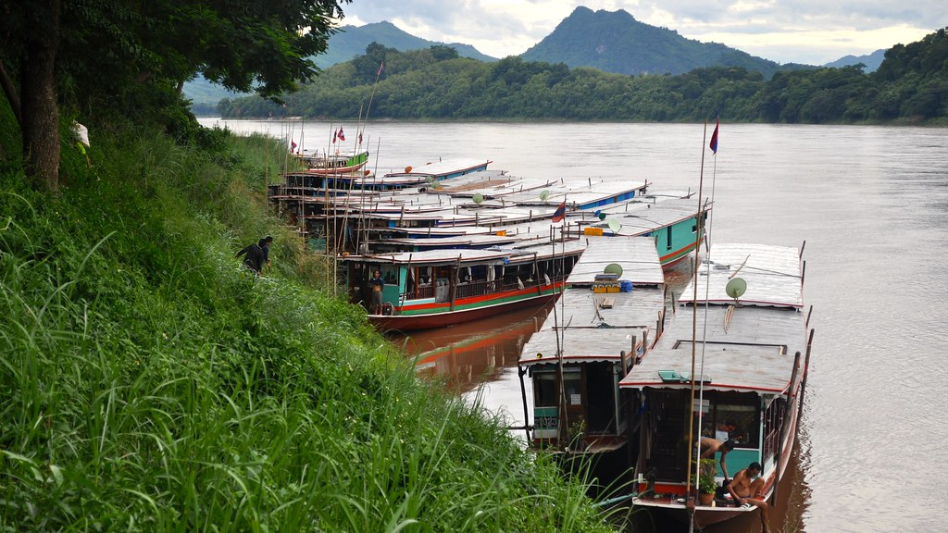
Mekong River Fragmentation
The Mekong River supports the largest inland fishery in the world, producing over 2 million tonnes of fish annually. This ecosystem sustains the livelihoods and food security of approximately 60 million people across six countries.
Over the last 30 years, a surge in hydropower dams—from the Lancang cascade in China to projects in Laos and Cambodia—has fundamentally re-engineered the river. These dams regulate seasonal discharge, reducing the vital peak flood pulses and increasing dry-season flows. This "flattens" the river's natural rhythm, disrupting the ecological cues that trigger fish migration and reproduction.
Impact 1 (Massive Fish Loss from Blocked Migration): Many Mekong fish species are highly migratory, traveling hundreds of kilometres to reach spawning grounds. Large dams without effective fish-passage systems act as total barriers. Projections indicate a 30–40% decline in fish biomass under full development scenarios, a catastrophic loss of protein for rural communities.
Impact 2 (The Sediment Trap and Delta Collapse): The Mekong historically carried massive sediment loads that replenished the delta. Dams now trap this silt upstream. Without new sediment, the Mekong Delta in Vietnam is literally eroding and sinking. This is causing increased subsidence and salinity intrusion, threatening one of the world's most productive agricultural regions.
Upstream countries (like Laos, positioning itself as the "battery of Southeast Asia") capture the immediate economic benefits of energy production and electricity exports. The ecological and livelihood costs—ruined fisheries and lost land—fall disproportionately on downstream communities in Cambodia and Vietnam. The people most affected (subsistence fishers and smallholders) are typically the least powerful actors in the decision-making processes that approve these dams. They are the "downstream recipients of upstream decisions," bearing costs for which they receive no compensation.
This Photo by Unknown Author is licensed under CC BY-NC-ND

Slide 49
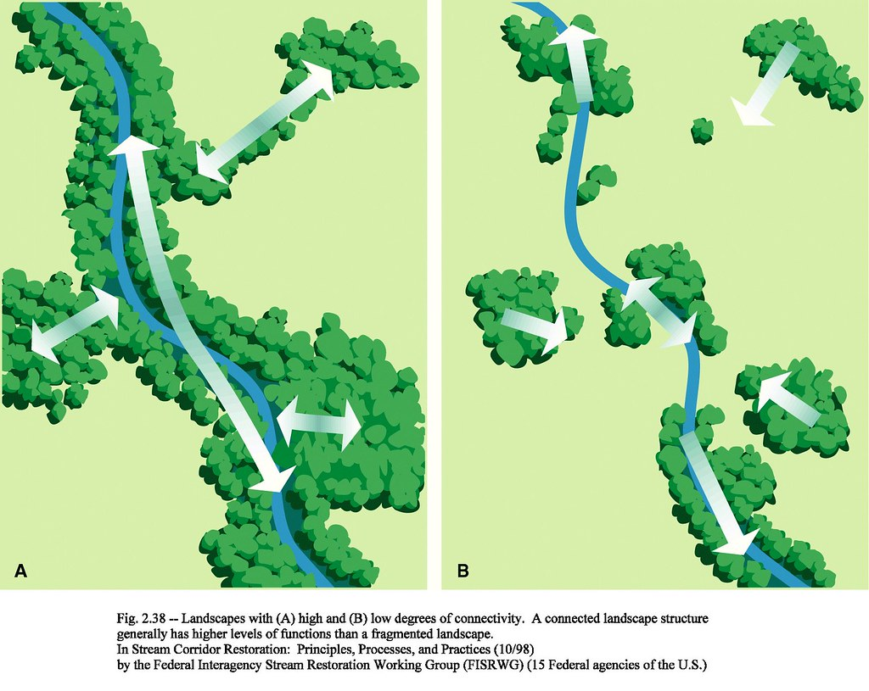
The Social Stratification of Loss
High-income regions and urban populations can often buffer the effects of aquatic degradation through significant technological investment. This includes access to advanced water treatment, the ability to purchase bottled water during crises, and insurance against environmental damage like floods.
In contrast, rural and low-income communities typically lack these financial and technical buffers. They are often forced to rely on untreated or minimally treated water and depend directly on local aquatic resources for their primary nutrition and livelihoods, leaving them with no choice but to absorb the health and economic impacts of a failing ecosystem.
The ecological and social costs—including livelihood collapse, the spread of disease (like malaria), and chronic pollution—are "socialised," meaning they are spread across entire downstream populations. Downstream recipients of these decisions often receive no compensation for the loss of their commons.
The heaviest costs of biological degradation fall on subsistence fishers, rural smallholders, and indigenous peoples. For these groups, the collapse of a fishery or the contamination of an aquifer is not just an ecological statistic but a catastrophic threat to food security and cultural identity.
These communities typically have the least power in the institutional processes that approve major water projects. Because they are not the primary constituents or shareholders of the entities driving the degradation, their interests are often ignored in a system designed for economic extraction rather than stewardship.
This Photo by Unknown Author is licensed under CC BY-SA-NC

Slide 50
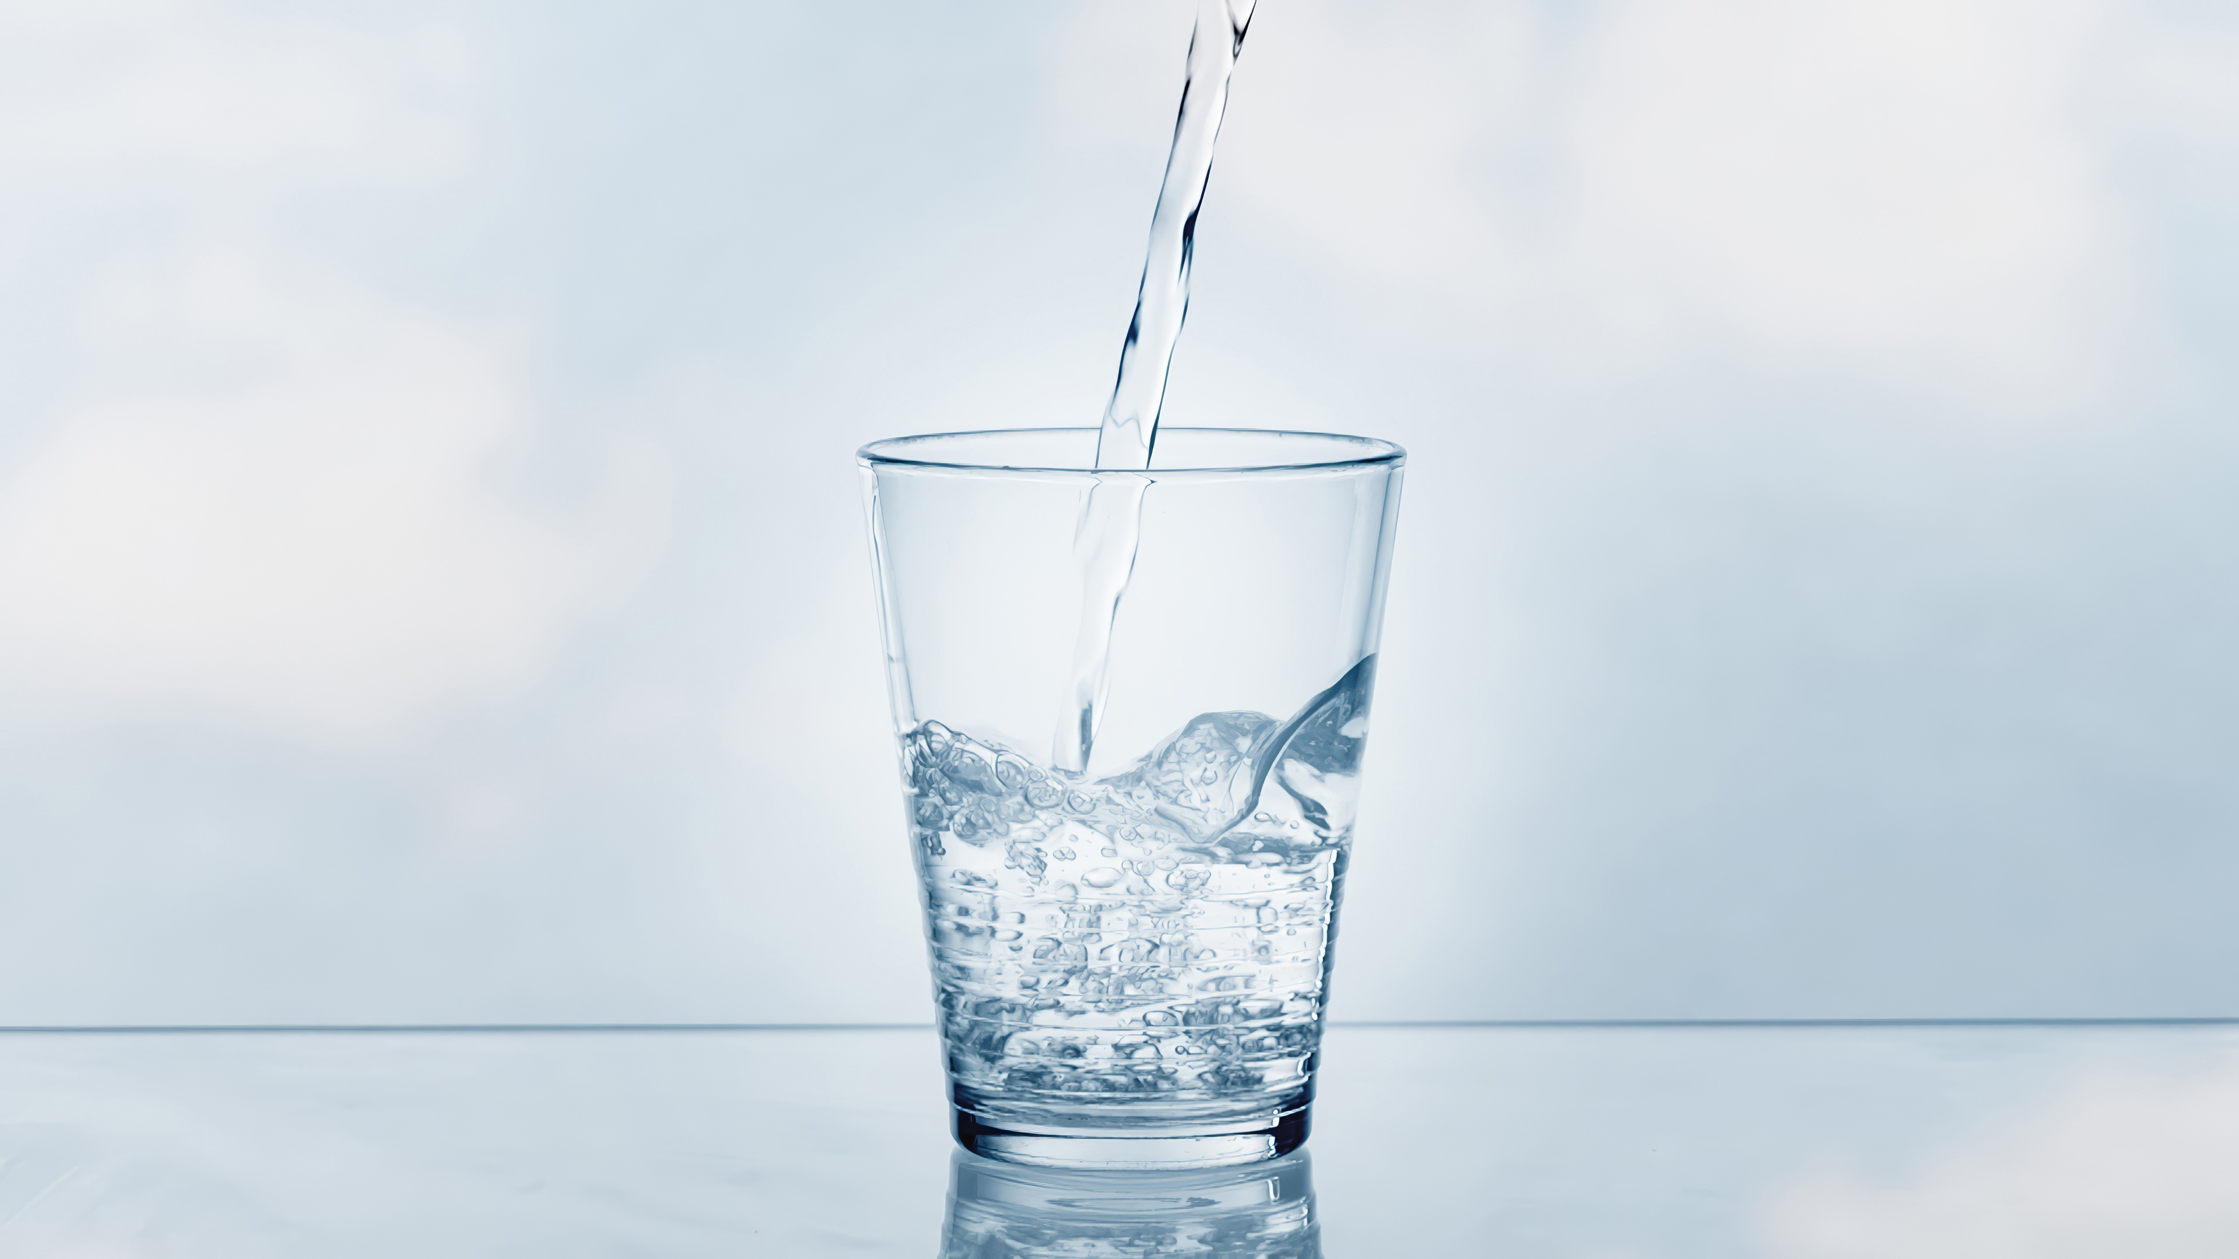
Conclusion
Integrated Water Resources Management (IWRM) is a framework that seeks to coordinate water quality, quantity, and ecosystem governance under a single institutional umbrella. This approach recognizes that managing water in "sectoral silos"—where different agencies handle irrigation, environment, and urban supply separately—is the root cause of most governance failures.
This policy direction shifts the definition of "available water" by legally mandating the quantity, timing, and quality of water necessary to sustain living systems. Instead of treating ecological needs as "water left over" after human use, environmental flows institutionalise the principle that a river basin must remain biologically functional to be sustainable.
The EU Water Framework Directive (WFD): Representing a fundamental departure from traditional policy, the WFD shifts the goal from meeting simple human-use "standards" to achieving "good ecological status". It integrates biological, chemical, and physical (hydromorphological) criteria to ensure water bodies are managed as whole living systems.
Current systems are often reactive, responding only after a mass fish kill or a toxic bloom makes damage impossible to ignore. True reform requires governance designed to detect silent signals—such as gradual species loss or nutrient accumulation in sediments—before they escalate into human tragedies.
Reform must confront the asymmetry where those who benefit from water re-engineering are geographically and politically "upstream" from those who bear the ecological and social costs.
The history of water management shows that "dams and canals are the easy part". The real challenge of the future lies in institutional imagination: deciding who gets water, at what cost to whom, and within what binding ecological limits.
We must choose between maintaining systems designed for an era of "apparent abundance" or building new ones that respect ecological integrity as the foundation of water security.

Slide 51


